Slide 1
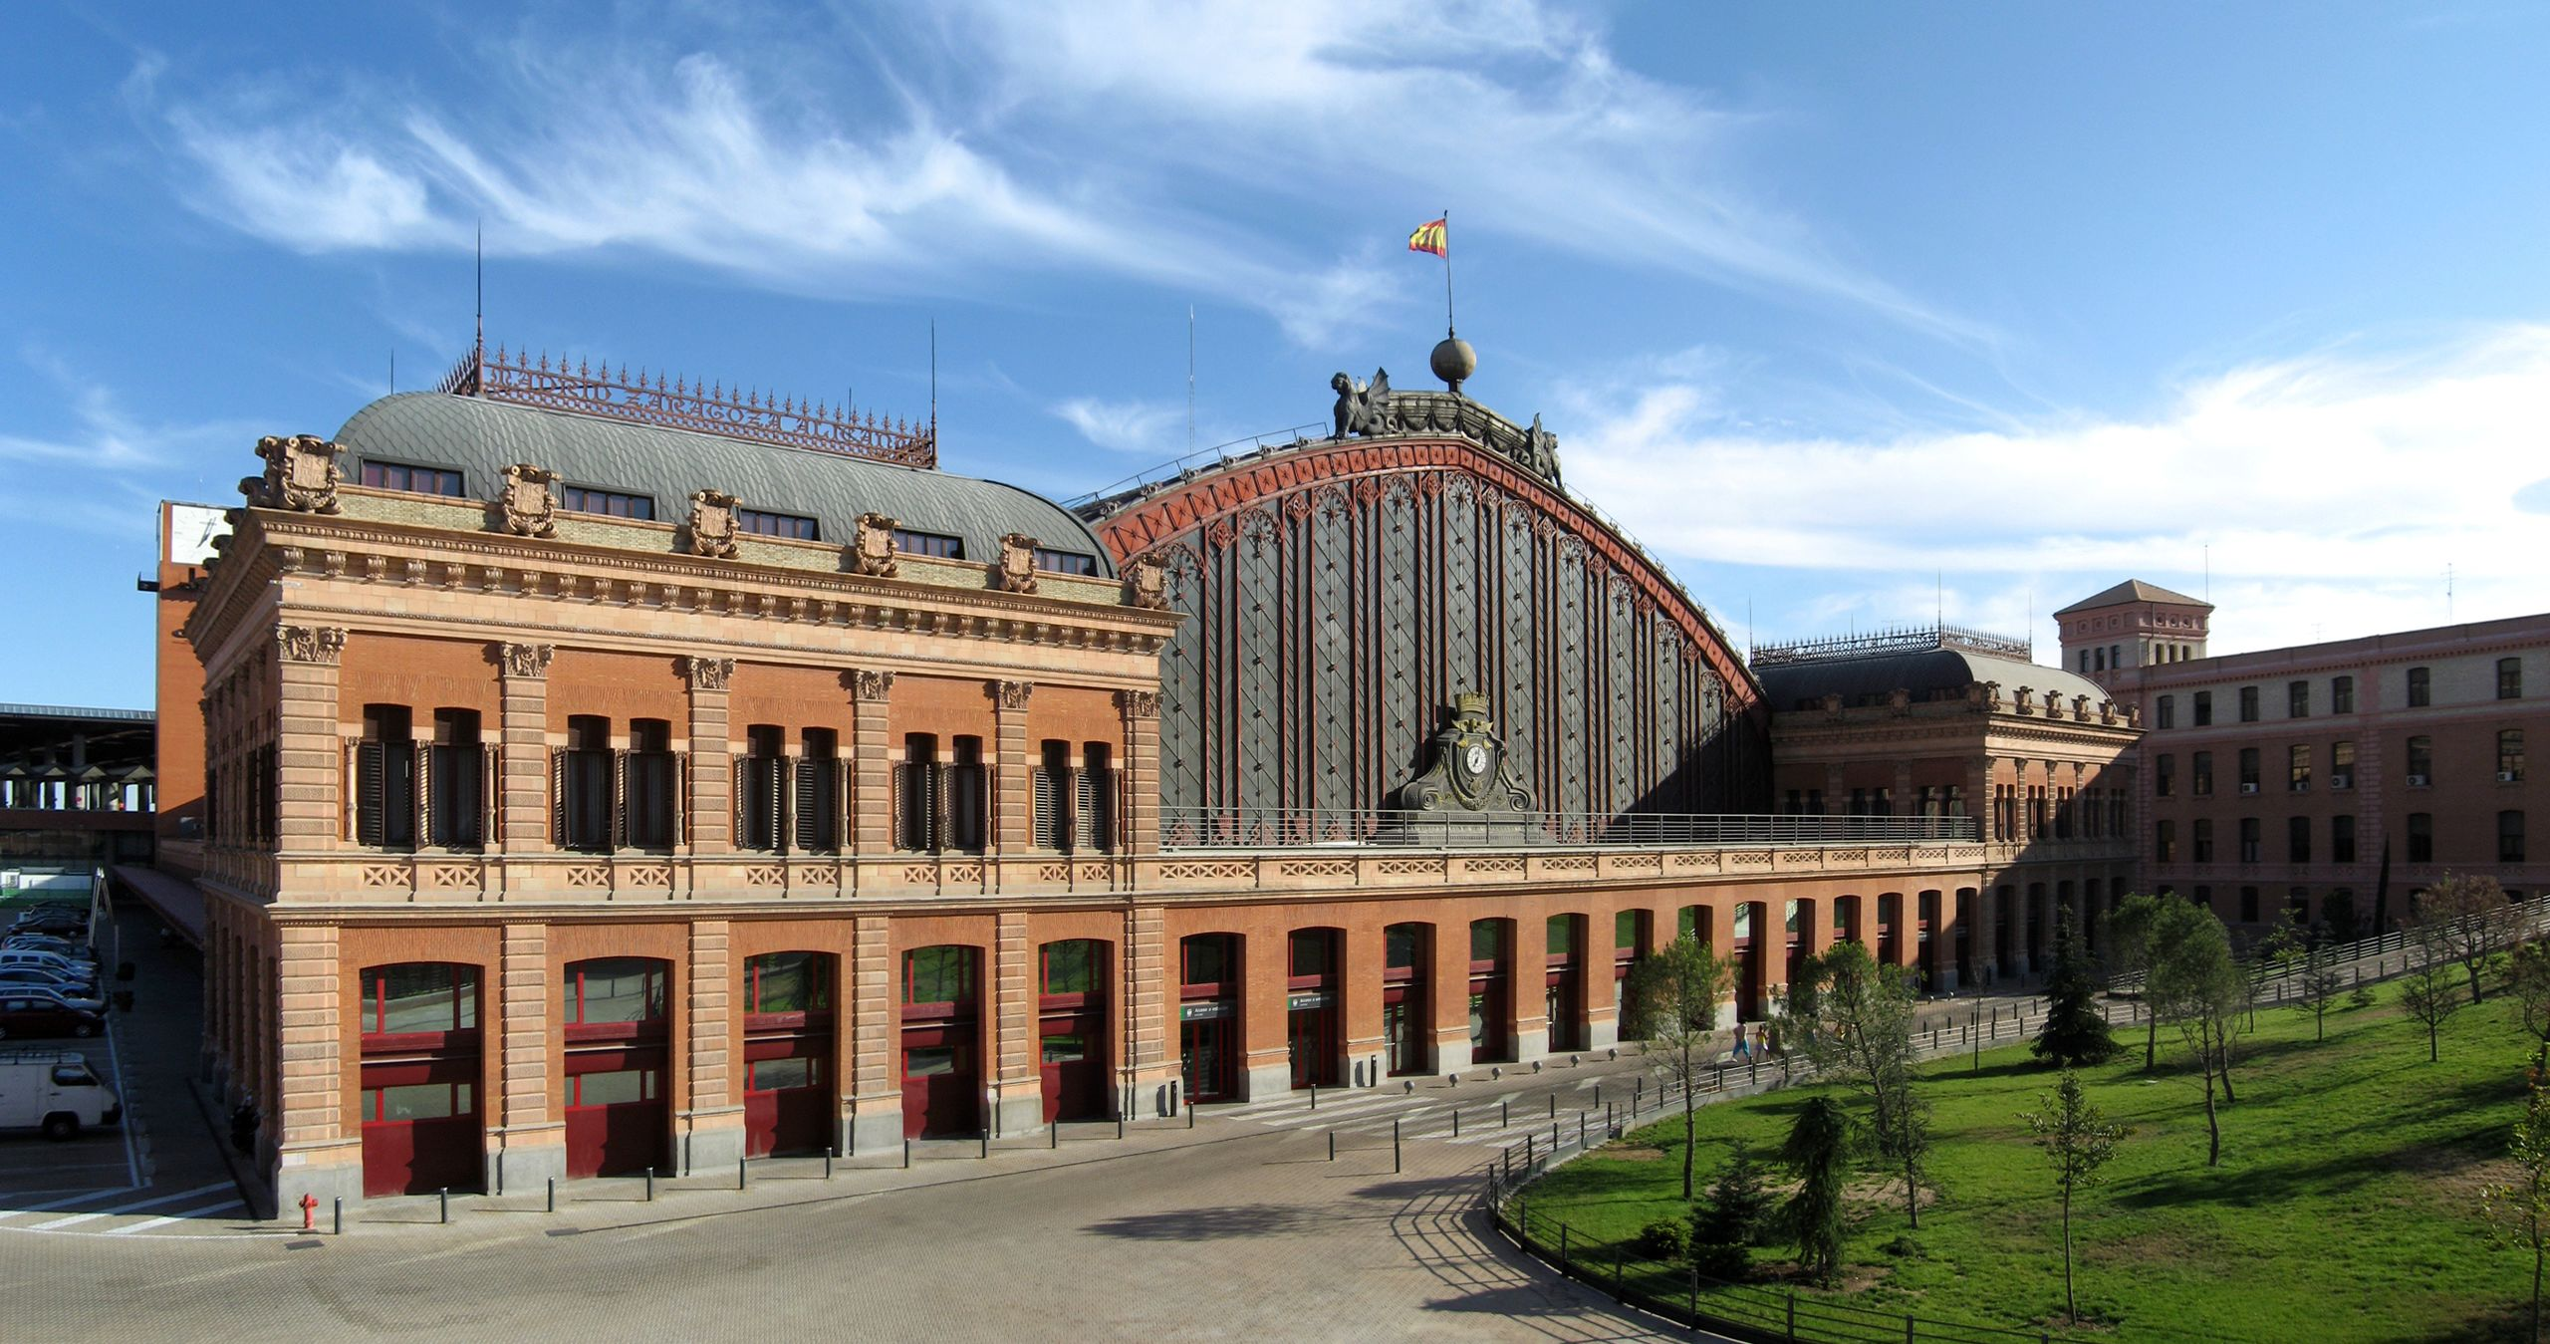
FORENSIC DECISION MAKING
October 11th, 2023
Exterior of the old Atocha Station in Madrid (Gryffindor / CC BY-SA)

Slide 2
Neuron

Slide 3
NEURON MEMBRANE
Extracellular
Membrane
Two layers phospholipids
Intracellular
Membrane
Two layers phospholipids
Extracellular

Slide 4
NEURON MEMBRANE
Extracellular
Na⁺
Na⁺
Na⁺
Na⁺
Na⁺
Na⁺
Na⁺
Na⁺
Na⁺
Na⁺
Membrane
Na⁺
Intracellular
Na⁺
Na⁺
Membrane
Na⁺
Na⁺
Na⁺
Na⁺
Na⁺
Na⁺
Na⁺
Na⁺
Na⁺
Na⁺
Extracellular

Slide 5
NEURON MEMBRANE
Extracellular
Na⁺
Na⁺
Na⁺
Na⁺
Na⁺
Na⁺
Na⁺
Na⁺
Na⁺
Na⁺
Membrane
Na⁺
Intracellular
Na⁺
Na⁺
Membrane
Na⁺
Na⁺
Na⁺
Na⁺
Na⁺
Na⁺
Na⁺
Na⁺
Na⁺
Na⁺
Extracellular

Slide 6
NEURON MEMBRANE
Extracellular
K⁺
K⁺
K⁺
Membrane
K⁺
K⁺
K⁺
K⁺
Intracellular
K⁺
K⁺
K⁺
K⁺
K⁺
K⁺
Membrane
K⁺
K⁺
K⁺
Extracellular

Slide 7
NEURON MEMBRANE
Extracellular
Cl⁻
Cl⁻
Cl⁻
Membrane
Cl⁻
Cl⁻
Cl⁻
Cl⁻
Cl⁻
Cl⁻
Cl⁻
Cl⁻
Cl⁻
Intracellular
Cl⁻
Cl⁻
Cl⁻
Cl⁻
Cl⁻
Cl⁻
Cl⁻
Membrane
Cl⁻
Cl⁻
Cl⁻
Extracellular

Slide 8
NEURON MEMBRANE
Extracellular
K⁺
Na⁺
Na⁺
Na⁺
Na⁺
Na⁺
K⁺
Na⁺
Na⁺
K⁺
Na⁺
Na⁺
Na⁺
Membrane
Cl⁻
Cl⁻
Cl⁻
Na⁺
Cl⁻
Cl⁻
Cl⁻
K⁺
Cl⁻
Cl⁻
K⁺
Cl⁻
K⁺
K⁺
Intracellular
K⁺
K⁺
Na⁺
K⁺
Cl⁻
K⁺
Cl⁻
Na⁺
K⁺
Cl⁻
Cl⁻
K⁺
Cl⁻
Cl⁻
Cl⁻
Cl⁻
Membrane
K⁺
K⁺
Na⁺
Na⁺
Na⁺
Na⁺
Na⁺
Na⁺
Na⁺
Na⁺
Na⁺
Na⁺
K⁺
Extracellular

Slide 9
Ion channels
Voltage gated
Ligand gated
Membrane
open
closed
open
closed

Slide 10
Ion channels
Na⁺
Na⁺
Na⁺
Voltage gated
Ligand gated
Na⁺K⁺ pump
Membrane
K⁺
open
closed
open
closed
K⁺

Slide 11
RESTING STATE
Extracellular
K⁺
Na⁺
-70mV
Na⁺
Na⁺
Na⁺
Na⁺
K⁺
Na⁺
Na⁺
K⁺
Na⁺
Na⁺
Na⁺
Na⁺K⁺ pump
Na⁺
Membrane
Cl⁻
Cl⁻
Cl⁻
Na⁺
Cl⁻
Cl⁻
Cl⁻
K⁺
Cl⁻
Cl⁻
K⁺
Cl⁻
K⁺
K⁺
Intracellular
K⁺
K⁺
Na⁺
K⁺
Cl⁻
K⁺
Cl⁻
Na⁺
K⁺
Cl⁻
Cl⁻
K⁺
Cl⁻
Cl⁻
Cl⁻
Cl⁻
Na⁺K⁺ pump
Membrane
Na⁺
K⁺
K⁺
mV
K⁺
Na⁺
+30
Na⁺
Na⁺
Na⁺
Na⁺
-55
Na⁺
Na⁺
Na⁺
Na⁺
K⁺
-70
Na⁺
time
Extracellular

Slide 12
Depolarization
Extracellular
K⁺
-60 mV
Na⁺
Na⁺
Na⁺
Na⁺
Na⁺
K⁺
Na⁺
Na⁺
K⁺
Na⁺
Na⁺
Na⁺
Na⁺
Na⁺K⁺ pump
Na⁺
Na⁺
Membrane
Cl⁻
Cl⁻
Cl⁻
Na⁺
Cl⁻
Cl⁻
Cl⁻
K⁺
Cl⁻
Cl⁻
K⁺
Cl⁻
K⁺
K⁺
Intracellular
K⁺
K⁺
Na⁺
K⁺
Cl⁻
K⁺
Cl⁻
Na⁺
K⁺
Cl⁻
Cl⁻
K⁺
Cl⁻
Cl⁻
Cl⁻
Cl⁻
Na⁺K⁺ pump
Membrane
Na⁺
K⁺
Na⁺
K⁺
mV
K⁺
Na⁺
+30
Na⁺
Na⁺
Na⁺
Na⁺
-55
Na⁺
Na⁺
Na⁺
Na⁺
K⁺
-70
Na⁺
time
Extracellular

Slide 13
Action potential
K⁺
-55mV
Extracellular
Na⁺
Na⁺
Na⁺
Na⁺
Na⁺
K⁺
Na⁺
Na⁺
K⁺
Na⁺
Na⁺
Na⁺
Na⁺
Na⁺K⁺ pump
Na⁺
Na⁺
Na⁺
Membrane
Na⁺
Na⁺
Cl⁻
Cl⁻
Cl⁻
Na⁺
Cl⁻
Cl⁻
Cl⁻
K⁺
Cl⁻
Cl⁻
K⁺
Cl⁻
K⁺
K⁺
Intracellular
K⁺
K⁺
Na⁺
K⁺
Cl⁻
K⁺
Cl⁻
Na⁺
K⁺
Cl⁻
Cl⁻
K⁺
Cl⁻
Cl⁻
Cl⁻
Cl⁻
Na⁺K⁺ pump
Na⁺
Na⁺
Membrane
Na⁺
K⁺
Na⁺
K⁺
mV
K⁺
Na⁺
+30
Na⁺
Na⁺
Na⁺
Na⁺
-55
Na⁺
Na⁺
Na⁺
Na⁺
K⁺
-70
Na⁺
time
Extracellular

Slide 14
Action potential
Extracellular
K⁺
Na⁺
-70mV
Na⁺
Na⁺
Na⁺
Na⁺
K⁺
Na⁺
Na⁺
K⁺
Na⁺
Na⁺
Na⁺
Na⁺
Na⁺K⁺ pump
Na⁺
Na⁺
K⁺
Membrane
Na⁺
Cl⁻
Cl⁻
Cl⁻
Na⁺
Cl⁻
Cl⁻
Cl⁻
K⁺
Cl⁻
Cl⁻
K⁺
Cl⁻
K⁺
K⁺
Intracellular
K⁺
K⁺
Na⁺
K⁺
Cl⁻
K⁺
Cl⁻
Na⁺
K⁺
Cl⁻
Cl⁻
K⁺
Cl⁻
Cl⁻
Cl⁻
Cl⁻
Na⁺K⁺ pump
Membrane
K⁺
Na⁺
K⁺
Na⁺
K⁺
K⁺
mV
K⁺
Na⁺
+30
Na⁺
Na⁺
Na⁺
Na⁺
-55
Na⁺
Na⁺
Na⁺
Na⁺
K⁺
-70
Na⁺
time
Extracellular

Slide 15
Action potential
Extracellular
-
-
-
+
+
+
+
+
+
+
+
+
+
+
+
+
+
+
+
-
-
-
-
-
-
-
-
-
-
-
-
-
-
-
-
-
-
Intracellular
Intracellular
+
+
+
-
-
-
-
-
-
-
-
-
-
-
-
-
-
-
-
-
-
-
-
-
+
+
+
+
+
+
+
+
+
+
+
+
+
Extracellular

Slide 16
Action potential
Extracellular
+
+
+
-
-
-
+
+
+
+
+
+
+
+
+
+
-
-
-
+
+
+
+
-
-
-
-
-
-
-
-
-
-
-
-
-
-
Intracellular
-
-
-
+
+
+
+
-
-
-
-
-
-
-
-
-
-
-
-
-
-
+
+
+
-
-
-
+
+
+
+
+
+
+
+
+
+
Extracellular

Slide 17
An action potential (spike) is an all-or-none phenomenon
Weak stimulus
axon
Strong stimulus
axon
Frequency of spikes is the most important code

Slide 18
mV
+30
Depolarization
-55
-70
time
mV
+30
Hyperpolarization
-55
-70
-80
time

Slide 19
SYNAPSE
presynaptic axon terminal
Synaptic vescicle
neurotransmitter
Synaptic cleft
Ligand garted channel
postsynaptic dendrite

Slide 20
mV
+30
POST SYNAPTIC EXCITATORY POTENTIAL
-55
-70
time
mV
+30
POST SYNAPTIC INHIBITORY POTENTIAL
-55
-70
-80
time

Slide 21
ON THE DENDRITES AND THE SOMA ALL THE POST SYNAPTIC EXCITATORY POTENTIALS AND THE POST SYNAPTIC INHIBITORY POTENTIALS SUMS UP
IF THAT SUM REACHES THE THRESHOLD, AT THE LEVEL OF THE AXON HILLOCK AN ACTION POTENTIAL IS GENERATED, CONDUCTED ALONG THE AXON TO THE TERMINALS, AND TRANSMITTED TO THE NEXT NEURONS

Slide 23
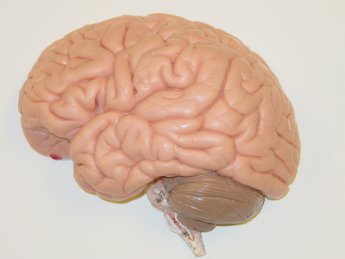

Slide 24
Patrick J. Lynch, medical illustrator / CC BY (https://creativecommons.org/licenses/by/2.5)

Slide 25
Henry Vandyke Carter / Public domain

Slide 26
Blausen.com staff (2014). Medical gallery of Blausen Medical 2014 / CC BY (https://creativecommons.org/licenses/by/3.0)

Slide 27
Dr. Johannes Sobotta / Public domain

Slide 28
Dr. Johannes Sobotta / Public domain

Slide 29
The original uploader was RobinH at English Wikibooks. / CC BY-SA

Slide 30
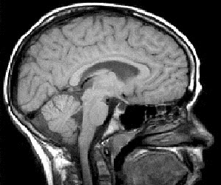
(MRI scan)

Slide 31
PERCEPTION

Slide 32
Probably, the single most important thing to know about perception is:
The brain builds our experience of the outside world
(perception is an active process)

Slide 33
Scientists do not know exactly how perceptual processes work
but Artists do, implicitly, and they use their knowledge

Slide 34
Perception is an active process.
thus
there is not a necessary, obligatory identity between the world and our perception of the world

Slide 35
The sensory systems
They share the same general principles:
Receptors: specialized and selective cells that transduce energies
Receptive fields: the part of the world the receptors respond to
A number of relais structures (nuclei) within the brain that process information from the receptors

Slide 36
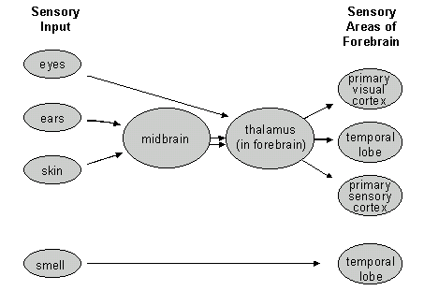
The sensory systems

Slide 37
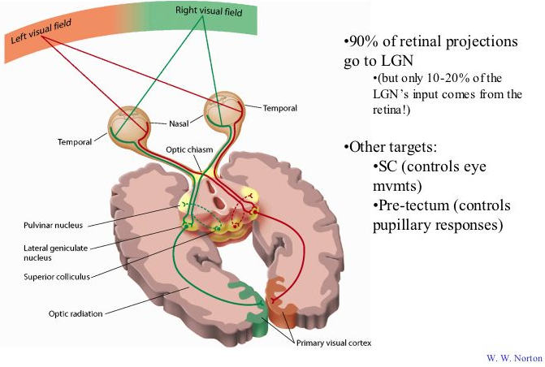
The visual system

Slide 38
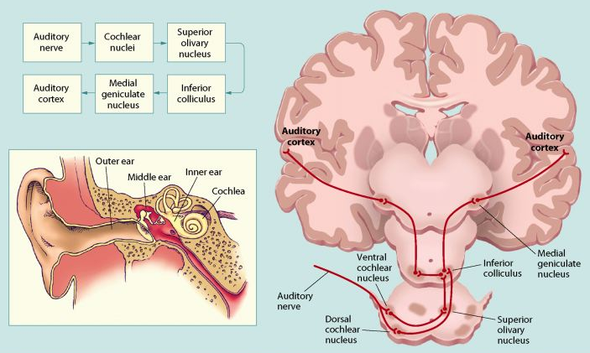
The auditory system

Slide 39
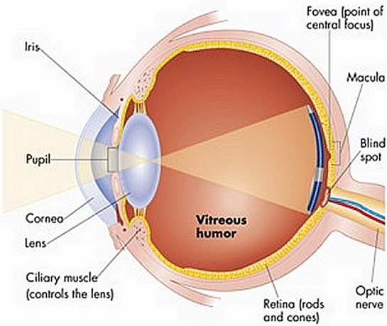
The eye
The lenses of the eye focus the light emitted by objects in the world onto the retina at the back of the eye, where the retina is located.
The retina contains light sensitive cells which convert light to electrical activity, and
a network of neurons that process visual information and transmit it down the optic nerve to the brain.

Slide 40
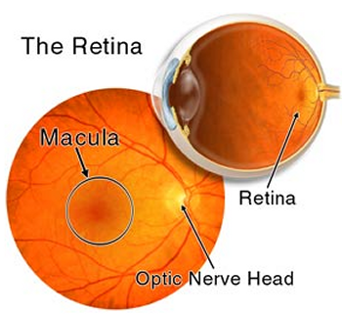

Slide 41
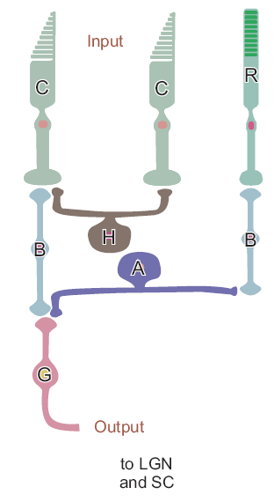
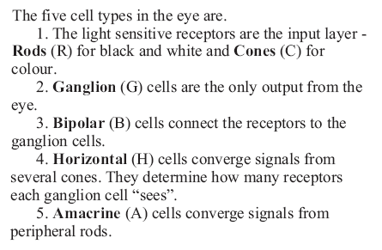
The Retina 2

Slide 42
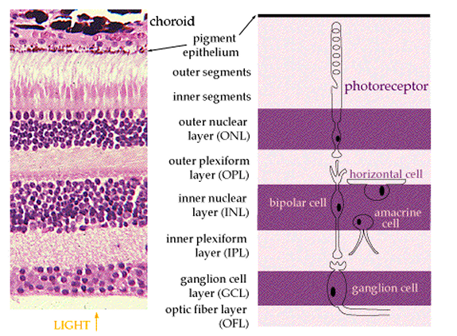
The Retina 3

Slide 43
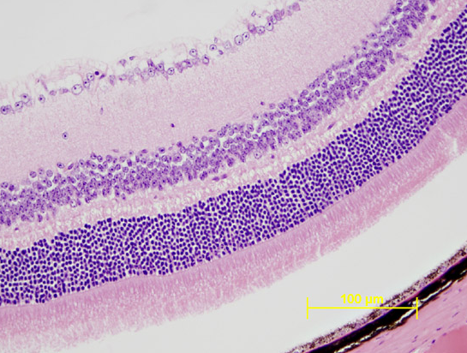
The Retina 4

Slide 44
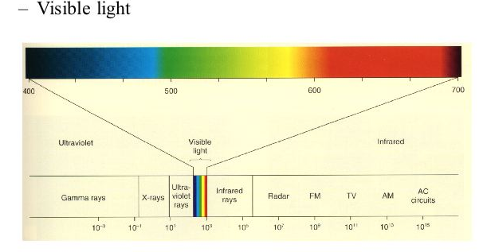
The Retina (5)

Slide 45
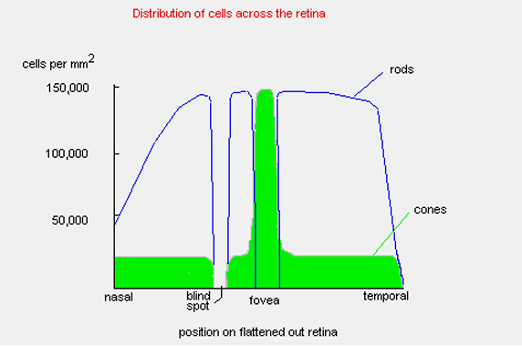
Distribution of cones and rods

Slide 46
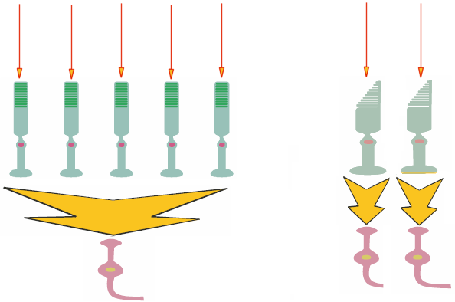
Connections of cones and rods (simplified)
Light
Light
Rods
Cones
Ganglion cells
Ganglion cells
Large convergence
Small convergence

Slide 47
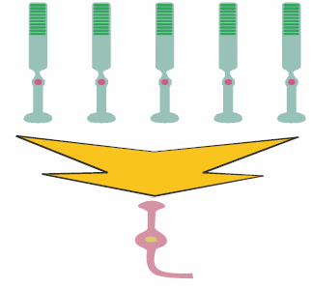
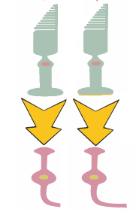
Two “visual systems”
Rods system
(scotopic vision)
Cones system
(photopic vision)
Low acuity (due to large spacing and convergence)
High sensitivity (due to large convergence)
Black and white vision
Peripheral vision
High acuity (due to reduced spacing and convergence)
Low sensitivity (due to small convergence)
Colour vision
Central vision (fovea)

Slide 48
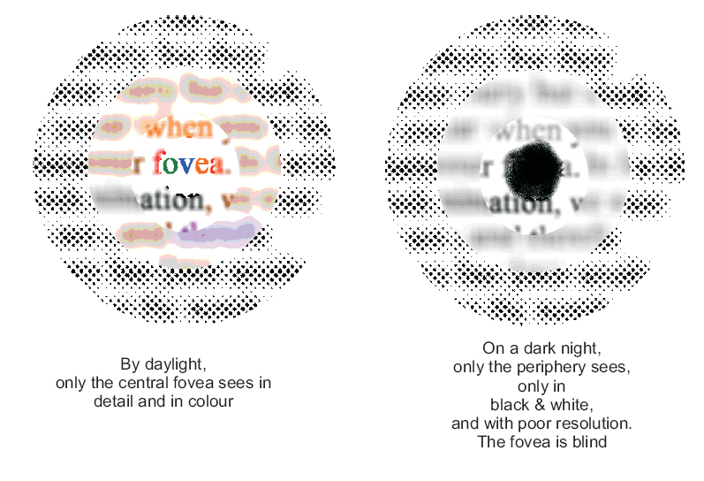

Slide 49
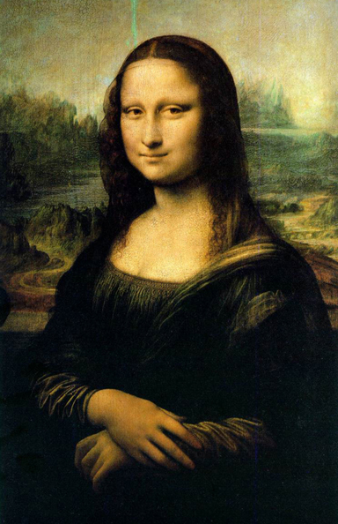
Mona Lisa smile

Slide 50
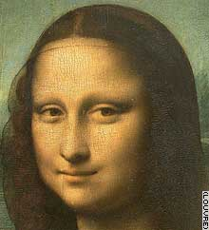
Why is the smile so elusive?
At least two hypotheses ground onto the physiology of the visual system

Slide 51
Effect of spatial frequencies
Livingstone, M.S. (2000) Is It Warm? Is It Real? Or Just Low Spatial Frequency? Science, 290 (5495), 1299
“our central vision is dominated by significantly higher spatial frequencies than is our peripheral vision. Conversely, vision only a few degrees from the center of gaze is much blurrier than in the fovea”
The “sfumato” technique makes the smile more apparent in the low spatial frequency range, and therefore more apparent to peripheral vision than to central vision.

Slide 52
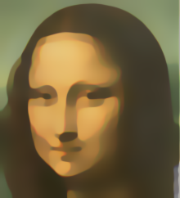
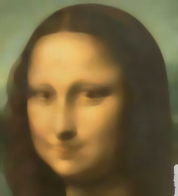
Effect of spatial frequencies
Livingstone, M.S. (2000) Is It Warm? Is It Real? Or Just Low Spatial Frequency? Science, 290 (5495), 1299
High frequencies enhanced
(mimicking central vision)
Original
Low frequencies enhanced
(mimicking peripheral vision)

Slide 53
Receptive fields
(functional organization within the retina, and beyond)
Horizontal cells
Amacrine cells
Horizontal connections among retinal cells create functional structures

Slide 54
Receptive fields
(Lateral Inhibition)
Horizontal cells
Amacrine cells
Through the horizontal connections one active cell (photoreceptor or bipolar cell) may inhibit adjacent cells

Slide 55
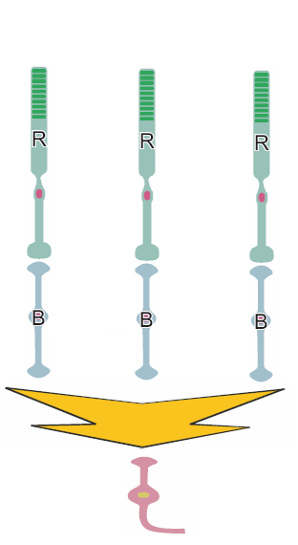
Receptive fields
(Lateral Inhibition)

Slide 56
Receptive fields
(Lateral Inhibition)

Slide 57
Receptive fields
(Lateral Inhibition)

Slide 58
Receptive fields
(Lateral Inhibition)

Slide 59
Receptive fields
(Lateral Inhibition)

Slide 60
Receptive fields
(Lateral Inhibition)
Center ON
(periphery OFF)
Center OFF
(periphery ON)
More complex receptive fields exist in the visual cortex

Slide 61
Lateral Inhibition
One effect of the lateral inhibition is that the signal-to-noise ratio is enhanced
Actual light profile
Ganglion cell activity

Slide 62
Mach bands (1866)

Slide 63
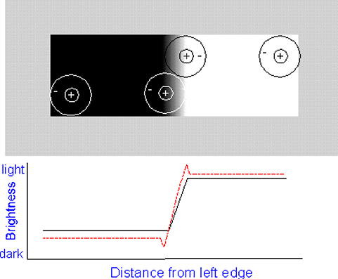
Mach bands

Slide 64
Mach bands

Slide 65
Mach bands

Slide 66
Mach bands
http://www.hutchinsoncenter.umaine.edu:16080/perceive

Slide 67
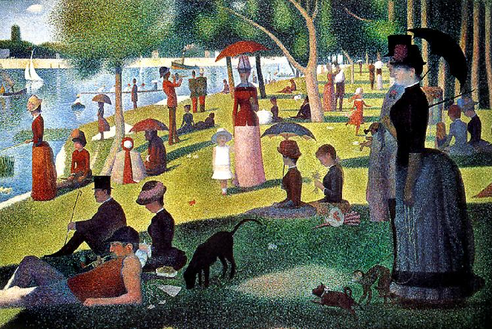
“Mach bands”
Georges Seurat Sunday Afternoon on the Island of La Grande Jatte
1884-86, oil on canvas, Art Institute of Chicago

Slide 68
Hermann’s grid illusion (1870)

Slide 69
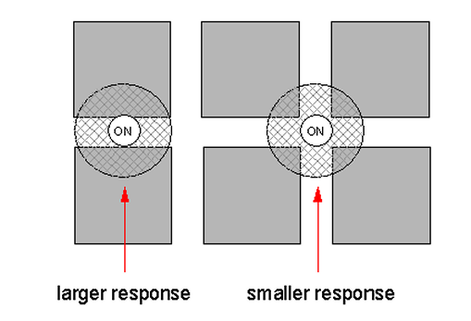
Hermann’s grid illusion (1870)
This is the classic explanation, but others exist as well

Slide 70
Is perception due to the simple summation of elementary physiological processes that occur in the brain (bottom-up process)?

Slide 71
Hubel and Wiesel – receptive fields in the visual cortex
simple cells - respond to "bars" of light of a
particular orientation (orientation selective)

Slide 72
Hubel and Wiesel - cells of visual cortex
+
+
+
+
-
-
-
-
-
-
(15 spikes)
on
off
+
+
+
+
-
-
-
-
-
-
(9 spikes)
+
+
+
+
on
off
-
-
-
-
-
-
(3 spikes)
on
off

Slide 73
Hubel and Wiesel - cells of visual cortex
+
+
+
+
+
+
+
+
+
+
+
+
+
+
+
+
-
-
-
-
-
-
-
-
-
-
-
-
-
-
-
-
-
-
-
-
-
-
-
-
+
+
+
+
+
+
+
+
+
+
+
+
+
+
+
+
-
-
-
-
-
-
-
-
-
-
-
-
-
-
-
-
-
-
-
-
-
-
-
-

Slide 74
Hubel and Wiesel – receptive fields in the visual cortex
simple cells - respond to "bars" of light of a
particular orientation (orientation selective)
complex cells - respond to "bars" of light of a
particular orientation, moving in particular
direction (direction selective)

Slide 75
Hubel and Wiesel - cells of visual cortex
++
+++
++
++
+++
++
+++
+++
+++
+++
+++
+++
+++
+++
+++
+++
+++
+++
+++
+++
+++
+++
+++
+++
+++
+++
+++
+++
+++
+++
+++
+++
+++
off
++
+++
++
on
++
+++
++
+++
+++
++
+++
++
++
+++
++
+++
+++
+++
+++
+++
+++
+++
+++
+++
+++
+++
+++
+++
+++
+++
+++
+++
+++
+++
+++
+++
+++
+++
+++
+++
+++
+++
++
+++
++
on
off
++
+++
++
+++

Slide 76
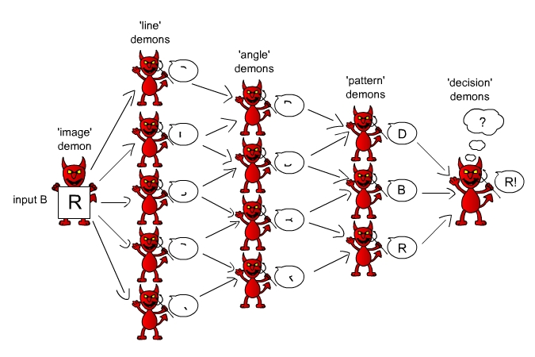
Pandemonium Model of Selfridge (1959) for letter recognition

Slide 77
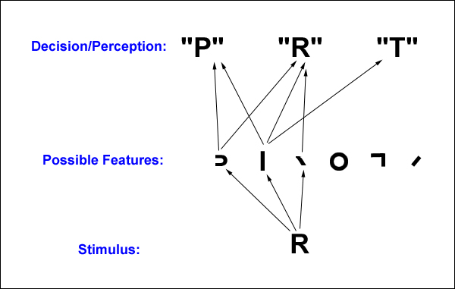
Pandemonium Model of Selfridge (1959) for letter recognition
A model for recognizing letters by analyzing their features. The stimulus, R, activates three feature-units. These feature-units cause strong activation of the R letter-unit and weaker activation of units for letters such as the P and the T, which lack some of R’s features. The R is identified by the high level of activation of the R letter-unit.

Slide 78
Pandemonium Model of Selfridge (1959) for letter recognition
The Pandemonium model would have difficulty identifying all of these as A’s.

Slide 80
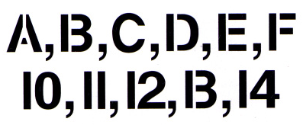

Slide 81
Gestalt Psychology (Wertheimer, Koffka)
Stimuli contain more structure than what is in the simple parts
“The whole is more than the sum of the parts”
central aspect of perception is the formation of “Gestalts” (configuration)
i.e., configurations emerge from arrangements of items

Slide 82
Gestalt Psychology - Perceptual Organization
"The whole is different than the sum of the parts"

Slide 83
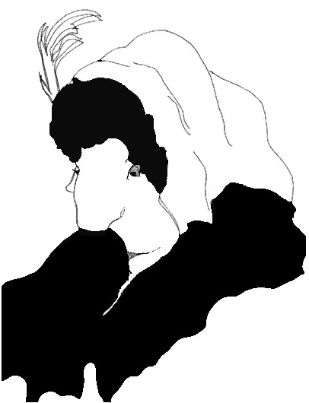

Slide 84
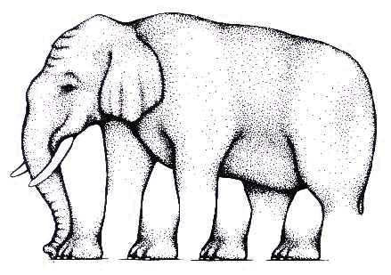

Slide 86
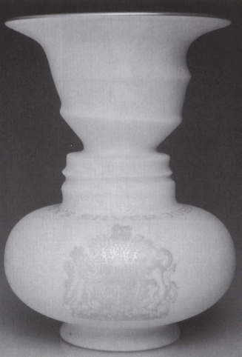

Slide 87
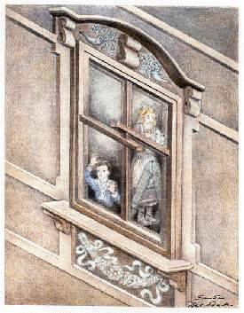

Slide 88
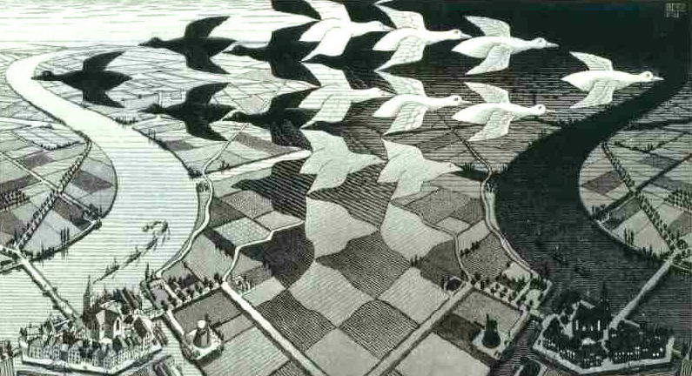
Maurits C. Escher
(1898-1972)
"Day and Night"
M. C. Escher woodcut, 1938

Slide 89
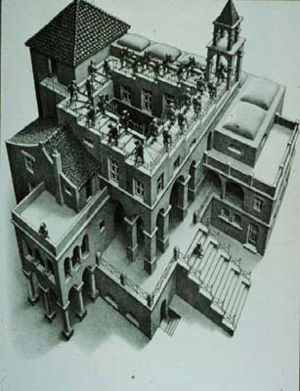
Maurits C. Escher
(1898-1972)
Ascending and descending
Lithograph, 1960
“Drawing hands"

Slide 90
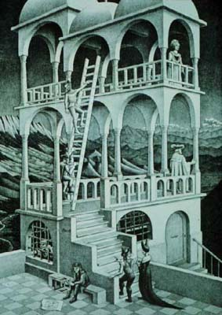
Maurits C. Escher
(1898-1972)
Belvedere
Lithograph, 1958

Slide 91
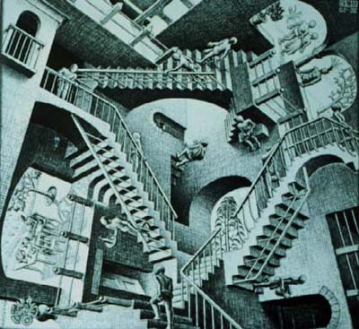
Maurits C. Escher
(1898-1972)
Relativity
Lithograph, 1953

Slide 92
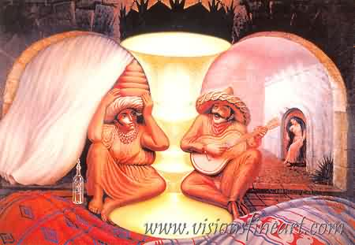
Octavio Campo
(1943)
Forever always

Slide 93
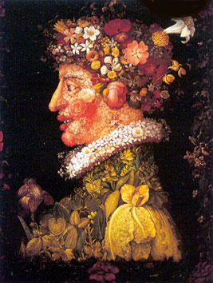
Giuseppe Arcimboldo
Spring, oil on canvas

Slide 94
Giuseppe Arcimboldo
Summer, oil on canvas

Slide 95
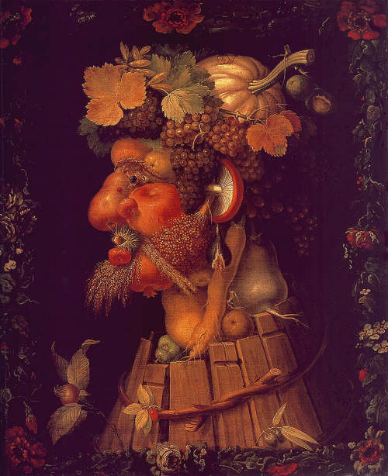
Giuseppe Arcimboldo
Autumn, oil on canvas

Slide 96
Giuseppe Arcimboldo
Winter, oil on canvas

Slide 97
DEPTH PERCEPTION
The problem:
The retinal image (the projection of the visual scene over the retina) is 2-dimensional.
How can we retrieve information about depth/distance?

Slide 98
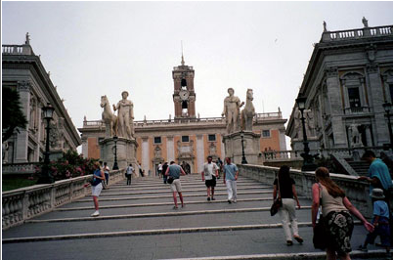
DEPTH PERCEPTION

Slide 99
DEPTH PERCEPTION

Slide 100
Depth Cues
Binocular (oculomotor)
Eye Convergence
Stereoscopic depth (binocular disparity)
Monocular
Perspective Cues
Relative Size
Occlusion
Cast Shadows
Shape from Motion

Slide 101
Depth Cues
Convergence
You converge your eyes when looking at close objects and diverge to look at distant objects
The amount of convergence can be used as cues for absolute depth (for objects not too far away from you)

Slide 102
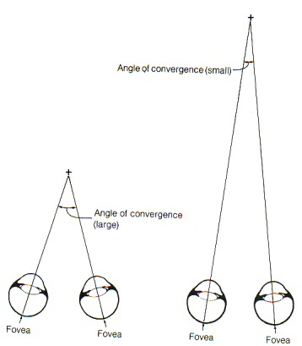
Depth Cues
Convergence

Slide 103
Depth Cues
Binocular disparity
Each eye gets a slightly different view of the world because the two eyes are in slightly different positions.
Retinal (binocular) disparity is the difference between the lateral position of object in the left and right eyes

Slide 104
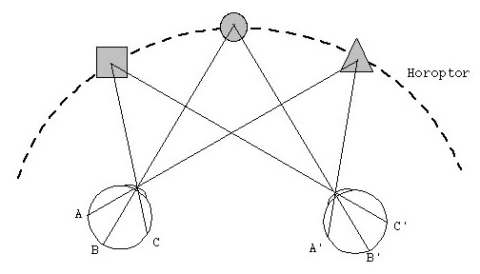
The Horopter
Horopter: images are fused (single image)
Region of fused images: Panum’s Fusion Area

Slide 105
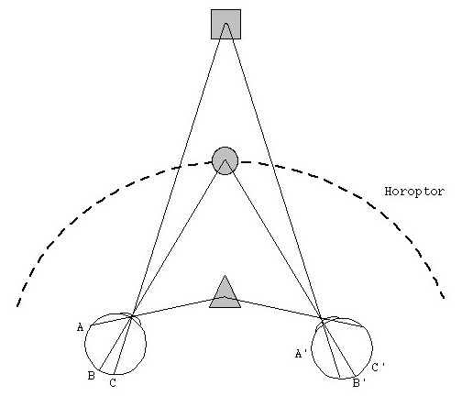
Out of the horopter
Images not fused: images fall on non-corresponding points
Not fused: Diplopia
Binocular disparity

Slide 106
Depth Cues
- Perspective cues:
Linear perspective: Lines that are parallel in the real world appear to converge in a drawing.
The greater the distance, the greater the convergence.
At infinity, lines meet at the vanishing point.

Slide 107
Depth Cues
Linear Perspective

Slide 108
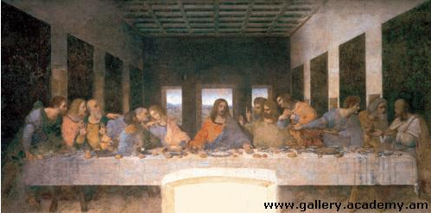
Depth Cues
Linear Perspective

Slide 109
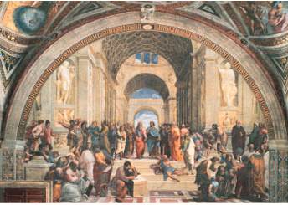
Depth Cues
Linear Perspective

Slide 110
Depth Cues
Perspective cues:
- Height in the Field
“Elevation” or “relative height”
Objects below horizon: higher objects appear farther
Objects above horizon: lower objects appear farther

Slide 111
Depth Cues
Perspective cues:
- Height in the Field

Slide 112
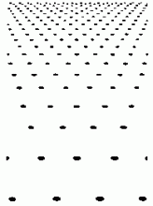
Depth Cues
- Texture gradients: Surface texture gets smaller and denser with distance

Slide 113
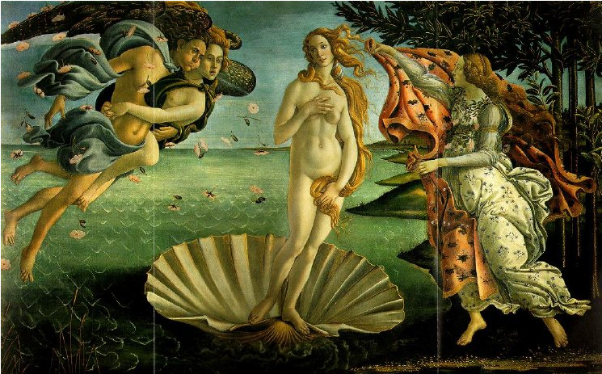
Depth Cues
- Texture gradients: Surface texture gets smaller and denser with distance

Slide 114
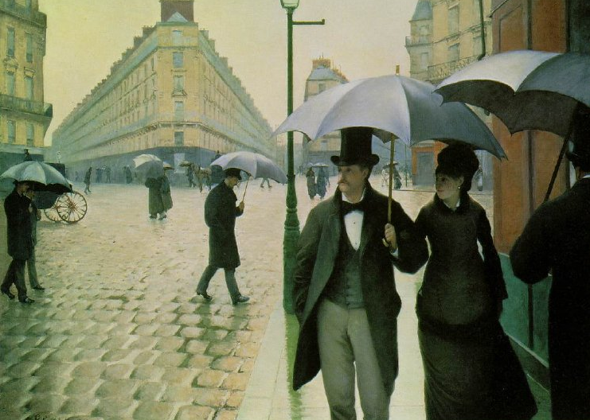
Depth Cues
- Texture gradients: Surface texture gets smaller and denser with distance

Slide 115
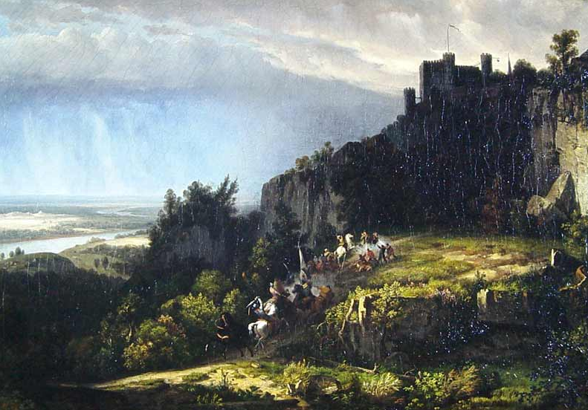
Depth Cues
- Aerial perspective: distant objects appear less clear
Worthington Whittredge - Fight Below the Battlements, 1849

Slide 116
Depth Cues
- Aerial perspective: distant objects appear less clear
Georges Seurat, Bathing at Asnières, 1883-1884

Slide 117
Depth Cues
Relative size: If 2 objects are same size, closer one casts larger retinal image
Eduard Manet, Le Dejeuner sur l'herbe

Slide 118
Depth Cues
Relative size

Slide 119
Depth Cues
Partial occlusion or interposition

Slide 120
Depth Cues
Partial occlusion or interposition
Musicians and dancers, c. 1350 B.C

Slide 121
Depth Cues
Partial occlusion or interposition
Lascaux (France), 18,000 Years before Present

Slide 122
Depth Cues
Familiar size: knowledge of object’s size influences perception of distance

Slide 123
Depth Cues
- Shading and Lighting: default assumption: light from above

Slide 124
Depth Cues
Binocular (oculomotor)
Eye Convergence
Stereoscopic depth (binocular disparity)
Monocular
Perspective Cues
Relative Size
Occlusion
Cast Shadows
Shape from Motion

