Slide 1
EPISTEMOLOGY AND PROFESSIONAL ETHICS
October 17, 2023
Fabio Ferlazzo

Slide 2
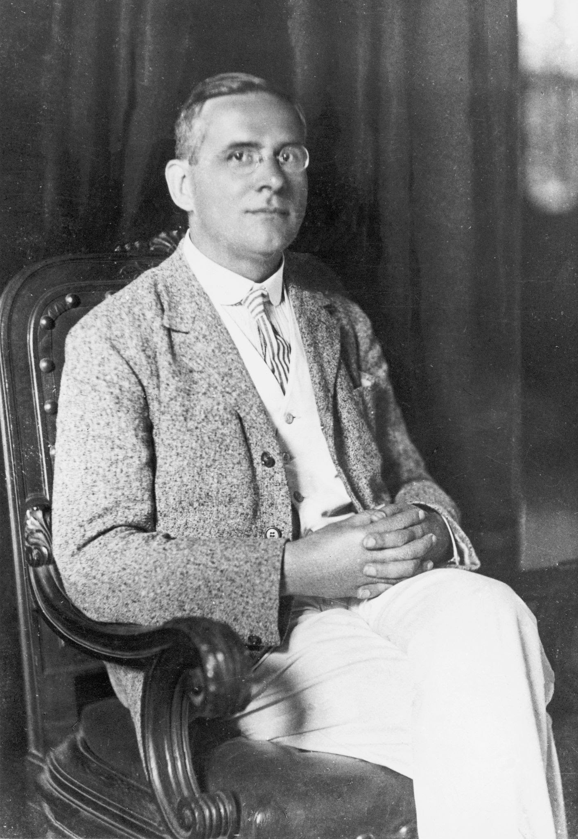
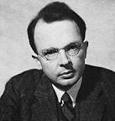
The Vienna Circle
(1922-1936, Schlick, Carnap, Neurath, von Bertalanffy, etc.)
They founded the logical positivism (verificationism, neopositivism)
Moritz Schlick
Otto Neurath
Rudolf Carnap

Slide 3
The Vienna Circle
(1922-1936, Schlick, Carnap, Neurath, von Bertalanffy, etc.)
Interests in science, mathematics, logic, language
Against Hegel, Heidegger, and the dominant ‘800 philosophy
(Their works are incomprehensible and obscure)
Vienna Circle valued clarity, reason, precision
and devalued mysticism, romanticism, nationalism
In essence, they valued science

Slide 4
Logical positivism
1) Analytic statements vs synthetic statements
2) Verifiability theory of meaning

Slide 5
1) Analytic statements vs synthetic statements
Analytic propositions can be true or false because
of their meaning alone
«All the single men are unmarried»
No need of an empirical evidence that the sentence is true
It only depends on the logical relations between
the words meanings (internal coherence)
However, it’s not a truth about the world

Slide 6
1) Analytic statements vs synthetic statements
Mathematical knowledge is analytic
Empirical sciences produce synthetic propositions

Slide 7
2) Verifiability theory of meaning
How have words their meaning?
«The light is on»
«La luce è accesa»
How can we attach a meaning to these to equal sentences?
The meaning of a proposition is how it can be verified
If a proposition cannot be verified, it’s meaningless

Slide 8
2) Verifiability theory of meaning
«The light is on» → look at the lamp
meaningful
«The soul is eternal»
meaningless
Only statements that are testable have meaning
Experience is the only source of knowledge and meaning

Slide 9
2) Verifiability theory of meaning
Observation vs theory
The distinction is far from being clearcut
Theories are abstractions from observations
But what’s an observation? Naked eye? Instruments?
What should be done with things we cannot observe,
not even with an instrument (e.g. black hole)?
Usually, we observe consequences more than things

Slide 10
Discovery vs Justification
It’s rare that scientists discover something in a scientific manner
They have ideas, dreams, popular knowledge and so on:
discovery is outside the realm of science
Science begins when the endeavor of verifying a theory starts

Slide 11
Falling of logical positivism
A number of reasons. Among them:
1) We can make a meaningless proposition testable:
«the light is on and the spirit is eternal»
can be tested by falsifying the first part
(if A is false then A&B must be false)

Slide 12
Falling of logical positivism
A number of reasons. Among them:
2) The verification principle in itself is not analytic,
nor synthetic
Thus it is meaningless

Slide 13
Falling of logical positivism
A number of reasons. Among them:
3) It relies on inductive reasoning:
from observations to theories.
And the inductive reasoning is fallacious

Slide 14
DATA
Data do not exist independently of a theory
(i.e., there are no “objective” data)

Slide 15
INDUCTION
(from observations to theory)
Inductive reasoning is a method of drawing conclusions by going from the specific to the general.
It’s usually contrasted with deductive reasoning, where you go from general information to specific conclusions.

Slide 16
INDUCTION
(from observations to theory)
My professor is older than 40
All the professor I met are older than 40
thus
All the professors are older than 40

Slide 17
INDUCTION
(from observations to theory)
INDUCTIVIST TURKEY (B. Russell)

Slide 18
INDUCTIVIST TURKEY (B. Russell)
A turkey, in an american nurture, decides to shape its vision of the world scientifically, according to the Logical Positivism.
The turkey found that, on his first morning at the turkey farm, he was fed at 9 a.m. Being a good inductivist turkey he did not jump to conclusions. He waited until he collected a large number of observations that he was fed at 9 a.m. and made these observations under a wide range of circumstances, on Wednesdays, on Thursdays, on cold days, on warm days. Each day he added another observation statement to his list. Finally, he was satisfied that he had collected a number of observation statements to inductively infer that “I am always fed at 9 a.m.”.
However, on the morning of Christmas eve he was not fed but instead was killed.

Slide 19
INDUCTION
Induction by enumeration
How many white swans you need to observe in order to state that the proposition “all the swans are white” is true?

Slide 20
INDUCTION
Induction by elimination
Problem: the hypotheses are infinite
"When you have eliminated all which is impossible, then whatever remains, however improbable, must be the truth." —Sherlock Holmes

Slide 21
INDUCTION
Fallacy of inductive logic

Slide 22
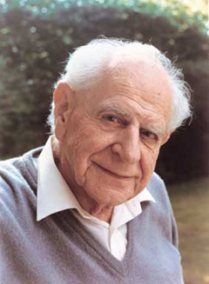
Karl R. Popper
(Vienna, 1902 – London, 1994)
“The scientific status of a theory relies on its falsifiability”
Discovery and justification
Corroboration

Slide 23
INDUCTION
Falsification
You only need one black swan to state for sure that the proposition “all the swans are white” is false!

Slide 24
NULL HYPOTHESIS!

Slide 25
Population
Rome
Florence
160 cm
195 cm
height

Slide 26
Population
Rome
Florence
160 cm
195 cm
height
Sample
Average = 175 cm

Slide 27
Population
Rome
Florence
160 cm
195 cm
height
Sample
Average = 175 cm
Sample
Average = 180 cm
Difference = -5 cm

Slide 28
Population
Rome
Florence
160 cm
195 cm
height

Slide 29
Population
Rome
Florence
160 cm
195 cm
height
Sample
Average = 182 cm

Slide 30
Population
Rome
Florence
160 cm
195 cm
height
Sample
Average = 182 cm
Sample
Average = 170 cm
Difference = 12 cm

Slide 31
Population
Rome
Florence
160 cm
195 cm
height

Slide 32
Population
Rome
Florence
160 cm
195 cm
height
Sample
Average = 169 cm

Slide 33
Population
Rome
Florence
160 cm
195 cm
height
Sample
Average = 169 cm
Sample
Average = 180 cm
Difference = -11 cm

Slide 34
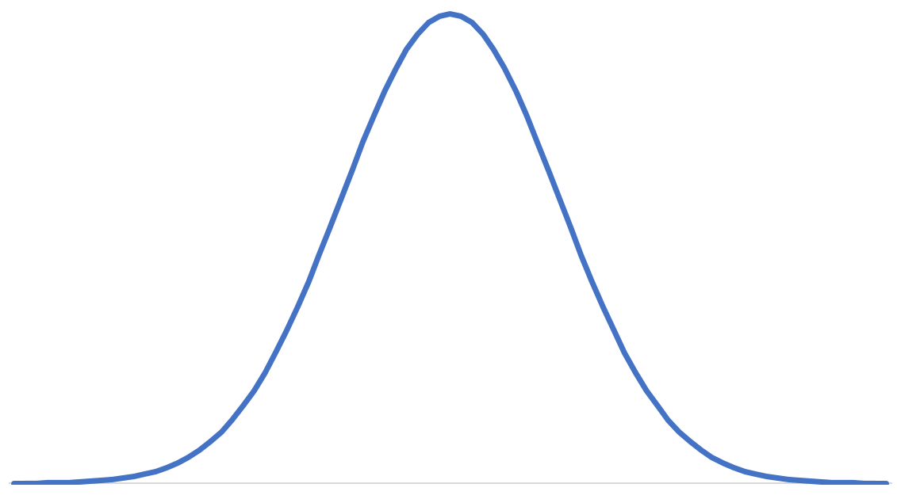
Population
Rome
Florence
160 cm
195 cm
height
Sampling distribution under the null hypothesis (h0) that
people from Rome and Florence belong to
the same population (same average height)
The variability is only due to chance.
frequency
-30 cm
-20 cm
-10 cm
0 cm
10 cm
20 cm
30 cm
height difference

Slide 35
Population
Rome
Florence
160 cm
195 cm
height

Slide 36
Population
Rome
Florence
160 cm
195 cm
height
Sample

Slide 37
Population
Rome
Florence
160 cm
195 cm
height
Sample
Average = 165 cm
Sample
Average = 188 cm
Difference = -23 cm

Slide 38
Rome
Florence
160 cm
195 cm
height
Sampling distribution under the null hypothesis.
frequency
Difference = -23 cm
-30 cm
-20 cm
-10 cm
0 cm
10 cm
20 cm
30 cm
height difference
If the probability of measuring a difference of 23 cm is below (usually) .05 then the null hypothesis is rejected

Slide 39
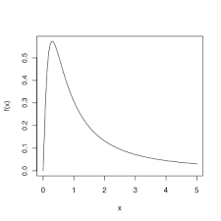
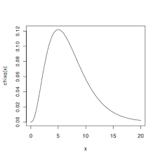
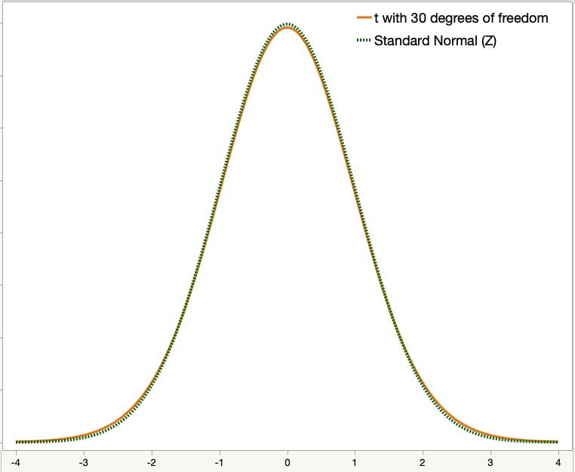
Many sampling distributions, depending on the statistics being used
Fisher’s F
Chi- squared
Student’s t

Slide 40
An example: the null-hypothesis (H₀)
DEFINITIONS OF H₀
The logical contradictory of the hypothesis that one seeks to test. If the null hypothesis can be proved false, its contradictory is thereby proved true (English & English, 1958, p. 350)
Symbolically, we shall use H₀ (standing for null hypothesis) for whatever hypothesis we shall want to test and H_{A} for the alternative hypothesis (Freund, 1962, p. 238). […] the acceptance of H₀ is equivalent to the rejection of H_{A}, and vice versa (p. 250).

Slide 41
An example: the null-hypothesis (H₀)
However
According to Popper, we cannot «accept» a theory, namely demonstrate a theory true.
Thus
we can only reject a null-hypothesis, but we cannot accept it or accept the alternative hypothesis

Slide 42
A ≠ B
**
Vd
A
B
C

Slide 43
A ≠ B
**
Vd
B = C
A
B
C

Slide 44
A ≠ B
**
Vd
B = C
A = C
A
B
C

Slide 45
A ≠ B
**
Vd
B = C
A = C
A = B
A
B
C

Slide 46
An example: the null-hypothesis (H₀)
DEFINITIONS OF H₀
The residual hypothesis that cannot be rejected unless the test statistic used in the hypothesis testing problem lies in the critical region for a given significance level. In particular, especially in psychology, the hypothesis that certain observed data are a merely random occurrence (Borowski & Borwein, 1991, p. 411)

