Slide 1
Comparative and European Public Law
Prof. Angelo Schillaci
angelo.schillaci@uniroma1.it
Lesson III – Presidential Government and US constitutional experience

Slide 2
Form of State/Form of Government (I)
Form of State
Confessional State
Secular State
People
Government
Territory
Historical classifications
Unitary State
Federal State
Regional State
Authoritarism
Totalitarianism
Democracy (-ies)
The role of the military

Slide 3
Form of State/Form of Government (II) Form of Government
Executive
Judiciary
Legislative
Legitimacy
Guarantees
Representation
Head of State
Counter-democracy*
Separation of powers
P. Rosanvallon, Counter-democracy, CUP 2010

Slide 4
How to study a form of Government (I)
Constitutional Provisions
History
Political System
Dynamic
Static

Slide 5
How to study a form of Government (II)
Who?
Stucture and Legitimation of Constitutional Bodies
What?
Main Features of Separation of Powers
How?
Relation among Constitutional Bodies: Who holds political direction?

Slide 6
Political Direction
Complete Balance
Parliamentary Side (“Congressional Government” in US history)
Strict Separation of Powers
Legislative
Executive
Direct Election
President
Parliament
Judiciary
Presidential Side (South America)
Presidential Government

Slide 7
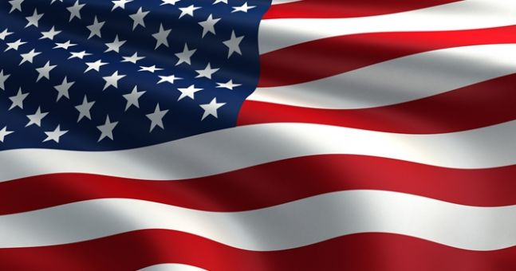
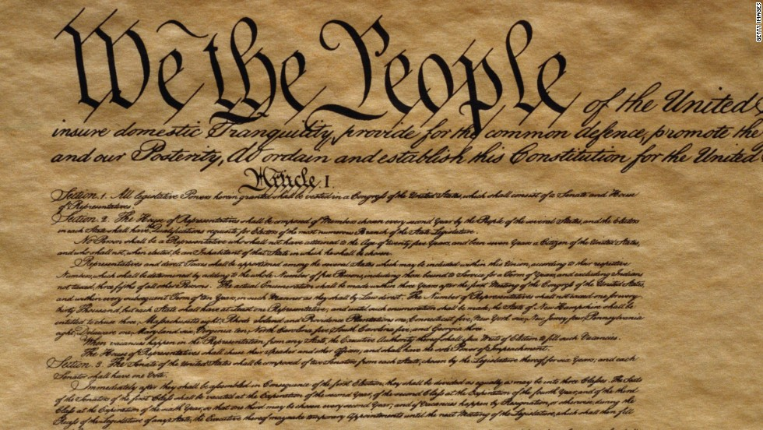
Presidential Government in the
United States of America
Constitution - 1787

Slide 8
Chief of the Executive Power
Congress of the United States
Two Houses
Direct Election
Supreme Court of the United States
Highest Federal Court
Chief Justice
President of the United States
Executive Office
Secretaries of State
“Direct” Election – 4 Years Term
Legislative Power
House of Representatives* – 435 members – 2 Years Term
Senate* – 100 members – 6 Years (renewed for 1/3 every 2 Years)
8 Associate Judges
Appointed by the President – Lifelong
Vice President (Head of Senate)

Slide 9
LEGISLATIVE POWER
U.S. CONGRESS
House of Representatives
• proportionate ratio
= according to the population of each state
Senate
• fixed ratio
= each state is represented on an equal footing

Slide 10
• In exercising the legislative power the two chambers are equal
= a bill cannot pass if it is not approved by both HR and S.
(in case of contrast, a committee can be appointed)
Perfect Bicameralism
• Besides legislative power, the Senate exercises other powers, especially in the field of checks & balances
< the Senate is the place where all the member states, equally represented, can lead the federation’s politics and check the presidential initiatives

Slide 11
EXECUTIVE POWER
It is entrusted to a single person, i.e. the President of the U.S.
The President is:
Chief of the State
leader of the executive branch
= he/she appoints the officials of the Federal Government and lead the administration

Slide 12
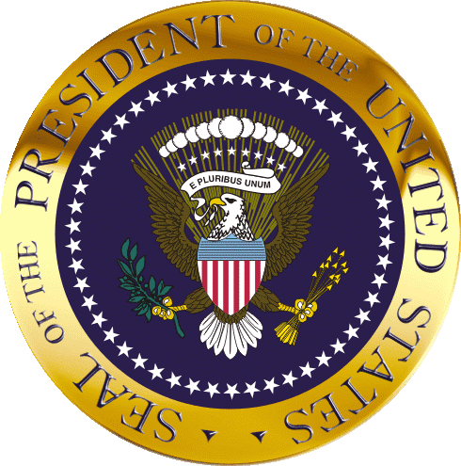
Primary Election – Role of Political Parties
Election Day ("the first Tuesday after the first Monday of November")
Why does it work as a direct election?
What if no candidates reach absolute majority?
Electoral College
Taking of the Oath (Jan 20)

Slide 13
U.S. POLITICAL SYSTEM
Two-party system
Pragmatic organization (no strict internal discipline) functional to the elections
Significant role played by lobbies
Low public participation in the election (almost 50%)
This is also because citizens are not automatically registered as voters, but have to apply to be registered as voters

Slide 14
The selection of the candidate
Conventions or Caucuses: party assembly
Primaries (open or restricted to the affiliated)

Slide 15
Why does it work as a direct election?
It is formally indirect because citizens enjoying the right to vote elect a restricted number of electors (so-called presidential electors), who gather in an electoral college, whose only duty to elect the President and the Vice-President.
In the first decades of the constitutional experience, the presidential electors were not considered bound by the popular vote.
With the progressive growth of democratic participation and the role of political parties in expressing a presidential candidate, the mandate of presidential electors turned (conventionally) into a mandatory duty to vote according to the popular vote.
If no candidates reach absolute majority, the HR would elect the President (XII Amendment).

Slide 16
No dissolution of the Houses
Congress of the United States
President of the United States
No relation of confidence with the President
No power to initiate legislation
The Congress can’t make the P. resign for mere political reasons
Strict Separation of Powers

Slide 17
RELATIONS BETWEEN THE PRESIDENT AND THE CONGRESS
=
The essence of the Presidential Form of Government

Slide 18
CHECKS & BALANCES
Remember J. Madison: “if men were angels…”
The framers based the Constitutions on the principle of separation of powers.
Nonetheless the rigidity of this principle is mitigated thanks to the provision of a system of “checks and balances” among the branches of government.
President and Congress are separate and independent institutions , but they are linked when carrying on their functions.

Slide 19
Checks and balances (I)
Veto Power
When the Congress presents a Bill to the President for signature, the President can refuse to sign, sending the Bill back to the Congress within 10 days, if the Congress is in session.
The Congress can overcome presidential veto by approving again the Bill with a 2/3 majority.
If the Congress adjourns session during the period expected for the veto (10 days), and the President doesn’t sign the Bill does not become law (pocket veto).

Slide 20
Checks and balances (II) - Impeachment
In the English tradition, impeachment was a trial carried out by the chambers of Parliament for crimes committed by the ministers of the Crown.
Throughout the history, however, impeachment has lost its role and has been substituted by the relation of confidence between the Parliament and the ministers (i.e., by the political responsibility of the ministers for their action).
The framers of U.S. Constitution decided to keep the possibility to impeach the President, the Vice President and other high officials of the Federal Government, also for the pure consistency with an ideal of ethic responsibility of those who are in charge of public functions.

Slide 21
Checks and balances (II) - Impeachment
The HR can impeach the P. by a simple majority vote
The Senate judges by a 2/3 majority vote
If convicted, the President leaves office
Chaired by the Chief Justice (not the VP)
The VP takes the oath
Treason, Bribery, and other grave crimes and misdemeanors

Slide 22
Impeachment is not a real criminal trial, but rather a judgment of the public opinion upon crimes committed by other federal officials.
In case of impeachment (i.e. the above mentioned procedure ends up with a conviction), the official is removed from his charge and can be judged by the ordinary courts for his crimes.

Slide 23
Checks and Balances (III)
Why the Senate?
Advice and Consent (through hearings)
Appointment of Embassadors, Federal Officers
Appointment of Supreme Court Judges
Control on Foreign Politics
Approval of Treaties
Consent to War

Slide 24
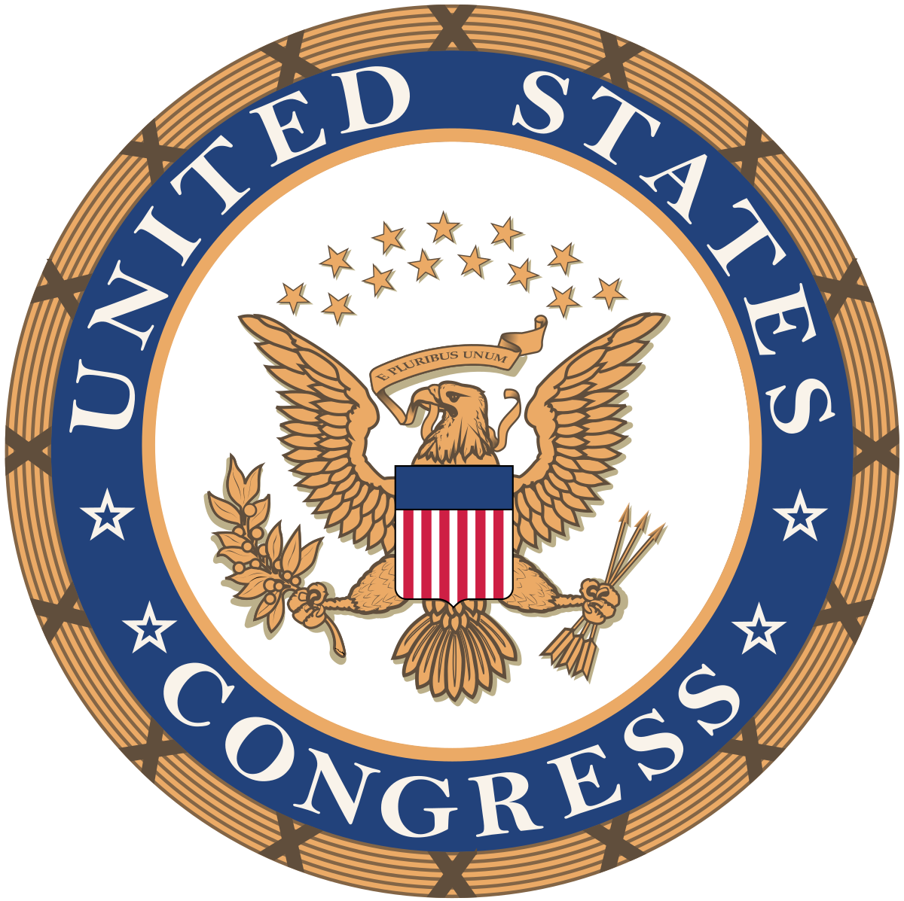
Checks and balances (IV)
Resistance (Roosevelt)
Convergence (Obama, Sebelius case)
Civil rights Revolution
Relation with the States
i.e. implied powers doctrine, Commerce Clause and new federal competences

Slide 25
Political Direction
Checks and Balances
Le pouvoir arrête le pouvoir
Different majorities (lame duck)
Different phases:
“Congressional” Government
“Imperial” Presidency

Slide 26
Congressional Government
The label has been made da W. Wilson (1885), and stuck as a description of the federal government from roughly 1867 to the turn of the century.
This set of organization of powers was a product of the political and constitutional struggles of the civil war (1861-1865).
The victorious republican party was largely composed of former Whigs, who had originally organized in the 1830s in opposition to the strong presidency of Andrew Jackson.
Their preference for congressional leadership, however, had to be delayed by the exigencies of civil war, which required giving extraordinary powers to the Republican President Abraham Lincoln.
Lincoln's death and disagreements with his successor, Andrew Johnson, led Congress to take legislative control of reconstruction.
For the first time, Congress overrode a presidential veto.
Soon, Congress routinely overrode Johnson's vetoes, before eventually attempting to remove him from office through an impeachment in 1867 for his resistance to congressional policy.

Slide 27
The long season of F.D Roosevelt presidency (1933-1945) deeply shaped the features of American presidentialism.
It strengthened the role of the President in the government.
It created an Administrative State.
It transformed the Executive Branch, from the weakest institution (as originally designed by the Framers), with its progressive intrusion in the legislative powers (budgetary process especially) and the enlargement of the federal administration in several fields.
This progressive cooperation between branches, led some scholars to say that the presidential government shall be interpreted as a system of separated institutions sharing powers, in which the role of the presidency was intended to grow.

Slide 28
Nonetheless, immediately after the end of the Roosevelt Era, the Congress managed to restore its role and a more balanced dualism has been established (e.g. Watergate scandal, 1972)

