Slide 1
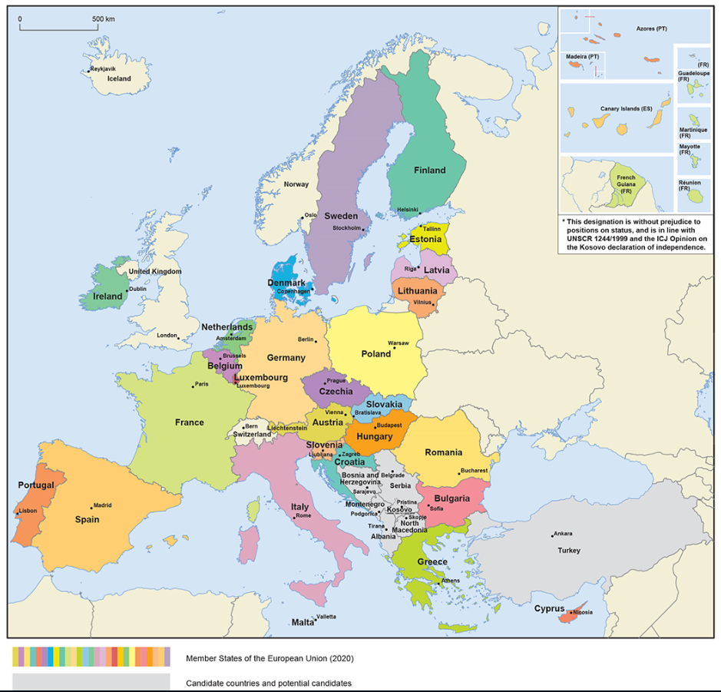
The European Union: 446 million people – 27 countries

Slide 2
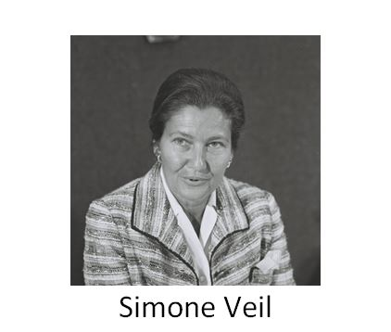
Pioneers – some of the architects of the European project
Their contribution to lasting peace and prosperity…
Konrad Adenauer
Alcide De Gasperi
Winston Churchill
Robert Schuman
Jean Monnet

Slide 3
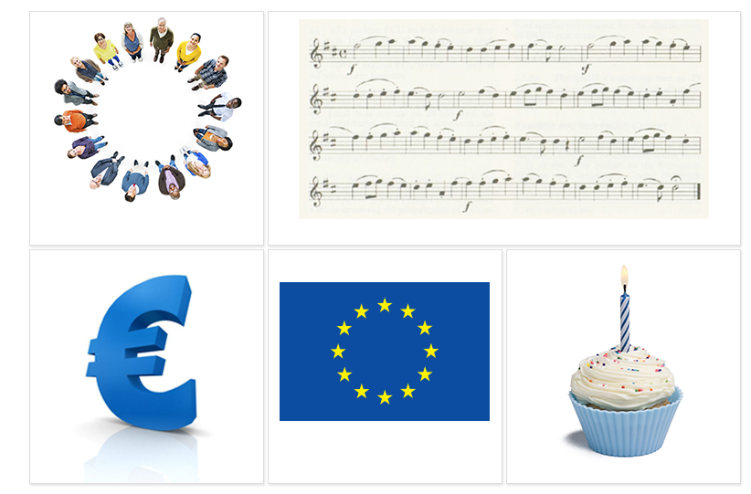
The EU symbols
The motto:
United in diversity
The European anthem
The euro
The European flag
Europe Day, 9 May

Slide 4
24 official languages
Български
Čeština
dansk
Deutsch
eesti keel
Ελληνικά
English
español
français
Gaeilge
hrvatski
Italiano
latviešu valoda
lietuvių kalba
magyar
Malti
Nederlands
polski
português
Română
slovenčina
slovenščina
suomi
svenska

Slide 5
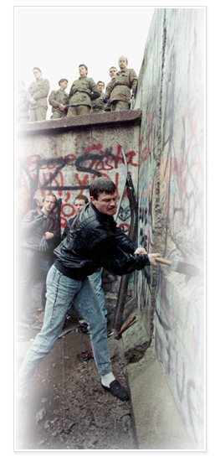
The big enlargement: uniting east and west
1989
Fall of Berlin Wall – end of Communism
EU economic help begins: Phare programme
1992
Criteria set for a country to join the EU:
• democracy and rule of law
• functioning market economy
• ability to implement EU laws
1998
Formal negotiations on enlargement begin
2002
Copenhagen summit agrees to a big enlargement of 10 new countries
2004
Ten new EU members: Cyprus, Czech Republic, Estonia, Hungary, Latvia, Lithuania, Malta, Poland, Slovakia, Slovenia
2007
Bulgaria and Romania join the EU
2013
Croatia joins on 1 July

Slide 6
Candidate countries and potential candidates
Country | Population (millions) in 2018
Bosnia and Herzegovina | 3.5
Montenegro | 0.6
Kosovo under UN Security Resolution 1244 | 1.8
North Macedonia | 2.1
Albania | 2.9
Serbia | 7.0
Turkey | 79.8

Slide 7
The treaties – basis for democratic cooperation built on law
1952
The European Coal and Steel Community
1958
The treaties of Rome:
• The European Economic Community
• The European Atomic Energy Community
(EURATOM)
1987
The European Single Act: the Single Market
1993
Treaty on European Union - Maastricht
1999
Treaty of Amsterdam
2003
Treaty of Nice
2009
Treaty of Lisbon

Slide 8
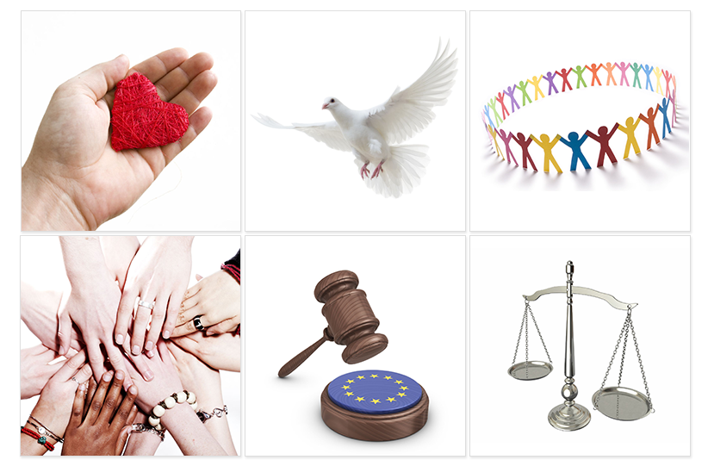
The EU Charter of Fundamental Rights
Binding for all the EU's activities
54 articles under 6 titles:
Dignity
Freedoms
Equality
Solidarity
Citizens’ rights
Justice

Slide 9
EU population compared to the rest of the world
Population in millions

Slide 10
How many people live in the EU?
Population in millions (2019)
446 million in total

Slide 11
The European economy: stronger together
2008: Worldwide financial crisis starts in the United States.
Coordinated response from European leaders:
Commitment to the euro and to financial stability
New crisis management tools and reforms of rules:
European Stability Mechanism: fund to help countries in extraordinary economic difficulties
New laws for stability of banks
Banking Union: EU-wide supervision of banks and a mechanism to close down failing banks
Better economic governance:
European Semester: annual procedure to coordinate public budgets
Euro+ pact, ‘Fiscal compact treaty’: mutual commitments to sound public finances

Slide 12
An investment plan for Europe
The European Fund for Strategic Investments
The Investment Plan for Europe, adopted in November 2014, uses public guarantees to stimulate private investment.
The plan’s European Fund for Strategic Investments has already mobilised €439 billion worth of investments (by October 2019), exceeding expectations.
The plan’s investments have supported the creation of 1.1 million jobs, a figure set to rise to 1.7 million by 2022.
More than one million small and medium-sized companies are set to benefit from improved access to finance and the plan has helped to boost EU Gross Domestic Product by 0.9%.

Slide 13
Banking union: safe and reliable banks
The EU’s response to the financial crisis:
Rulebook:
New laws to ensure that banks have adequate capital and better risk control
Supervision:
The European Central Bank supervises the +/- 130 of the most important banks
National bank supervisors work closely together
Resolution:
A Europe-wide Single Resolution Board can decide to wind down a failing bank
This is backed by a fund that banks themselves pay into, thus ensuring that taxpayers do not have to pick up the bill.

Slide 14
How does the EU spend its money?
The annual EU budget in 2019 was around €165.8 billion – a large sum in absolute terms, but only about 1% of the wealth generated by the economies of the Member States every year.

Slide 15
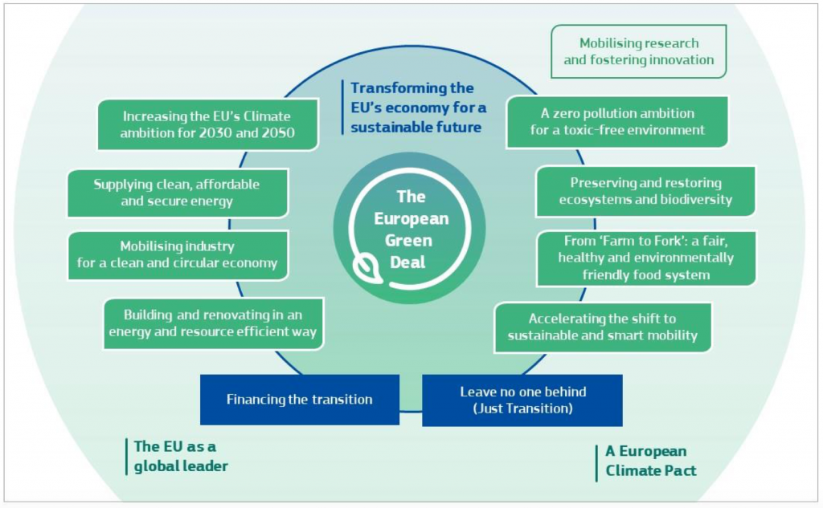
Climate change – The EU’s ambitious targets
Increasing the EU’s climate ambition for 2030 and 2050
Becoming the world’s first climate-neutral continent by 2050 is the greatest challenge and opportunity of our times. To achieve this, the European Commission presented the European Green Deal in December 2019.
The Green Deal is an integral part of the Commission’s strategy to implement the United Nation’s 2030 Agenda and the sustainable development goals.
The Commission will propose the first European ‘climate law’ by March 2020. This will enshrine the 2050 climate neutrality objective in legislation.
The EU has already started to modernise and transform the economy with the aim of climate neutrality. Between 1990 and 2018, it reduced greenhouse gas emissions by 23%, while the economy grew by 61%.
By summer 2020, the Commission will present an impact assessment plan to increase the EU’s greenhouse gas emission reductions target for 2030 to at least 50% and towards 55% compared with 1990 levels in a responsible way.

Slide 16
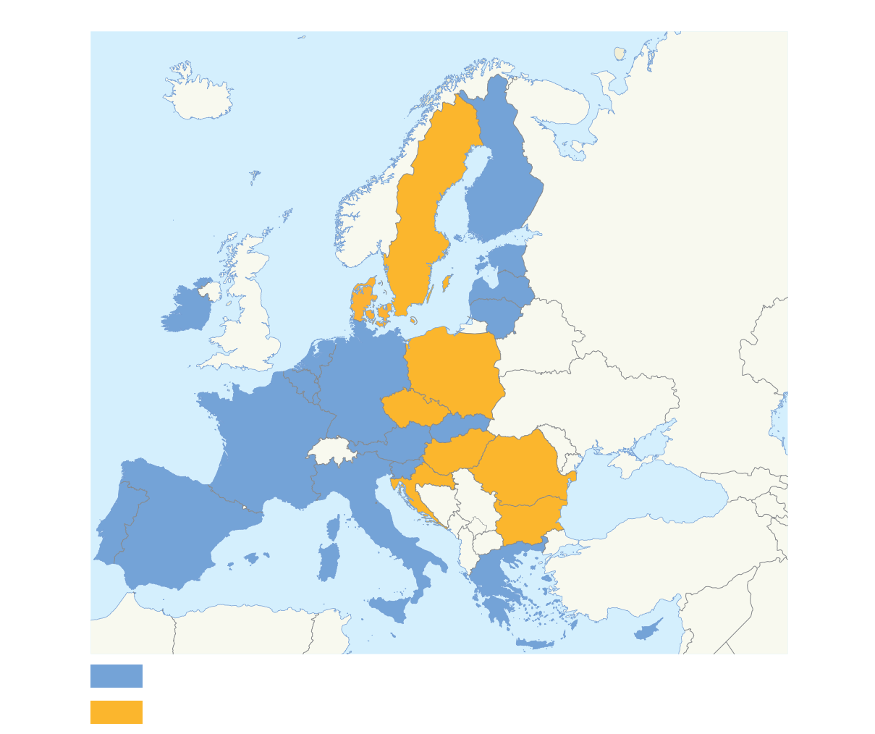
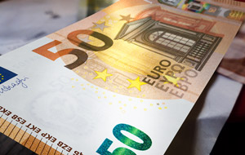
The euro – a single currency for Europeans
Why the euro?
No fluctuation risk and foreign exchange cost
More choice and stable prices for consumers
Closer economic cooperation between EU countries
EU countries using the euro
EU countries not using the euro
Can be used everywhere in the euro area
Coins: one side with national symbols, one side common
Notes: no national side

Slide 17
The single market: freedom of choice
Four freedoms of movement:
goods
services
people
capital
The single market has led to:
significant reductions in the price of many products and services, including airfares and phone calls
more choice for consumers
millions of new jobs
more opportunities for businesses

Slide 18
Connecting Europe: The Digital Single Market
Since May 2015, the European Commission has delivered most of the proposals announced in its Digital Single Market strategy. These include:
Roaming charges ended in June 2017, so people can use their mobile device when travelling in the EU, paying the same prices as at home.
Strong new EU rules on personal data protection came into force on 25 May 2018.
The WiFi4EU initiative supports installing free public Wi-Fi hotspots in local communities across the EU.
New tools to help defend people and businesses against cyberattacks.
From 2018, new rules let people use their online subscriptions to films and TV, e-books, video games and music services when travelling within the EU.
In 2018, plans to invest €1 billion in building a world-class European supercomputers infrastructure.

Slide 19
Social Europe
Europe has the best levels of social protection in the world and ranks highly in terms of quality of life and wellbeing.
It maintains these through a number of initiatives:
The European Social Charter guarantees fundamental social and economic rights. It guarantees a broad range of everyday human rights related to employment, housing, health, education, social protection and welfare
The European Social Fund is Europe’s main instrument for supporting jobs, helping people get better jobs and ensuring fairer job opportunities for all EU citizens. Investment of €10 billion a year improves job prospects for millions of Europeans, in particular those who find it difficult to get work
The European Employment Strategy's main aim is the creation of more and better jobs throughout the EU
The Youth Guarantee is a commitment by all Member States to ensure that all young people under the age of 25 years receive a good quality offer of:
employment
continued education
apprenticeship
traineeship
within a period of four months of becoming unemployed or leaving formal education.

Slide 20
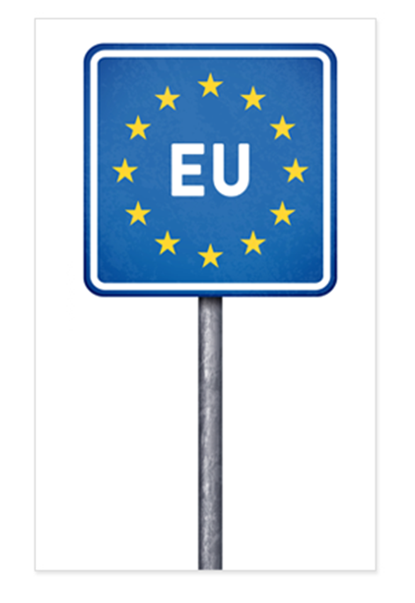
Free to move
Schengen
No police or customs checks at borders between most EU countries, and Norway, Liechtenstein, Switzerland and Iceland.
Controls strengthened at the EU’s external borders
More cooperation between police and immigration authorities from different EU countries
Buy and bring back any goods for personal use when you travel between EU countries

Slide 21
Going abroad to learn or volunteer
Erasmus+
Every year, more than 400 000 young people study or pursue personal development in other European countries with the support of the EU’s Erasmus+ programme for education, training, youth and sport.
In addition, Erasmus+ supports the European Solidarity Corps and the European Voluntary Service.

Slide 22
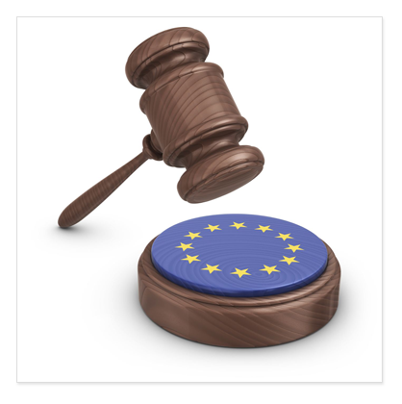
An area of freedom, security and justice
EU Charter of Fundamental Rights
Joint fight against terrorism
Cooperation between police and law-enforcers in different EU countries
Coordinated asylum and immigration policies
Civil law cooperation

Slide 23
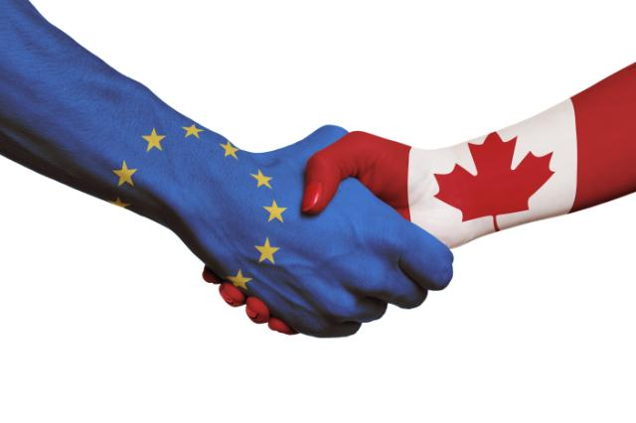
The EU: an exporter of peace and prosperity
Common foreign and security policy.
The EU pursues an ambitious trade negotiation agenda and a balanced and progressive trade policy to harness globalisation.
New trade agreements with:
Canada (2017)
Japan (2018)
and many more…
Development assistance and humanitarian aid.
Civil Protection Mechanism: governmental aid delivered in the immediate aftermath of a disaster
rescEU, a new system intended to increase overall disaster-response capacities.

Slide 24
The EU: strengthening security and defence cooperation
The EU’s foreign and security policy is centred on:
• Promoting international peace and security,
• Development cooperation,
• Human rights and the rule of law
• Responding to humanitarian and climate emergencies.
Internationally, the EU uses its diplomatic, political, economic, security and humanitarian tools for peaceful solutions to conflicts, in particular in Libya, Syria and Ukraine.
In December 2017, 25 Member States agreed to establish a Permanent Structured Cooperation, a legally binding framework to work together more closely on security and defence.
In 2017, a European Defence Fund was launched for cooperation in research and development for joint industrial defence products and technologies. The Fund will invest €90 million in research and €500 million in development by 2020.
In April 2019, the European Parliament endorsed plans for the Fund to receive an estimated €13 billion in the EU’s next long-term budget between 2021 and 2027, and finance collaborative research projects mainly through grants.

Slide 25
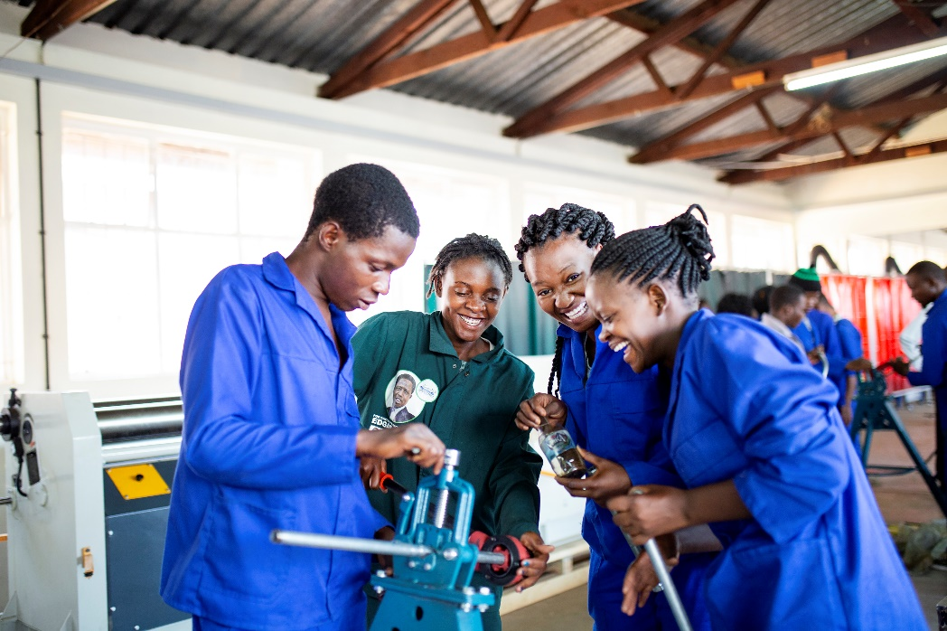
The EU is the biggest provider of development aid in the world
Through aid and cooperation, the European Union supports developing countries and their transition to economic and social stability.
The European Union and its Member States continued to be the world's leading provider of official development assistance in 2018 and stepped up their efforts directed at developing countries.
Collective assistance from the European Union and its Member States amounted to more than €74.4 billion in 2018.
In September 2018, the Africa–Europe Alliance for Sustainable Investment and Jobs was launched. Its aim is to take the EU’s partnership with Africa to the next level by helping to improve job creation in Africa by supporting education and skills, boosting trade and mobilising investment in strategic economic sectors.

Slide 26
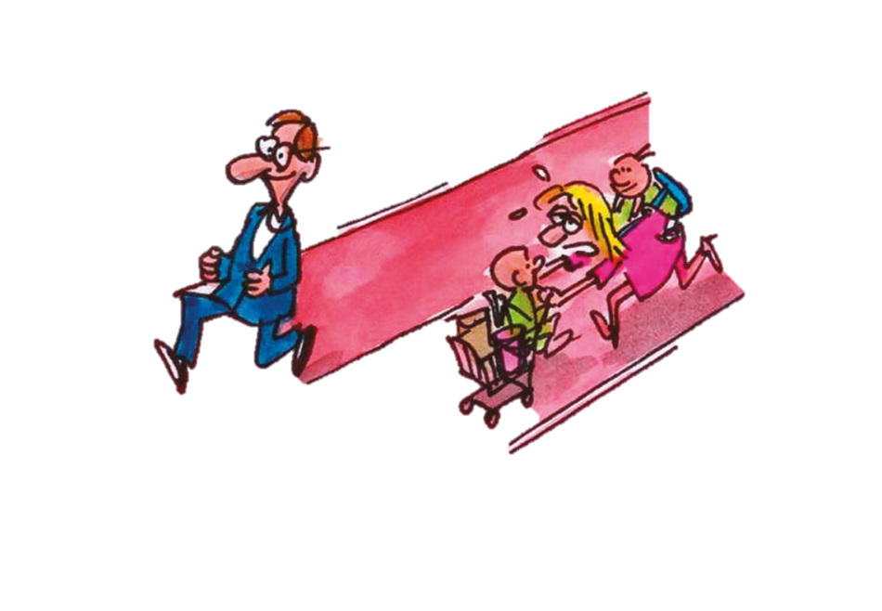
Gender equality
Equality between women and men is a fundamental value of the EU
The EU aims to help women get the jobs they want and the same pay as men, and help them strike a better balance between work and other areas of life:
Employment: In 2017, the share of women in work in the EU went up to 66.6%, compared to nearly 80% of men
Equal pay: On average, women earn 16% less than men in the EU. In November 2017, the EU presented New Start, an Action Plan to close the gap between what women and men are paid
Funding: Investing in specific actions to help get women into work include schemes to retrain and improve skills; helping women return to work after a career break, by providing quality childcare, providing individual guidance to women improving employers’ awareness of the challenges faced by women
The Economy: The gap in employment between men and women costs the EU economy €370 billion per year. Improving gender equality could create 10.5 million jobs by 2050 and boost the EU economy by between €1.95 and €3.15 trillion
Another major priority is to stop violence against women and girls. The EU-funded NON.NO.NEIN campaign, encourages men and women to take a stand on violence against women.

Slide 27
Improving health and the environment
Pollution knows no borders – joint action needed
EU action has helped bring about:
cleaner bathing water
much less acid rain
lead-free petrol
easy and safe disposal of old electronic equipment
strict rules on food safety from farm to fork
more organic and quality farming
more effective health warnings on cigarettes
registration and control of all chemicals (REACH)

Slide 28
Protecting consumers' rights
As a consumer you are protected by basic laws all over the EU, even when you travel or shop online
Clear labelling
Health and safety standards
Unfair practice in contracts prohibited
Passengers’ rights, such as compensation for long delays
Help to resolve problems

Slide 29
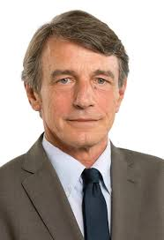
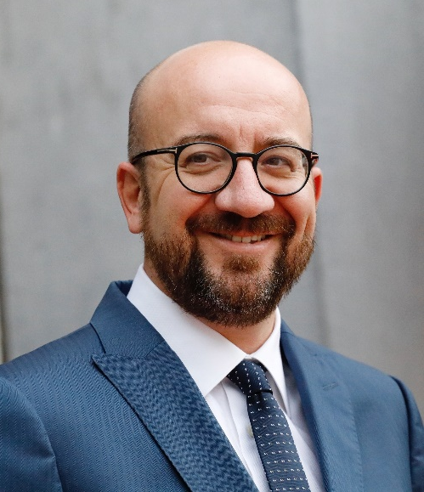
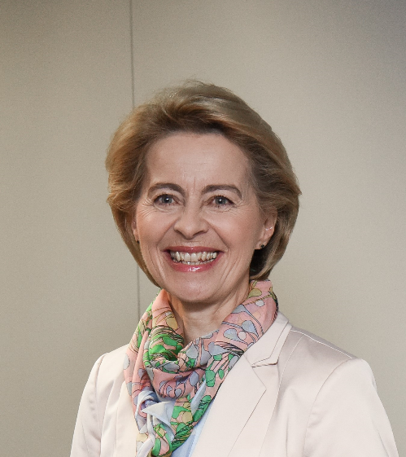
Three key players
The European Parliament
- voice of the people
David Sassoli, President of the European Parliament
The European Council and the Council
- voice of the Member States
Charles Michel, President of the European Council
The European Commission
- promoting the common interest
Ursula von der Leyen, President of the European Commission

Slide 30
The EU institutions
European Council (summit)
European Parliament
Council of Ministers
(The Council)
European Commission
Court of Justice
Court of Auditors
Economic and Social Committee
Committee of the Regions
European Investment Bank
Agencies
European Central Bank

Slide 31
How EU laws are made
Citizens, interest groups, experts: discuss, consult
Commission: makes formal proposal
Parliament and Council of Ministers: decide jointly
National or local authorities: implement
Commission and Court of Justice: monitor implementation

Slide 32
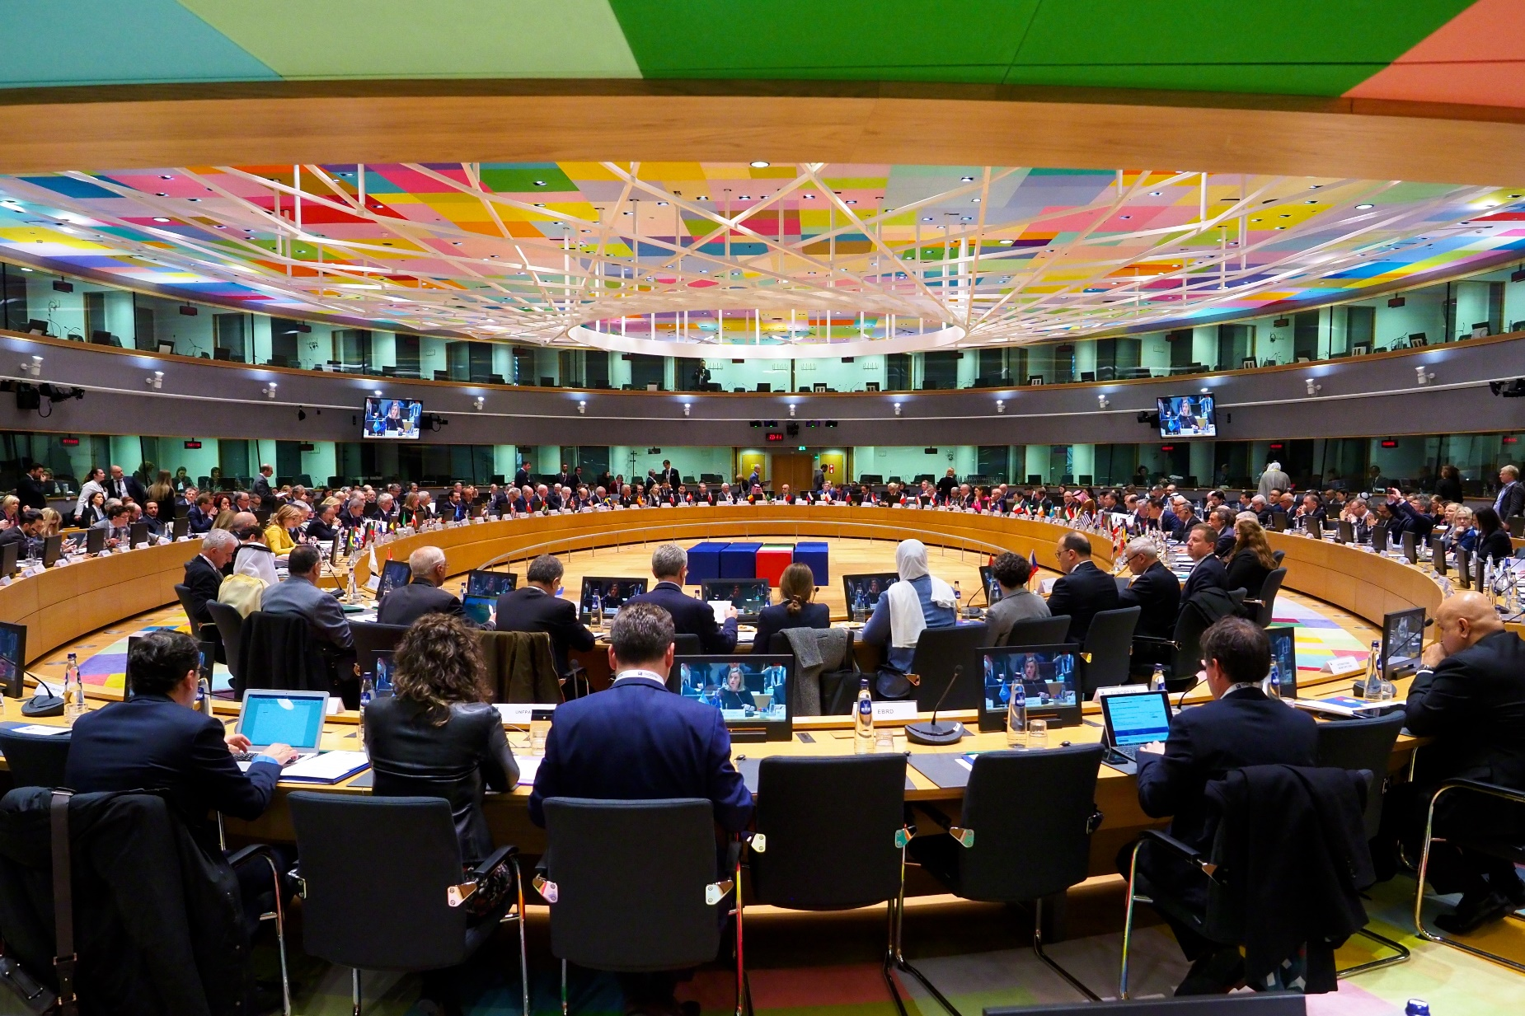
Council of Ministers – voice of the Member States
One minister from each EU country
Presidency: rotates every six months
Decides EU laws and budget together with Parliament
Manages the common foreign and security policy

Slide 33
Council of Ministers – how they vote
Most decisions in the Council are taken by ‘double majority’.
A decision must have the support of at least:
• 55% of Member States
• Member States that represent 65% of the EU’s population

Slide 34
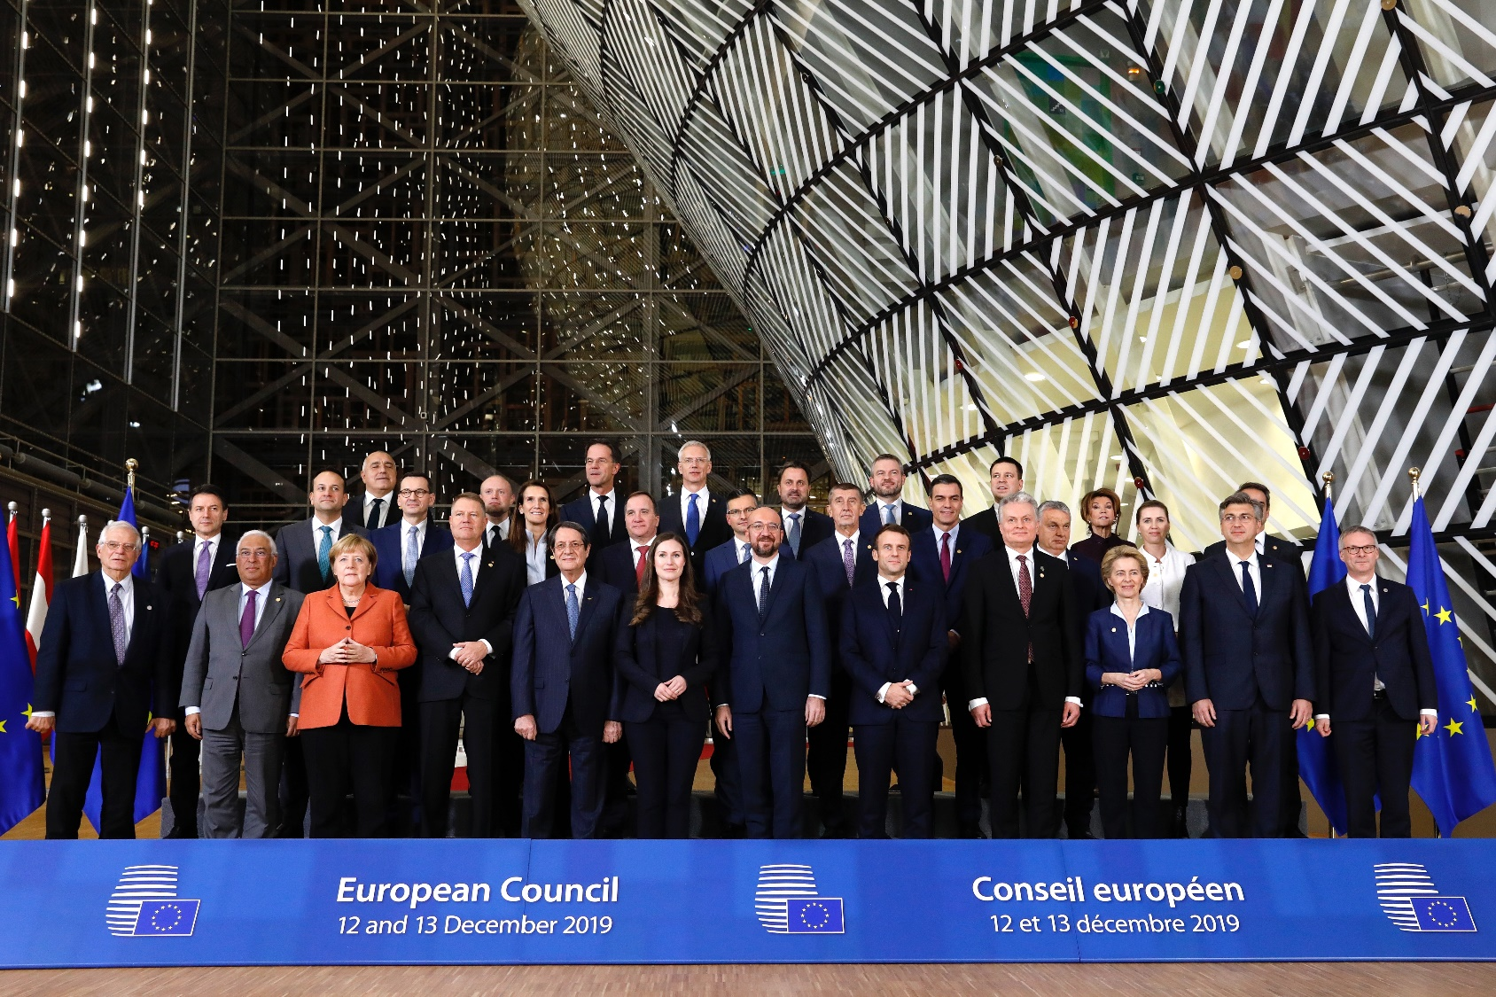
Summit at the European Council
Summit of heads of state and government of all EU countries
Held at least 4 times a year
Sets the overall guidelines for EU policies
President: Charles Michel

Slide 35
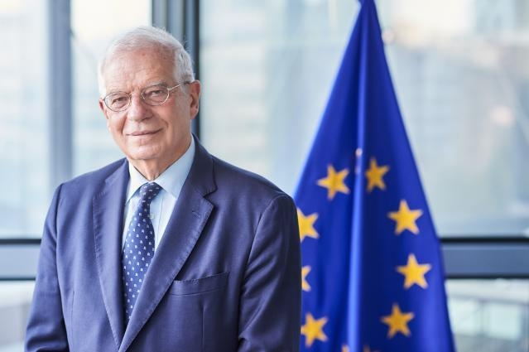
The high representative for foreign affairs and security
Josep Borrell
Double role:
chairs meetings of the Foreign Affairs Council
Vice-President of the European Commission
Manages the common foreign affairs and security policy
Head of the European External Action Service

Slide 36
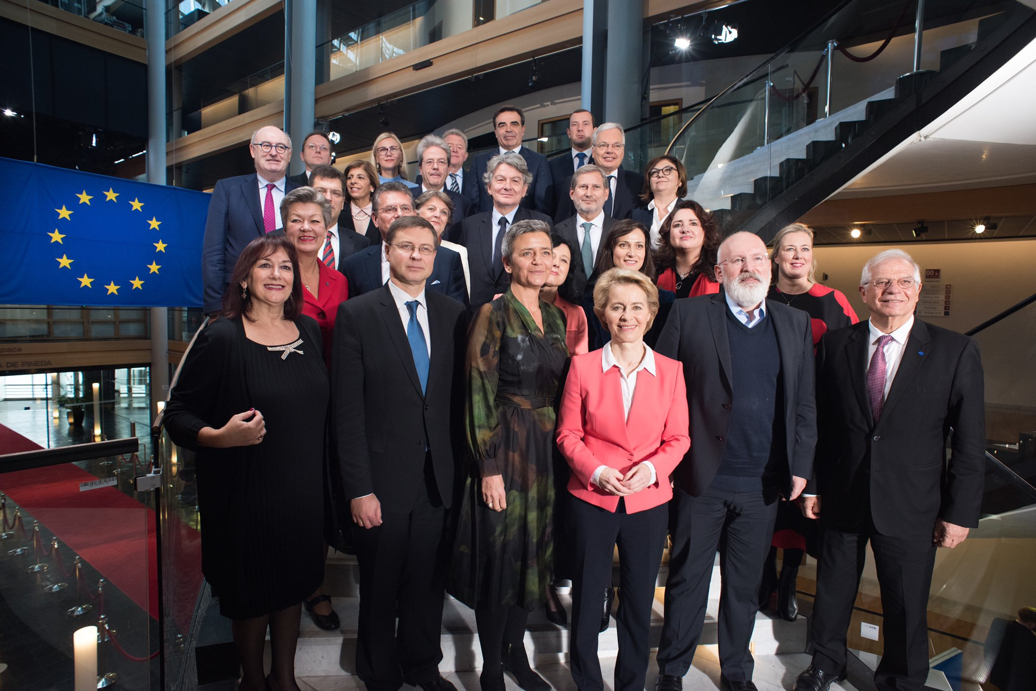
The European Commission – promoting the common interest
27 Commissioners, one from each EU country
Proposes new legislation
Executive organ
Guardian of the treaties
Represents the EU on the international stage

Slide 37
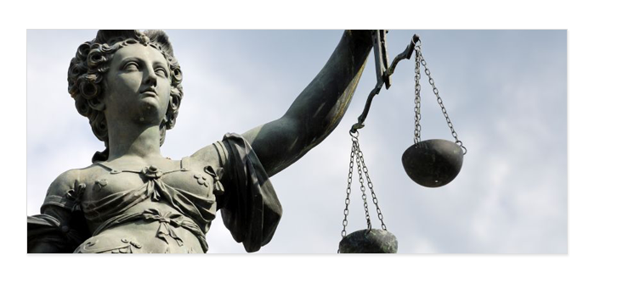
The Court of Justice – upholding the law
27 independent judges, one from each EU country
Rules on how to interpret EU law
Ensures EU countries apply EU laws in the same way

Slide 38
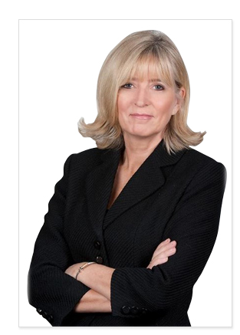
The European Ombudsman
Emily O’Reilly
The European Ombudsman
Investigates complaints about poor or failed administration by the EU institutions
For example: unfairness, discrimination, abuse of power, unnecessary delay, failure to reply or incorrect procedures
Anyone in the EU can make a complaint

Slide 39
The European Court of Auditors: getting value
for your money
27 independent members
Checks that EU funds are used properly
Can audit any person or organisation dealing with EU funds

Slide 40
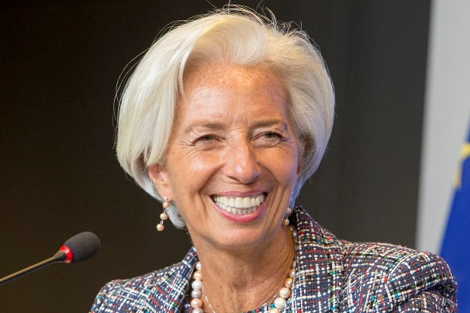
The European Central Bank: managing the euro
Christine Lagarde President of the Central Bank
Ensures price stability
Controls money supply and decides interest rates
Supervises that banks are safe
Works independently from governments

Slide 41
The European Economic and Social Committee: voice of civil society
Represents trade unions, employers, farmers, consumers and so on
Advises on new EU laws and policies
Promotes the involvement of civil society in EU matters

Slide 42
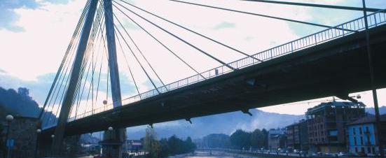
The Committee of the Regions: voice of local government
Represents cities and regions
Advises on new EU laws and policies
Promotes the involvement of local government in EU matters

Slide 43
Getting in touch with the EU
Questions about the EU? Europe Direct can help
By phone, email or webchat
Regional information centres across the EU
europa.eu/europedirect

