Slide 1
The generalized system of preferences

Slide 2
Wto and GSP
Human rights/social rights/environmental standards as an element of international trade.
WTO rules on non-trade measures
Part IV of the GATT (1964):
UNCTAD 1964 non-reciprocal trade concessions from industrialised countries to developing countries
Non-reciprocity and non-discrimination
1971/1979 Enabling Clause: Waiver of Article I , to allow developed countries to accord preferential tariff treatment to products originating in developing countries.

Slide 3
The EU’s GSP
GSP currently in force: Regulation 978/2012 (until 2023). The Commission proposed to extend the current regulation until 2027.
Wto case: India v. EU 2001 GSP and Drug Arrangement
India: The Drug Arrangement was contrary to Article I GATT as it was discriminatory.
The WTO panel: the Drug Arrangement was not unconditional and not generalised
Appellate Body (2004): accepted the EU’s interpretation of non-discrimination: treat different situations differently.

Slide 4
The EU’s GSP
2012 GSP gives priority to sustainable development.
Objective:
«assist developing countries in their efforts to reduce poverty and promote good governance and sustainable development»

Slide 5
The EU’s GSP
ELIGIBILITY
General arrangement - to all developing countries (World Bank data)
Special incentive arrangement for sustainable development and good governance (GSP+) - diversification of treatment among developing countries. Vulnerability and commitment to human rights and sustainable development (application and acceptance in writing of the commitments)
Special arrangement for least-developed countries (EBA)

Slide 6
THE EU’S GSP
ECONOMIC ADVANTAGES – positive conditionality/incentives
RULES OF ORIGIN: Commission Regulation 2454/93 as amended by Commission Regulation 1063/2010
Value added rule: for LDCs 70 % and single transformation for textiles and clothing, for the others, 50 % of foreign inputs.
Cumulation of origins
Administrative semplification: self certification of origin

Slide 7
IMPLEMENTATION
NEGATIVE CONDITIONALITY- SUSPENSION OR WITHDRAWAL OF PREFERENCES
MYANMAR/BURMA 1997
BELARUS 2007
SRI LANKA 2010
BANGLADESH 2013

Slide 8
MYANMAR/BURMA

Slide 9
Myanmar

Slide 10
MYANMAR/BURMA
1997
CFSP sanctions 1997
1997–1998
ILO procedure 1997/98
1997
Commission procedure 1995/1998. GSP suspension 1997
2011
Elections 2011 – Aung San Suu Kuy
2013
In 2013, sanction are lifted at all levels and GSP EBA is reinstated

Slide 11
BELARUS

Slide 12
Belarus

Slide 13
BELARUS
CFSP sanctions 2004 for democratic deficit in parliamentary elections and political repression, partially lifted in 2016. new CFSP sanctions after Russian aggression on Ukraine
ILO inquiry for violations of freedom of association of workers 2003
Commission investigation 2003. temporary withdrawal of GSP 2006, still in force

Slide 14
SRI LANKA

Slide 15
Sri Lanka

Slide 16
SRI LANKA
2010-2017
Tamil Tigers insurgency in the 70s.
EU relations only after 2004 tsunami
GSP since 2008
Special incentive was withdrawn in 2010 after reports of widespread human rights violations
Again in GSP status after 2015 elections (2017)

Slide 17
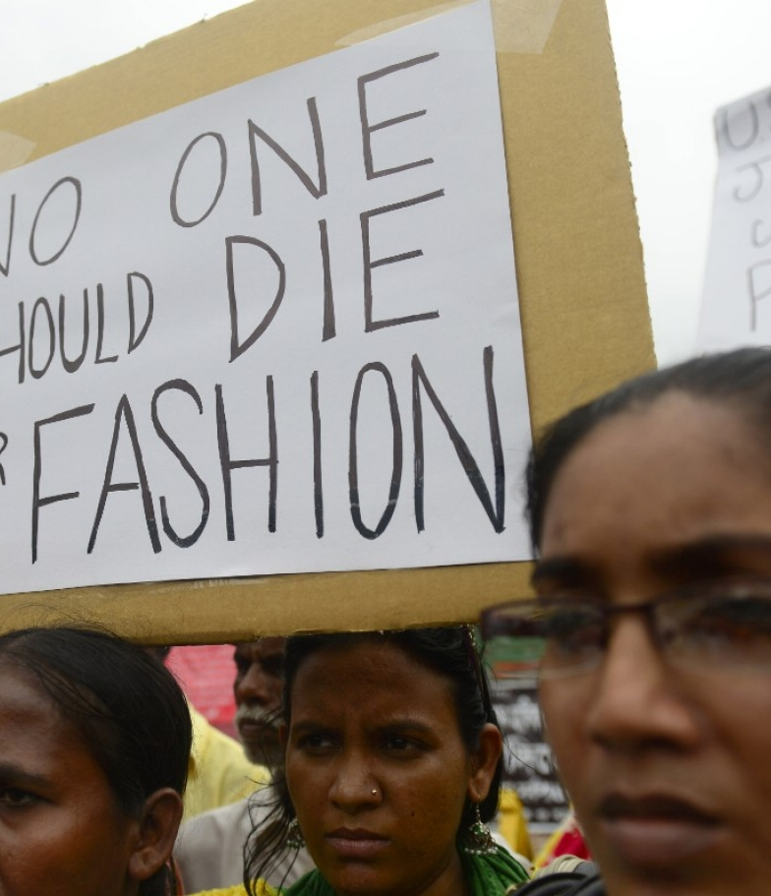
BANGLADESH
From the Rana Plaza disaster to the sustainability Compact

Slide 18
Bangladesh

Slide 19
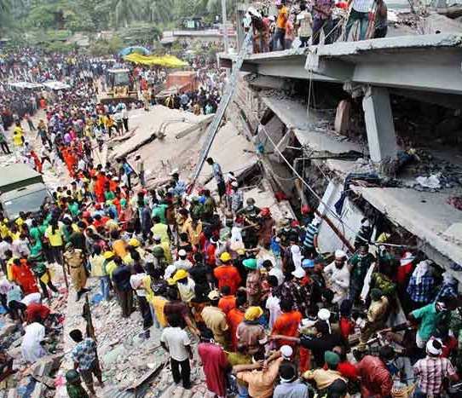
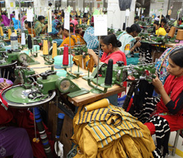
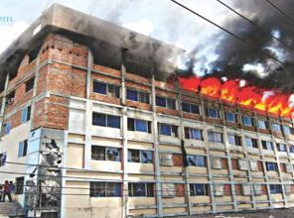
Bangladesh
EBA scheme.
Ready-made garment industry
Fire and building collapse
April 24, 2013 – collapse of the Rana Plaza Factory, with 1136 victims and 2535 injured

Slide 20
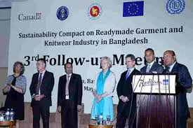
Bangladesh: the Global Sustainability Compact/Accord
Signed July 8, 2013. Participants: EU, ILO, USA, Canada, employers and trade unions
Respect for labour rights
Safety and structural integrity of buildings and health and safety of workers
Responsible business conduct
https://www.dw.com/en/taking-stock-of-bangladeshs-garment-sector/video-61673353.

Slide 21
El Salvador

Slide 22
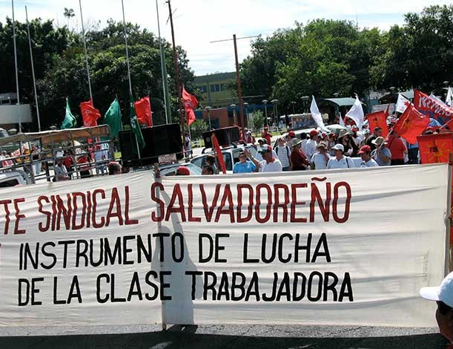
EL SALVADOR
2008: GSP+
Limitations to the right to organize pursuant to ILO Convention 87
Investigation and requirement to revise Article 47 of the Constitution of El Salvador
No withdrawal of GSP+ benefits

Slide 23
Bolivia

Slide 24
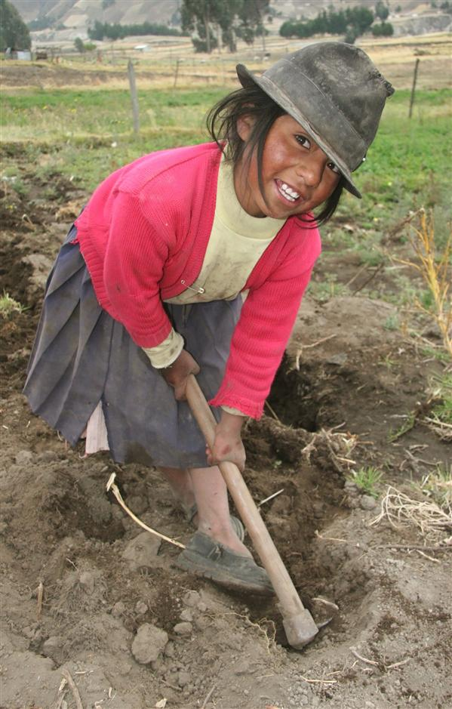
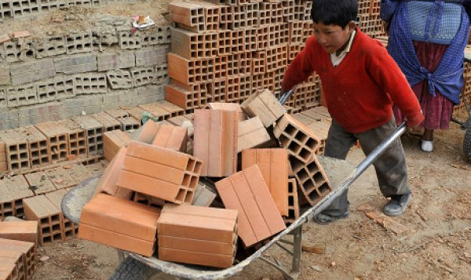
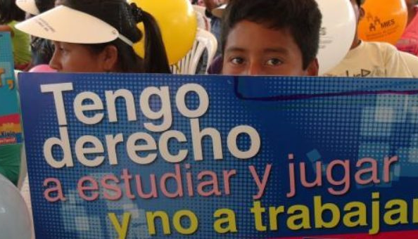
BOLIVIA
July 17, 2014, law on child labour, amended in 2018 to ban child labor under 14 years of age.
ILO and EU investigations. No suspension of gsp

