Slide 1
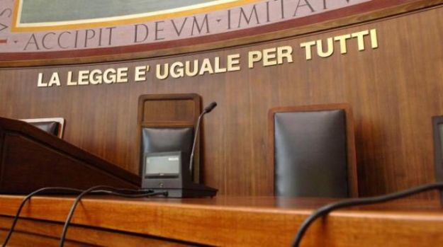
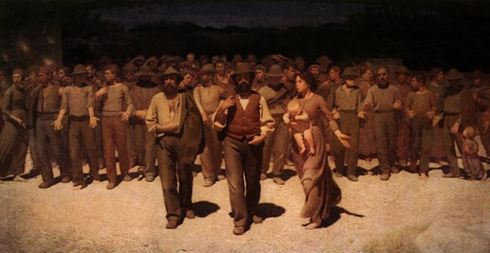
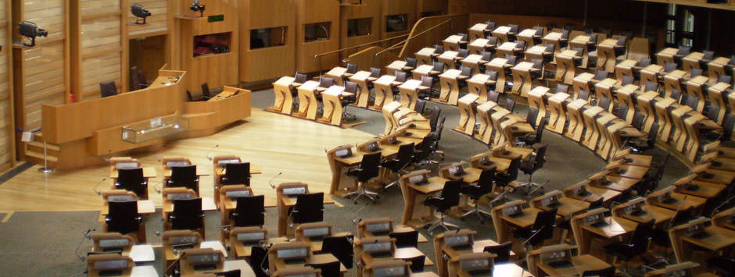
Master’s Degree
LM-55
Cognitive Forensic Sciences

Slide 2
Cognitive Forensic Sciences
Prof. Fabio Ferlazzo
Department of Psychology
Professor of General Psychology
Head of the Programme
fabio.ferlazzo@uniroma1.it

Slide 3
Cognitive Forensic Sciences
Prof. Fabio Ferlazzo
Department of Psychology
My research interests: cognitive processes (executive functions, decision making,…), methodology, extreme environments

Slide 4
Cognitive Science
The interdisciplinary and scientific study of the mind and its processes It examines the nature, the tasks, and the functions of cognition.
Origins: around 1950

Slide 5
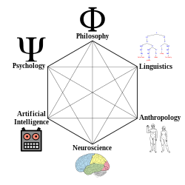
Cognitive Science
Hexagon_with_diagonals.svg: Charles Lowe Human.svg: created by NASA Phi.svg: jossi Psi2.svg: Gdh Lobes_of_the_brain_NL.svg: Mysid

Slide 6
Master’s degrees in Cognitive Sciences in Italy
6 programmes:
University of Milan - Cognitive Sciences and Decision-Making
University of Messina - Cognitive Sciences and Communication theories
University of Trento - Cognitive Science
University of Trento - Human Computer Interaction
University of Chieti/Pescara - Computational Cognitive Science
University Sapienza of Rome - Cognitive Forensic Sciences

Slide 7
Cognitive science has also a strong applied nature:
human error

Slide 8
Cognitive science has also a strong applied nature:
human error
Human error contributes approximately to:
94% of car accidents
90% of industrial accidents
80% of civil aviation accidents
75% of marine accidents
In healthcare, human error causes 250,000 to 440,000 deaths annually (in the United States).
The construction industry reports that human error is responsible for 60% to 80% of workplace accidents

Slide 9
Cognitive science has also a strong applied nature:
human error
Understanding how the cognitive system works might help preventing human errors

Slide 10
Cognitive Forensic Sciences
Forensic scientists—like any other experts—are vulnerable to a wide range of human factors that may influence the value of their work.

Slide 11
Cognitive Forensic
Sciences
Forensic scientists—like any other experts—are vulnerable to a wide range of human factors that may influence the value of their work.

Slide 12
Cognitive Forensic
Sciences
Individuals involved in the legal systems often make decisions and express judgements on the basis of evidence often outside their area of expertise.

Slide 13
Cognitive Forensic
Sciences
Recommendation 5, National Academy of Forensic Science (US)
The National Institute of Forensic Science (NIFS) should encourage research programs on human observer bias and sources of human error in forensic examinations. Such programs might include stud- ies to determine the effects of contextual bias in forensic practice

Slide 14
Cognitive Forensic
Sciences
Master’s Degree, LM-55 Scienze Cognitive
Schools: Medicine and Psychology, Law, Science
2 years

Slide 15
Cognitive Forensic
Sciences
Being a degree in Cognitive Science (LM-55), the programme has a strong multidisciplinary identity (e.g., Psychology, Law, Biology, Maths, Chemistry, Neuroscience, Philosophy)

Slide 16
Course | CFU
FORENSIC DECISION-MAKING - EPISTEMOLOGY AND PROFESSIONAL ETHICS | 6 + 3 Lab
FUNDAMENTALS OF CRIMINAL LAW | 9
PRINCIPLES OF CRIMINAL PROCEDURAL LAW AND INTERNATIONAL CRIMINAL LAW | 6+6
MEMORY - EYEWITNESS TESTIMONY AND EMOTION PSYCHOLOGY | 9 + 3 Lab
MATHEMATICAL MODELS FOR CRIMINAL ANALYSIS | 6
CRIMINOLOGY AND VICTIMOLOGY | 6+6
FORENSIC PSYCHOPATHOLOGY | 6
FORENSIC NEUROPSYCHOLOGY AND RESEARCH METHODS | 6 + 3 Lab
FORENSIC GENETICS AND LAB | 3 + 3 Lab
FORENSIC CHEMISTRY | 6
ONE MODULE CHOSEN BY STUDENT | 9
PSYCHOLOGY OF DEVIANCE AND LEGAL EDUCATION | 6 + 3 Lab
COGNITION AND EMOTION IN FORENSIC SCIENCE: FROM GENES TO BEHAVIOR | 6 + 3 Lab
OTHER TRAINING ACTIVITIES | 3
FINAL THESIS | 12

Slide 17
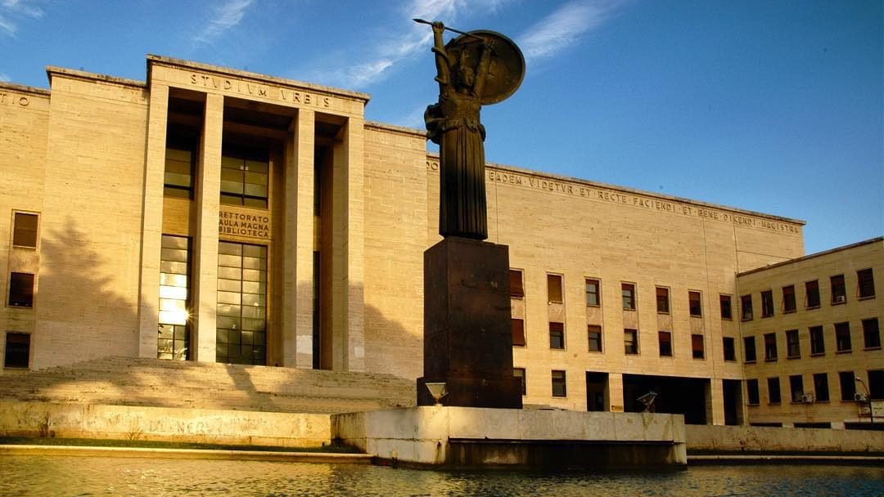
Sapienza University of Rome - 1303

Slide 18
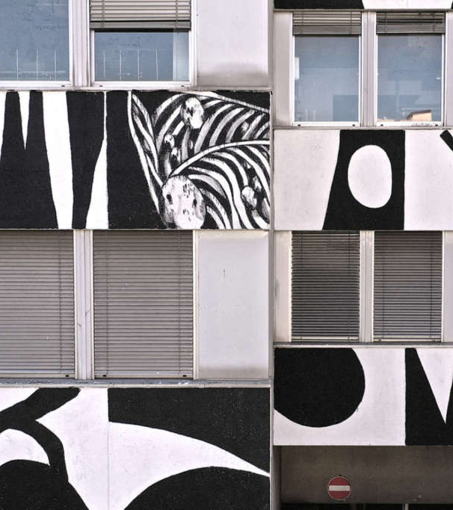
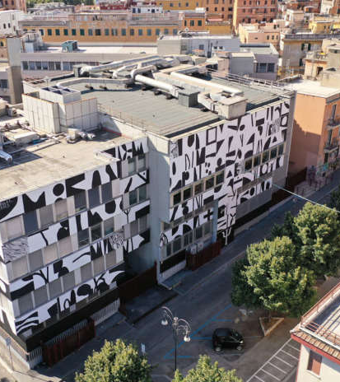
Psychology building

Slide 19
Classrooms (Aule)
Library (Biblioteca Valentini)
Reading hall (sala lettura)
Professors’ offices
Departments (scientific labs)
Courtyard
Psychology building

Slide 20
Sapienza: www.uniroma1.it

Slide 21
Programme https://corsidilaurea.uniroma1.it/en/corso/2022/31781/home

Slide 22
Please, use your Sapienza email address to communicate with offices at Sapienza (and us) Representative: Fabio Ferlazzo, fabio.ferlazzo@uniroma1.it Tutor: Giulia Lausi, giulia.lausi@uniroma1.it

