Slide 1
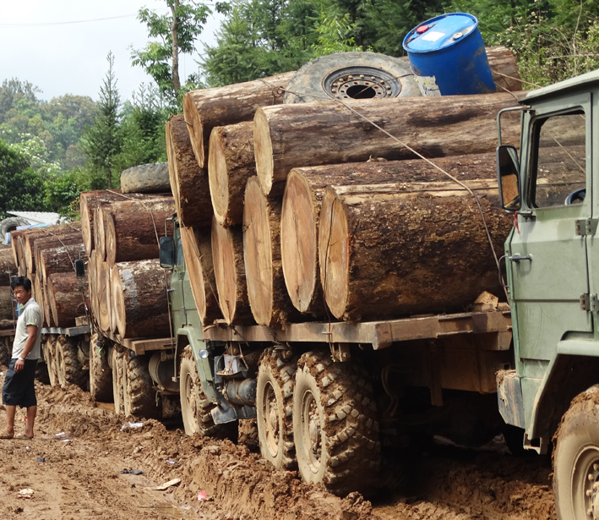
Trade in natural resources
Illegal timber. The FLEGT Regime

Slide 4
REDD+
UN Collaborative programme on Reducing Emissions from Deforestation and Forest Degradation (2007, COP13, Bali)
Conservation of forests and enhancement of forest carbon stocks (REDD+), COP19, Warsaw, 2013.
Article 5 Paris Agreement, 2015, COP21: carbon benefits deriving from the sustainable management of forests.
Incentives to developing countries that adopt measures for the conservation of forests

Slide 5
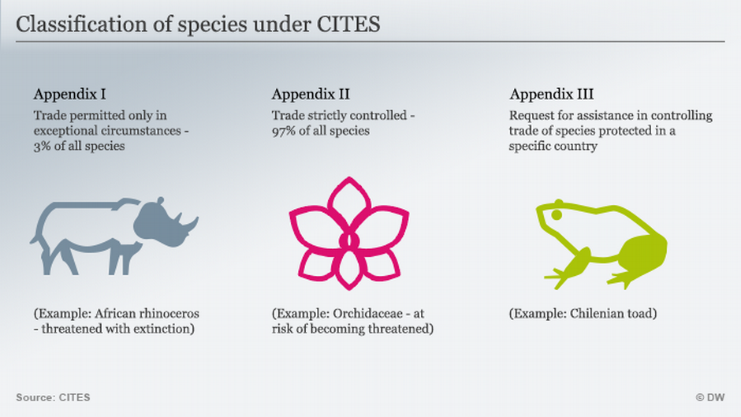
CITES
1973.
A CITES export authorization can replace a FLEGT certification

Slide 6
FLEGT – Forest Law Enforcement, Governance and Trade Licensing scheme
Commission Action Plan in 2003
Regulation No 2173/2005
Voluntary Partnership Agreements

Slide 7
FLEGT Regime. Objectives
Fight against illegal logging (timber harvested in violation of national laws)
Incourage sustainable forest management

Slide 8
Only timber products that have been legally harvested in accordance with the national legislation of the producing country may enter the internal market
Licensing scheme

Slide 10
EUTimber Regulation No 995/2010 prohibition to place on the market illegally harvested timber
Due diligence for EU operators who import timber from third countries
access to relevant information on the timber shipment
Risk assessment
Risk mitigation

Slide 12
Deforestation
Proposal November 17, 2021
REGULATION OF THE EUROPEAN PARLIAMENT AND OF THE COUNCIL
on the making available on the Union market as well as export from the Union of certain commodities and products associated with deforestation and forest degradation

Slide 13
Regulation on deforestation-free products (n. 2023/115)
soy, beef, palm oil, wood, cocoa, coffee, rubber and some of their derived products, such as leather, chocolate, tyres, or furniture
any operator or trader who places these commodities on the EU market, or exports from it, must be able to prove that the products do not originate from recently deforested land or have contributed to forest degradation (Due diligence)
Applicable since the end of 2024
https://www.youtube.com/watch?v=OYD2Nhzj410.
Implications of Europe's Deforestation Law: To Save Forests Or Save Jobs? | CNA Correspondent - YouTube

