Slide 1
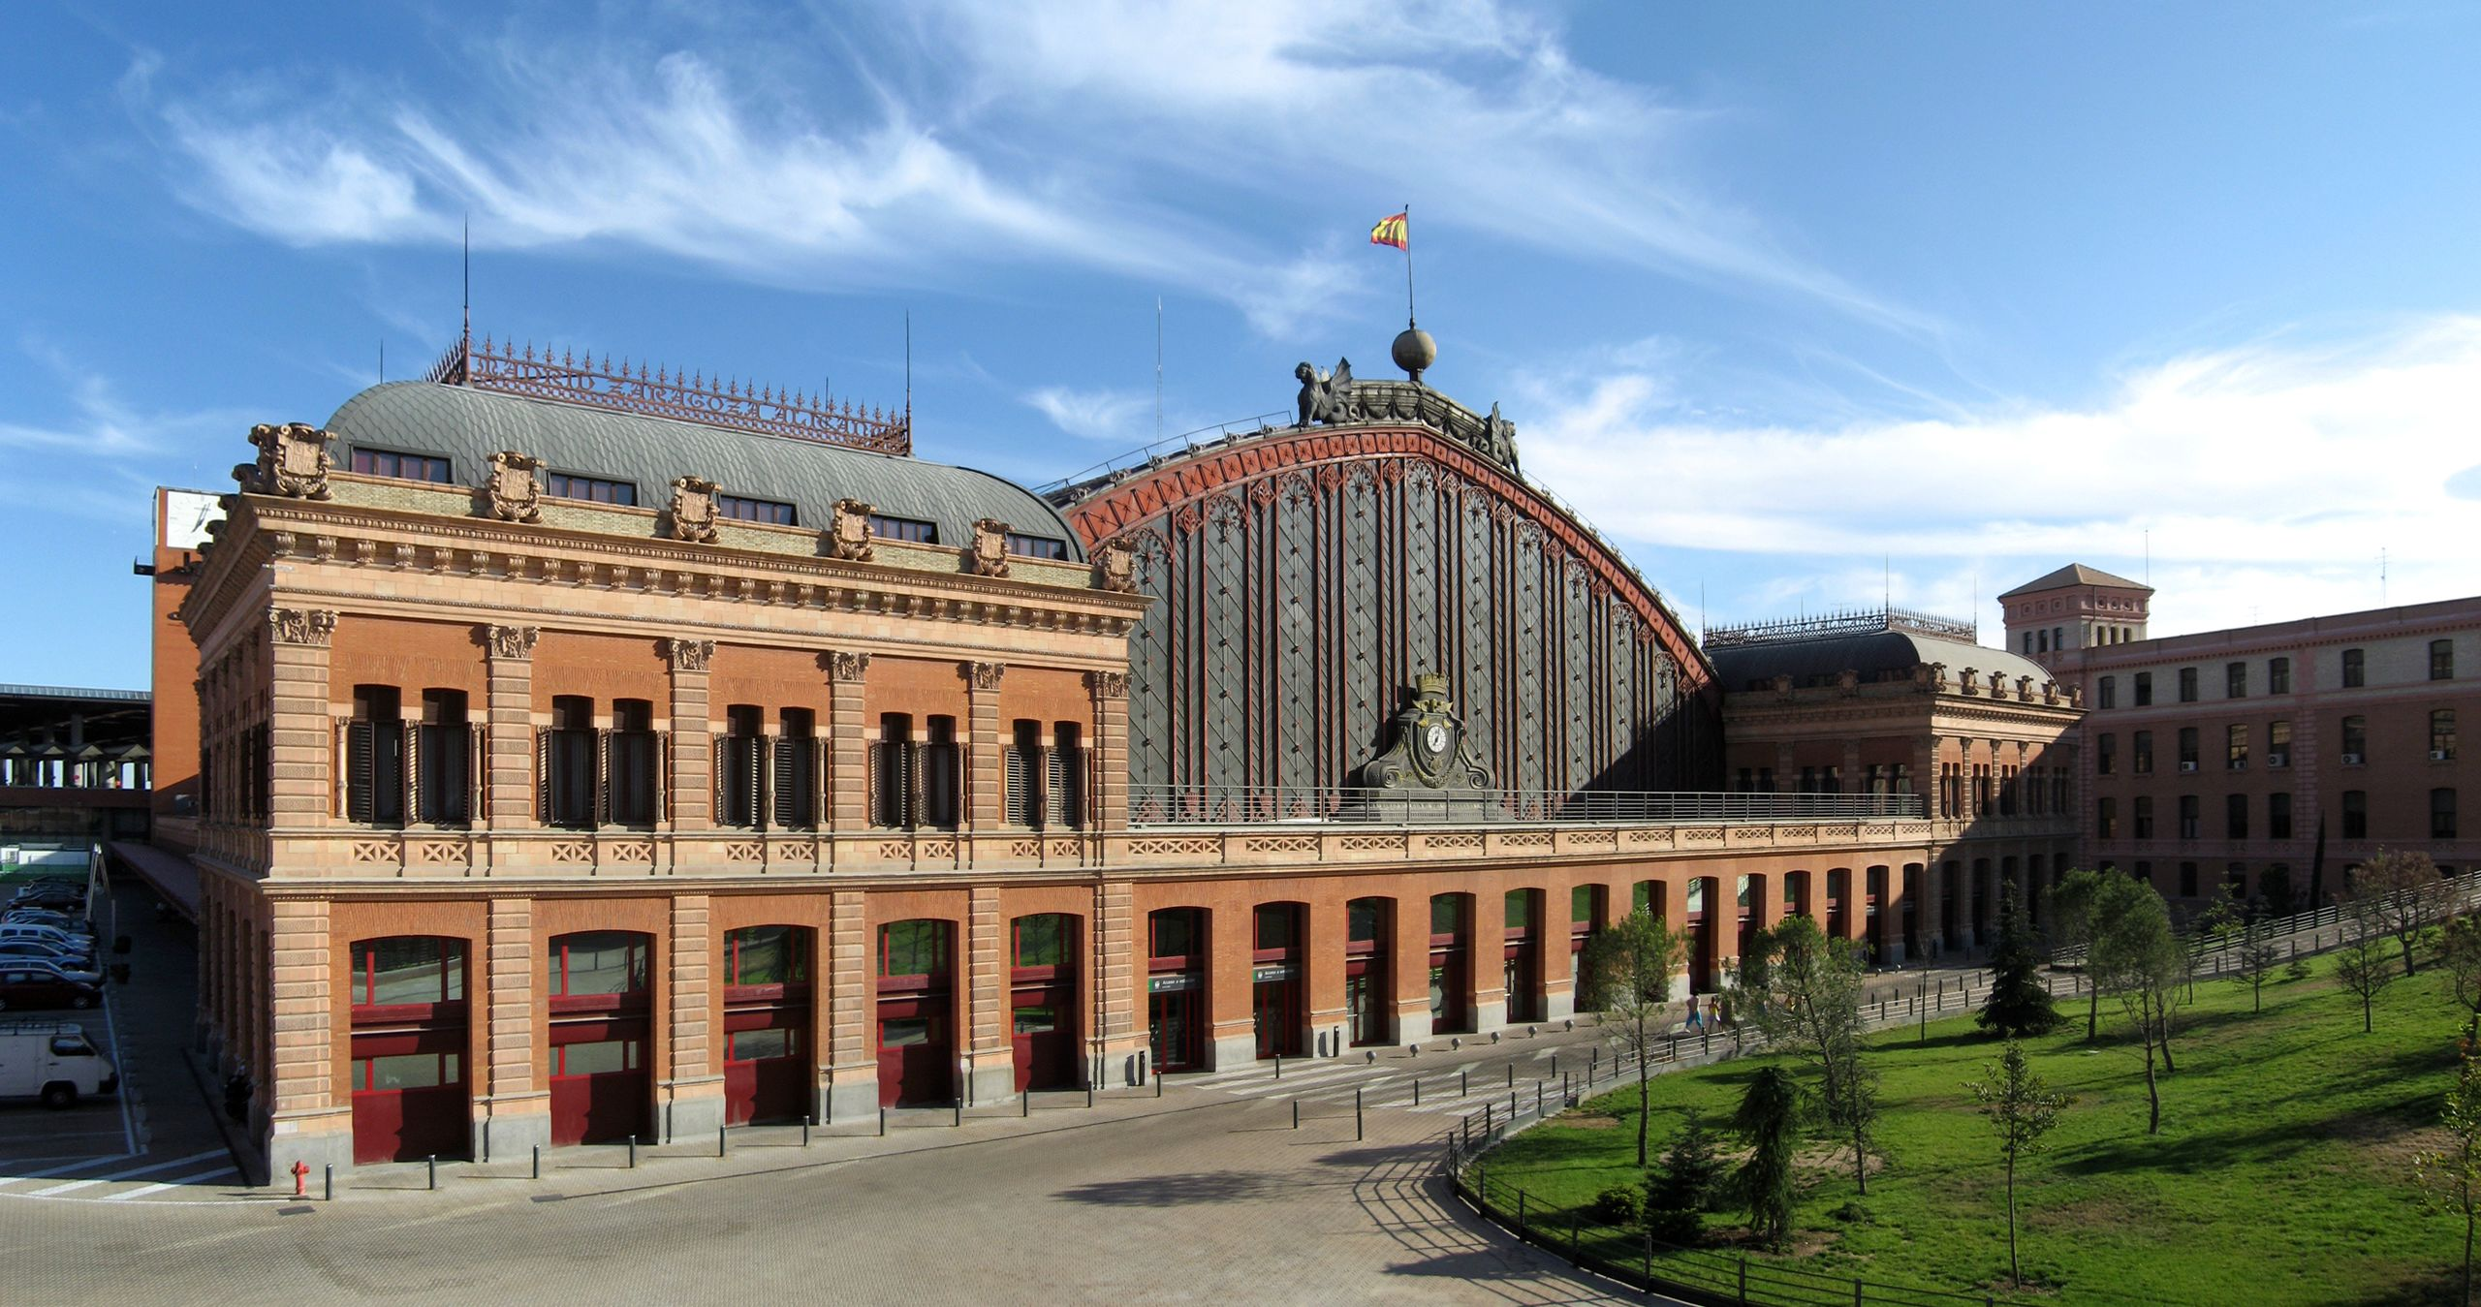
FORENSIC DECISION MAKING
December 11th, 2023
Exterior of the old Atocha Station in Madrid (Gryffindor / CC BY-SA)

Slide 2
Naturalistic Decision Making (NDM)
It was started in 1989 (e.g., Gary Klein) to understand how people make decisions in real, as opposed to artificial laboratory, settings.

Slide 3
Image Theory
Images:
Values (personal principles)
Trajectory (goals)
Strategic (plans)
Projection (anticipated events/states)

Slide 4
Image Theory
2) Decisions:
a) Adoption decisions about the constituents of the images
b) Progresses toward the goal

Slide 5
Image Theory
3) Assessment criteria:
a) Compatibility of the constituents
b) Profitability test

Slide 6
Image Theory
4) Decision rules:
a) Rejection threshold
b) Maximization

Slide 7
Image Theory
Adoption decisions
Progress decisions
Compatibility
test (threshold)
Value image
Compatibility
test (threshold)
Trajectory
image
Single
candidate
Multiple
candidates
Decision
Strategic
image
Profitability
test
Projection
image
Decision

Slide 8
Image Theory (empirical results)
(Pesta, Kass, Dunegan, 2005)
People use different strategies for judgements and decisions
Judgment: people use both negative (violations) and positive (non violations) features (compensatory rule)
Decision: people only use negative features (violations) (screening process)

Slide 9
Image Theory (verifiche empiriche)
(Pesta, Kass, Dunegan, 2005)
Scenario
An employee (John Snyder) in a bookshop
His behavior is described in terms of positive features (non-violations, 1 or 3) and negative features (violations, 1 or 3).

Slide 10
Image Theory (verifiche empiriche)
(Pesta, Kass, Dunegan, 2005)

Slide 11
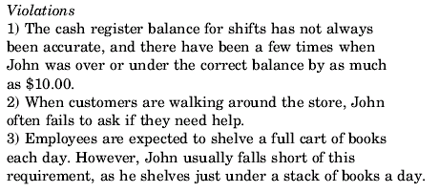
Image Theory (verifiche empiriche)
(Pesta, Kass, Dunegan, 2005)

Slide 12
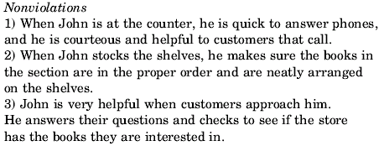
Image Theory (verifiche empiriche)
(Pesta, Kass, Dunegan, 2005)

Slide 13
Image Theory (verifiche empiriche)
(Pesta, Kass, Dunegan, 2005)
Participants must:
Judge the employee (judgement)
2) Decide whether or not to promote him (decision)

Slide 14
Image Theory (verifiche empiriche)
(Pesta, Kass, Dunegan, 2005)
Judge John Snyder
John Snyder is a good employe
John Snyder is a below average employee
(3) overall, how would you rate the performance of John Snyder? (Likert Scale 7 steps)

Slide 15
Image Theory (verifiche empiriche)
(Pesta, Kass, Dunegan, 2005)
Decision about promotion
The owner of the bookstore has asked you to recommend an employee for promotion to the position of Assistant Manager. Would you be willing to recommend that John Snyder be promoted to Assistant Manager?

Slide 16
Image Theory (verifiche empiriche)
(Pesta, Kass, Dunegan, 2005)
107 participants (students of the business school)

Slide 17
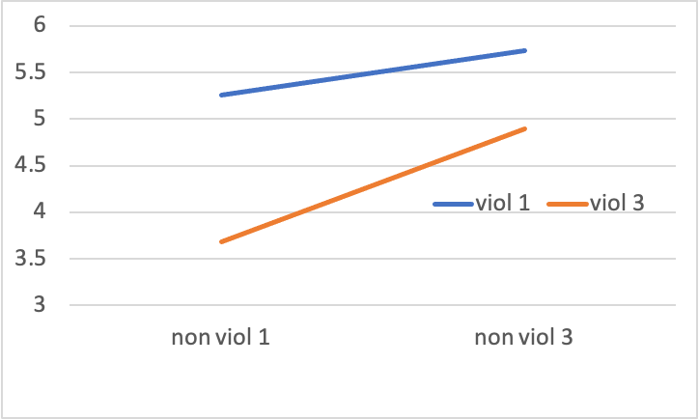
Image Theory (verifiche empiriche)
(Pesta, Kass, Dunegan, 2005)
Results for the judgement task

Slide 18
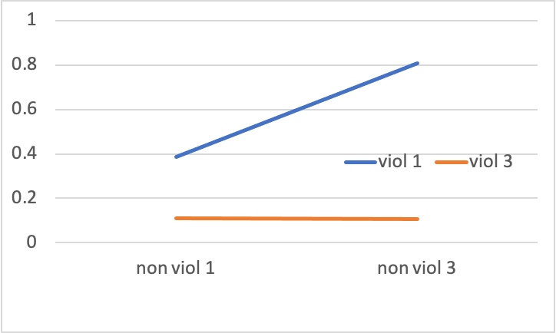
Image Theory (verifiche empiriche)
(Pesta, Kass, Dunegan, 2005)
Results for the decision task

Slide 19
Recognition primed heuristic (G. Klein)
NDM researchers (e.g., Klein, Calderwood, & Clinton-Cirocco, 2010; Klein, Orasanu, Calderwood, & Zsambok, 1993) discovered that decision makers in natural settings relied heavily on intuition.
But how intuition can be defined?

Slide 20
Recognition primed heuristic (G. Klein)
Intuition
Expertise
Mental models

Slide 21
Recognition primed heuristic (G. Klein)
Intuition
Expertise
Mental models
Experts seem to recognize a prime from the environment for a mental model they have of the situation, and make a decision on that ground

Slide 24
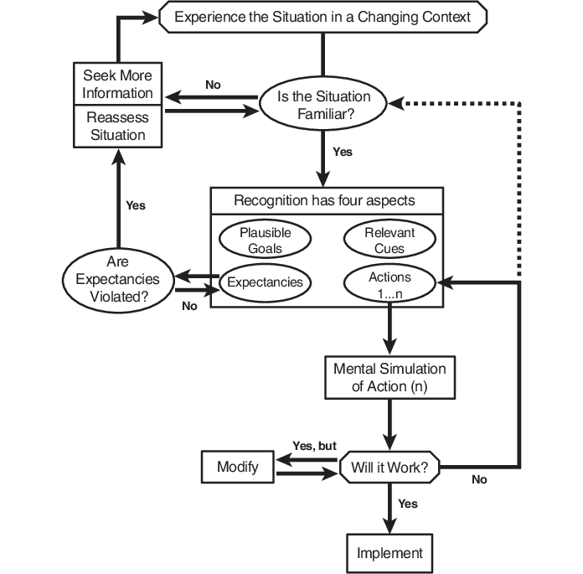
Recognition primed heuristic (G. Klein)

