Slide 1
Presentation made by Angèle Brégea, Thomas Schumacher and Gabrielle de Bernières

Slide 2
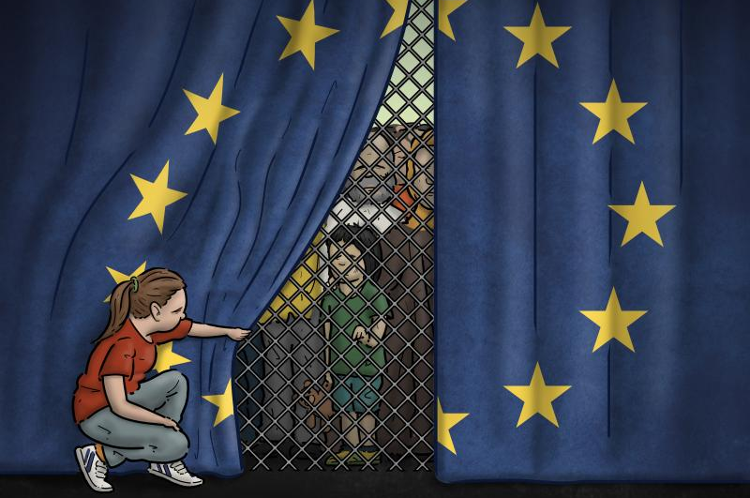
What do you think?
What is the reality?

Slide 3
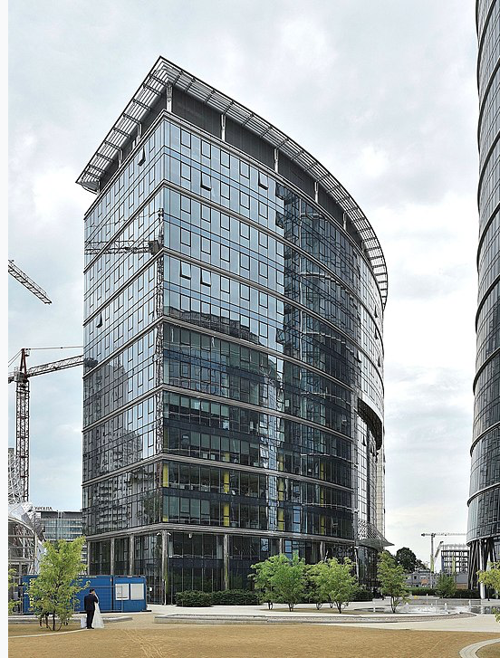
Outline
1. Basics (What should you know about Frontex)
2. Development of Frontex + Current operations
3. Criticism of Frontex
4. Discussion
5. Sources

Slide 4
FRONTEX: what you should know
2 dates to remember:
3 October 2005 : first establishment as the European Agency for the Management of Operational Cooperation at the External Borders
6 October 2016: became a fully-fledged EU’s agency (European Border and Coast Guard Agency) in response to the 2015-2016 European migrant crisis
Headquarters location: Warsaw, Poland

Slide 5
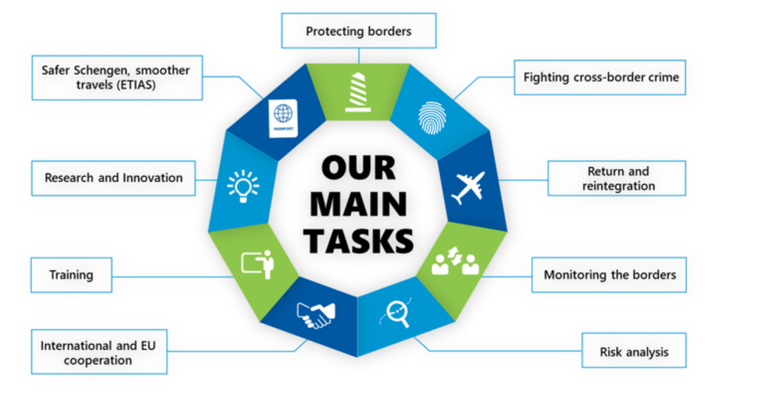
FRONTEX: what you should know
“Frontex, the European Border and Coast Guard Agency, supports EU Member States and Schengen-associated countries in the management of the EU’s external borders and the fight against cross-border crime. (...) They (FRONTEX’s officers) perform a variety of tasks such as border surveillance, fighting cross-border crime, and assisting in return operations. The officers stand together with national authorities to safeguard the Schengen Area, one of Europe’s greatest achievements.”
Source : FRONTEX’s official website (https://frontex.europa.eu/about-frontex/who-we-are/tasks-mission/)

Slide 6
FRONTEX: what you should know
Brief reminder of what Schengen area is
SIS (Schengen Information System): a reference tool in FRONTEX’s work
The 2015-2016’s migrant crisis: a little bit of context that led FRONTEX to evolve

Slide 7
2. Development of FRONTEX
6 million euros 2005 (start)
535 million euros in 2021
2 months ago Frontex accuses Greece of illegal push backs and threatens to end its operation in Greece
Major legislative changes in 2016 and in 2019
845 million euros in 2023
September 2023 EU General Court rejects damage claims against Frontex. Consequence: Further critical examinations are prevented

Slide 8
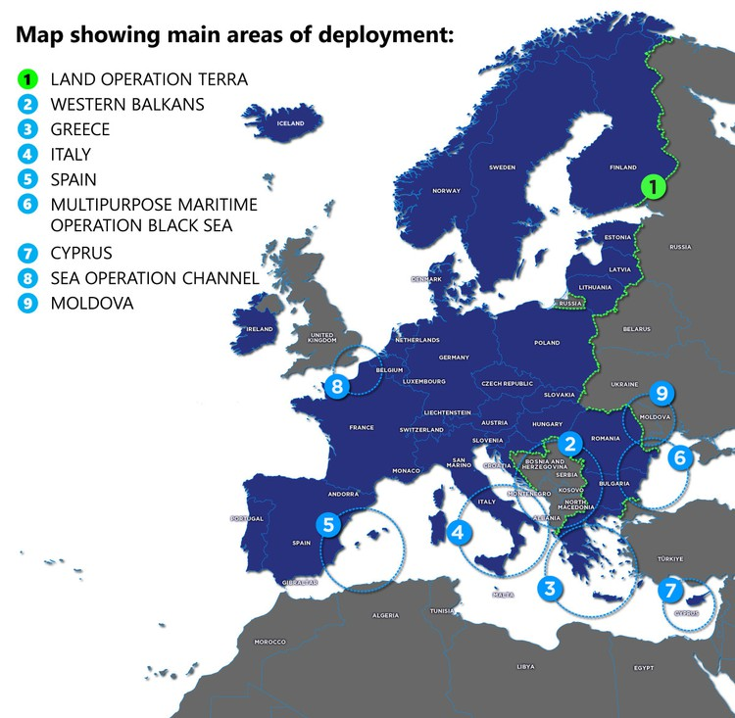
2. Development of FRONTEX
Joint Operation Poseidon in Greece -> 2,272 officers and 117 technical equipment in 2020.
Mrs. Von der Leyen said we need 10 000 Frontex employees now (2024) and not in 2027
Over 20 operations with 2700 officers

Slide 9
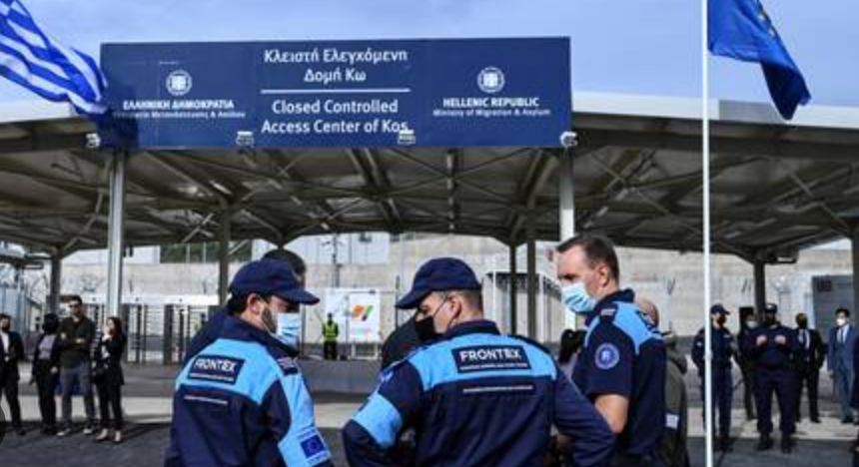
3. Don't ignore debate and criticism
No human fundamentals rights respects :
Example : Greece, 2011
« Frontexit » operation, 2013
Who is responsible ? => Risk externalization and delegation to member states
Lack of transparency, independence and efficiency (European Court of Auditors)
Frontex agents at the greek border

Slide 10
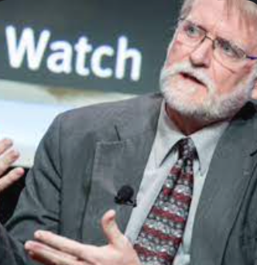
3. Efficiency and future perspectives
Not enough distance… And you, what do you think?
Bill Frelick : « As new migration crises arise in the Mediterranean basin and Frontex's responsibilities increase, it is urgent that asylum policy and Migration Policy of the EU gives priority to the protection of people and not to the application of measures at all costs ». « It is not only a legal obligation, but the EU, its institutions and Member States can and must respect EU-specific standards. »
Bill Frelick, Refugee Policy Director at Human Rights Watch

Slide 11
4. Some questions for you…
Schengen = Free movement within Europe and inter-cultural space => difficult to envisage a war. But could the strengthening of the external border with non-Europeans be a risk ?
Can we link the creation of frontex to the question of protecting European identity (see article Europe and the identity challenge: who are "we"?) by setting up entry controls ?
Are the reforms enough to make up for the criticism ?
What do you expect from an agency like frontex ?

Slide 12
Sources
FRONTEX: institution’s presentation and missions of FRONTEX:
https://frontex.europa.eu/about-frontex/who-we-are/tasks-mission/
https://en.wikipedia.org/wiki/Frontex
https://www.swp-berlin.org/publikation/der-ausbau-von-frontex
https://voxeurop.eu/en/walls-and-forced-returns-europes-only-response-to-migration/
https://frontex.europa.eu/what-we-do/operations/operations/
https://de.statista.com/statistik/daten/studie/1172183/umfrage/budget-der-europaeischen-agentur-fuer-die-grenz-und-kuestenwache-frontex/
https://de.statista.com/statistik/daten/studie/1172183/umfrage/budget-der-europaeischen-agentur-fuer-die-grenz-und-kuestenwache-frontex/
https://www.google.com/search?q=frontex+helps+refugees+English&tbm=isch&ved=2ahUKEwipzpfchtOBAxWP3wIHHdqCByMQ2-cCegQIABAA&oq=frontex+helps+refugees+English&gs_lcp=CgNpbWcQAzoHCAAQGBCABFC3BljKG2DBHWgAcAB4AIAB9AGIAf0TkgEGMC4xMi4zmAEAoAEBqgELZ3dzLXdpei1pbWfAAQE&sclient=img&ei=wHQYZanuPI-_i-gP2oWemAI&bih=739&biw=1536&client=firefox-b-d#imgrc=-Uq8Lxc3UwEAUM
Precisions about Schengen area:
https://en.wikipedia.org/wiki/Schengen_Area
Migrants crisis:
https://wol.iza.org/uploads/articles/550/pdfs/european-asylum-policy-before-and-after-the-migration-crisis.pdf
https://en.wikipedia.org/wiki/2015_European_migrant_crisis

Slide 13
Sources
Schengen Information System (SIS):
https://home-affairs.ec.europa.eu/policies/schengen-borders-and-visa/schengen-information-system_en
Criticisms :
https://www.lemonde.fr/international/article/2022/04/27/refoulements-en-mer-egee-les-recensements-errones-ou-mensongers-de-frontex_6123944_3210.html
https://fr.euronews.com/my-europe/2021/06/18/frontex-est-critiquee-de-toute-part-pour-sa-gestion-des-frontieres-de-l-ue
https://www.touteleurope.eu/institutions/qu-est-ce-que-l-agence-europeenne-de-garde-frontieres-et-de-garde-cotes-frontex/
https://www.cncd.be/Frontex-Droits-humains-en-danger
https://www.courrierinternational.com/article/immigration-la-cour-des-comptes-europeenne-attaque-frontex

