Slide 1
Climate change and migration. Some legal considerations

Slide 2
Climate change is the most relevant driver of migration, especially internal, but also international

Slide 3
IPCC Synthesis Report March 2023
Migration/displacement: a response to climate change, rather that a form of adaptation

Slide 4
GRID-2023
Global Report on Internal Displacement 2023, with data from 2022, was released on 11 May 2023 by the Internal Displacement Monitoring Center (IDMC), part of the Norwegian Refugee Council

Slide 5
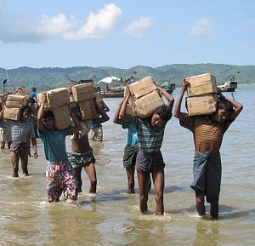
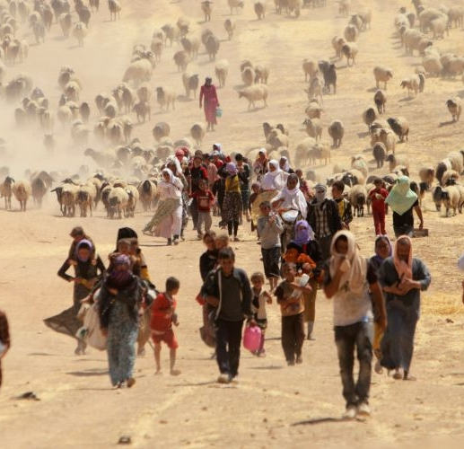
Nexus between climate change and migration. Problematic aspects

Slide 7
Definizioni e concetti - scenari
IOM Definition of Climate displaced persons
«Persons or groups of persons who, for compelling reasons of sudden or progressive changes in the environment as a result of climate change that adversely affect their lives or living conditions, are obliged to leave their habitual homes, or choose to do so, either temporarily or permanently, and who move either within their own country or abroad»

Slide 9
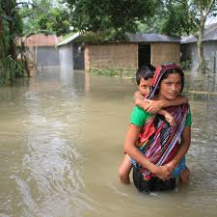
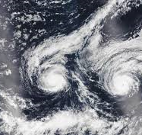
Scenarios. I. sudden-onset disasters

Slide 10
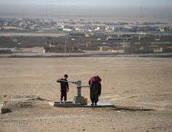
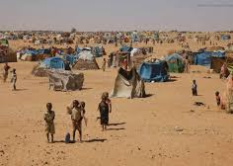
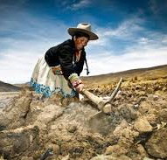
Scenario II – slow-onset environmental degradation

Slide 11
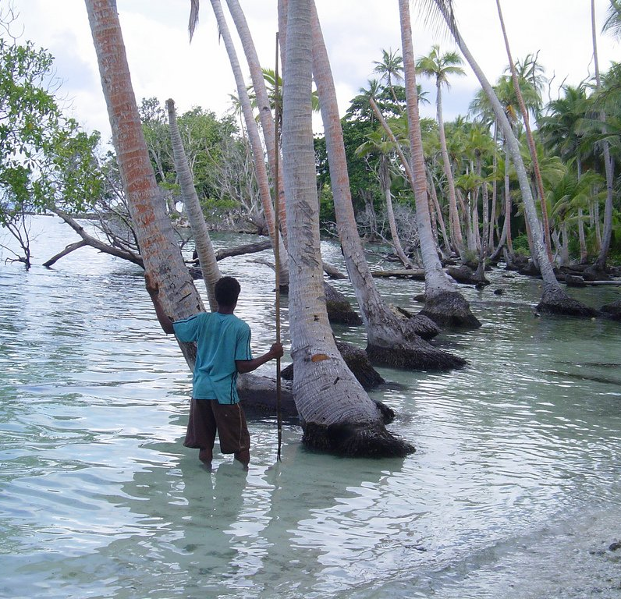
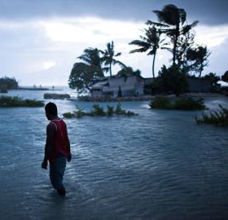
Scenario III – sinking small islands

Slide 12
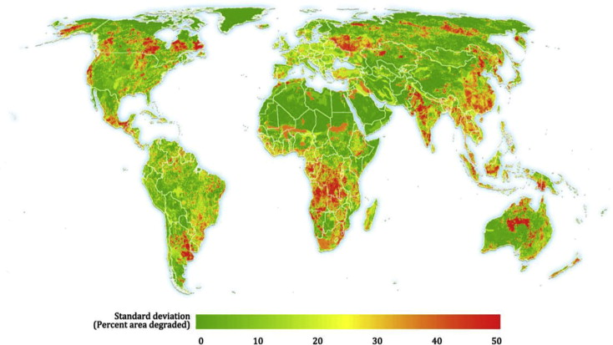
Scenario IV – designated high-risk areas
Programmed delocations, usually within the territory of the State

Slide 13
12 Alaska Native Villages

Slide 14
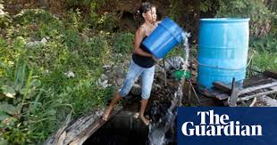
Scenario V – disorders creating serious disturbance to public order, violence, armed conflicts, which can be provoked, at least partially, by the scarsity of essential resources due to climate change

Slide 15
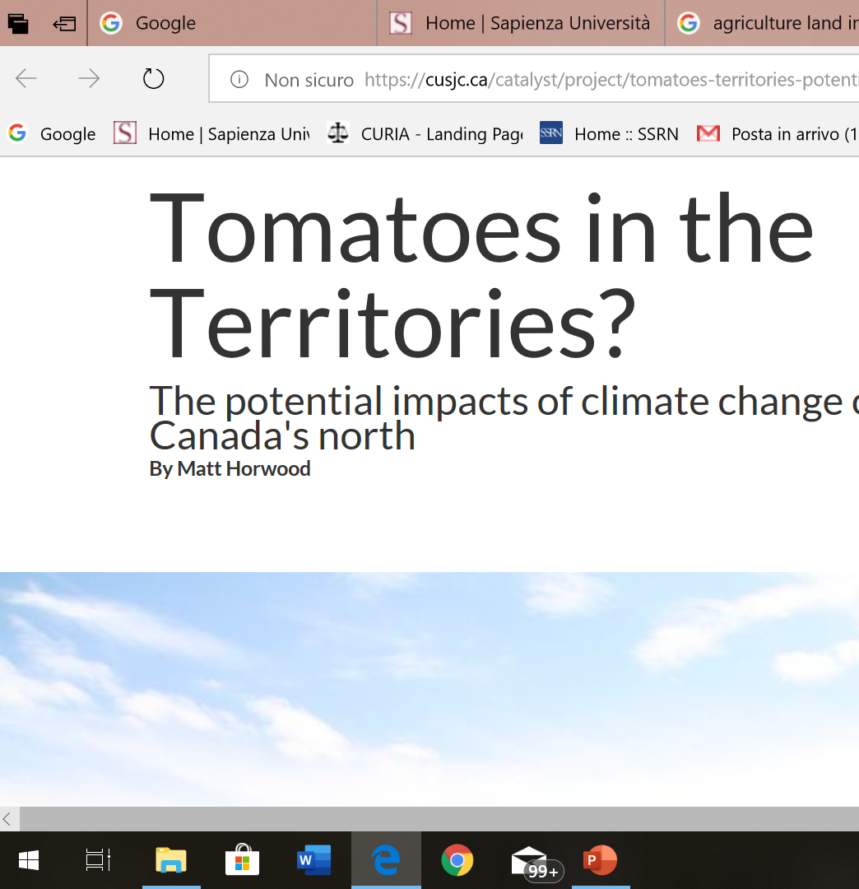
Scenario VI: pull factors created by climate change

Slide 16
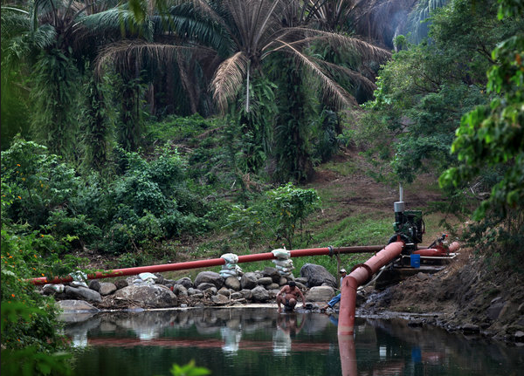
Scenario VII: economic incentives induced by actions for the mitigation of climate change

Slide 17
scenario VII
Biofuels
Extintion of industries like coal
Reforestation
Land-grabbing
Indirect land-use change

Slide 18
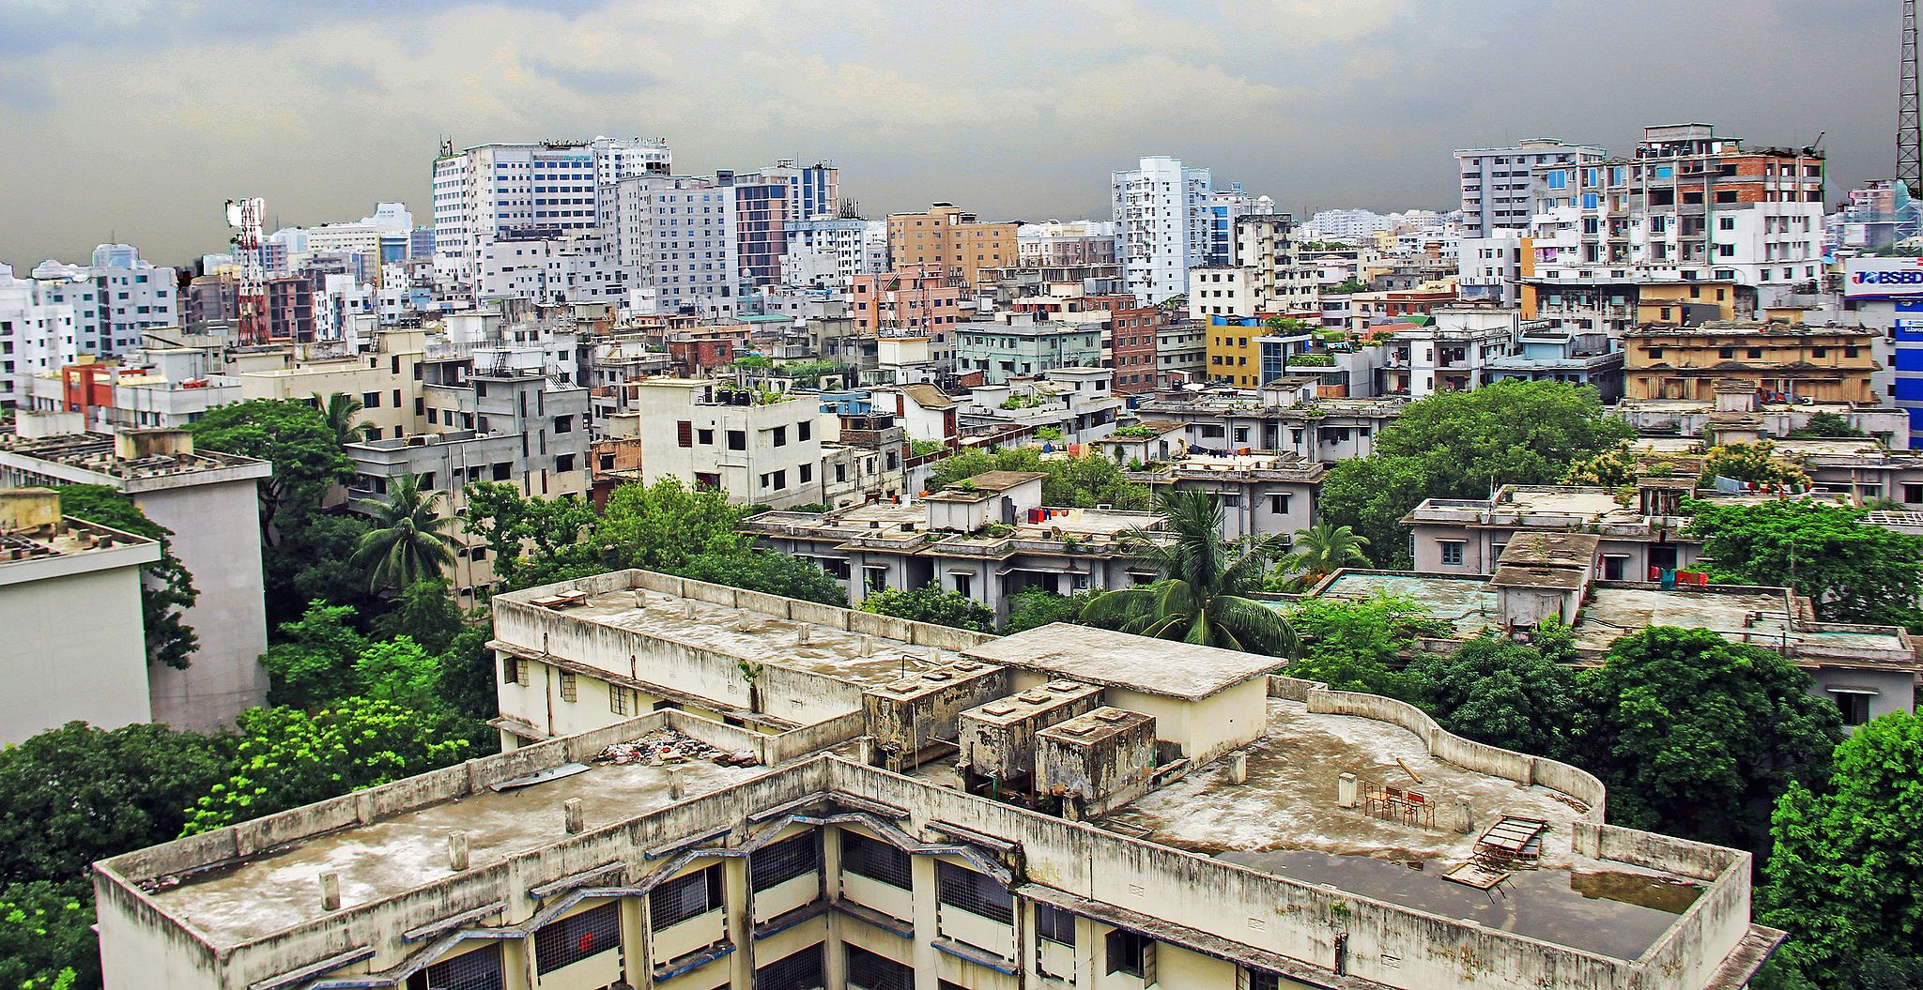
Scenario VIII: domino effect

Slide 19
scenario VIII
Urban elites leave the cities under the demographic pressure of internal migration due to climate change, which is exacerbating urbanization, especially in developing and vulnerable countries.
Usually these people are affluent people and resettle abroad

Slide 20
Water insecurity: a specific factor for migration

Slide 21
Hydric stress and migration. 4 possible scenarios
1. See-level rise
2. sudden-onset disasters: hurricanes, floods, drought
3. progressive degradation of the quality and quantity of water for essential needs
4. Sudden or slow-onset increase of the number of persons arriving at a location, urban or rural, as a result of migration, creating a water stress in the hosting communities. Water insecurity is in this case both cause and effect of migration

Slide 22
Intertwining factors
A) economic: vulnerability of the population, poverty, lack of resilience
B) political: bad governance, industrial and agricultural policies of the governments
C) social: both in the country of origin and in the country of destination
D) environmental: geographic conditions on which climate change impacts

Slide 23
E) gender:
Women and girls are more vulnerable to water scarsity

Slide 24
Legal instruments for the protection of CDPs
Instruments for the protection of migrants, refugees and IDPs (migration law)
Instruments for the mitigation of climate change, for adaptation to the impact of climate change

Slide 25
Instruments for the protection of the rights of migrants
UN Convention fo the protection of the rights of all migrant workers and of their family members (1990, in force since 2003)
ILO Conventions on the protection of migrant workers:
Migration for Employment Convention (n. 97, 1949), 50 ratifications
Migrant Workers Convention (n. 143, 1975), 24 ratifications. 2 parts: I. Migrations in abusive conditions; II. Equality of opportunities and treatment.

Slide 26
Geneva Convention of 1951 on the status of refugee, Article 1, A) 2)
Any person who owing to well- founded fear of being persecuted for reasons of race, religion, national- ity, membership of a particular social group or political opinion, is out- side the country of his nationality and is unable or, owing to such fear, is unwilling to avail himself of the protection of that country; or who, not having a nationality and being outside the country of his former habitual residence as a result of such events, is unable or, owing to such fear, is unwilling to return to it. I

Slide 27
UNHCR- October 2020
Legal considerations regarding claims for international protection made in the context of the adverse effects of climate change and disasters
Interaction with other migration drivers
Application of the Geneva Convention of 1951
Regional criteria (OUA Convention 1969 and Cartagena Declaration 1984)
Complementary forms of international protection

Slide 28
OAU CONVENTION GOVERNING THE SPECIFIC ASPECTS OF REFUGEE PROBLEMS IN AFRICA, Addis Ababa 1969
Art. 1: “2. The term "refugee" shall also apply to every person who, owing to external aggression, occupation, foreign domination or events seriously disturbing public order in either part or the whole of his country of origin or nationality, is compelled to leave his place of habitual residence in order to seek refuge in another place outside his country of origin or nationality”.

Slide 29
Declaraciòn de Cartagena 1984, conclusiòn tercera
“Reiterar que, en vista de la experiencia recogida con motivo de la afluencia masiva de refugiados en el área centroamericana, se hace necesario encarar la extensión del concepto de refugiado, teniendo en cuenta, en lo pertinente, y dentro de las características de la situación existente en la región, el precedente de la Convención de la OUA (artículo 1, párrafo 2) y la doctrina utilizada en los informes de la Comisión Interamericana de Derechos Humanos. De este modo, la definición o concepto de refugiado recomendable para su utilización en la región es aquella que además de contener los elementos de la Convención de 1951 y el Protocolo de 1967, considere también como refugiados a las personas que han huido de sus países porque su vida, seguridad o libertad han sido amenazadas por la violencia generalizada, la agresión extranjera, los conflictos internos, la violación masiva de los derechos humanos u otras circunstancias que hayan perturbado gravemente el orden público”.

Slide 30
IGAD Protocol on Free Movement (26 February 2020)

Slide 31
IGAD Protocol.
Intergovernmental Authority on Development (Member States: Gibuti, Etiopia, Kenya, Somalia, Sudan, Sud Sudan, Uganda, Eritrea)
Art. 16: Citizens of Members States may cross international borders ‘in anticipation of, during or in the aftermath of disaster’.

Slide 32
Legal instruments for the protection of IDPs

Slide 33
Great Lakes IDP Protocol 2006 Angola, Burundi, Central African Republic, Republic of Congo, Democratic Republic of Congo, Kenya, Uganda, Rwanda, Republic of South Sudan, Sudan, Tanzania and Zambia.
Art. 1.
Internally Displaced Persons: persons or groups of persons who have been forced or obliged to flee or to leave their homes or places of habitual residence, in particular as a result of or in order to avoid the effects of armed conflict, situations of generalized violence, violations of human rights or natural or human-made disasters, and who have not crossed an internationally recognized State border;
5. Internally Displaced Persons: also means persons or groups of persons who have been forced or obliged to flee or to leave their homes or places of habitual residence, in particular as a result of or in order to avoid the effects of large scale development projects, and who have not crossed an internationally recognized State border

Slide 34
Kampala Convention (African Union Convention for the Protection and Assistance of IDPs in Africa, 2009)
Contracting States: 40 out of 55 Members of the AU
Updates and renders binding the Guiding Principles
Transforms the legal framework centered on human rights in a system based on State responsibility and on the involvement and responsibility of other actors: AU, other international organizations, civil society organizations, non-State actors, especially opposition armed groups.

Slide 35
Sustainable development goals and IDPs

Slide 36
International cooperation in the fight against climate change
Mitigation of climate change with the reduction of GHG emissions and reinforcement of carbon sink (forests and other carbon sinks): UNFCCC 1992, Kyoto Protocol 1997, Paris Agreement, 2015).
Adaptation to climate change (Bali Action Plan 2007, Cancùn Agreement 2010, Paris Agreement 2015); financial aid to most affected States (2013, Warsaw international mechanism for loss and damage associated with climate change impacts)

Slide 37
Cancùn Adaptation Framework 2011 (COP16), par. 14(f)
14. Invites all Parties to enhance action on adaptation under the Cancun Adaptation Framework, taking into account their common but differentiated responsibilities and respective capabilities, and specific national and regional development priorities, objectives and circumstances, by undertaking inter alia, the following: … (f) Measures to enhance understanding, coordination and cooperation with regard to climate change induced displacement, migration and planned relocation, where appropriate, at national, regional and international levels

Slide 38
COP18, Doha, 2012
Decision on loss and damage associated to climate change: «enhance the understanding of… how impacts of climate change are affecting patterns of migration, dispacement and human mobility»

Slide 39
COP 19, 2013 Warsaw international mechanism for loss and damage

Slide 40
COP21 Paris 2015, Final Declaration
Also requests the Executive Committee of the Warsaw International Mechanism to establish, according to its procedures and mandate, a task force to complement, draw upon the work of and involve, as appropriate, existing bodies and expert groups under the Convention including the Adaptation Committee and the Least Developed Countries Expert Group, as well as relevant organizations and expert bodies outside the Convention, to develop recommendations for integrated approaches to avert minimize and address displacement related to the adverse impacts of climate change

Slide 41
UN World Conference – Sendai 2015
Sendai Framework for Disaster Risk Reduction 2015-2030
Climate change enhances the risk of natural catastrophes and it is necessary to promote the preparation of the most vulnerable communities to «disaster-induced displacement»

Slide 42
COP-27, Sharm-el-Sheik, 2022
The final Declaration refers to «displacement» and «migration» as one of the many «gaps» that must be addressed quickly during the discussions of the financing of the new mechanisms of loss and damage.

Slide 43
2015 Suva Declaration on Climate Change Pacific Island Development Forum
7. Highlight that irreversible loss and damage caused by climate change goes beyond adaptation and is already a reality for PSIDS if there is inadequate mitigation action, and that climate change is already resulting in forced displacement of island populations and the loss of land and territorial integrity and further highlight that such loss and damage results in breaches of social and economic rights;

Slide 44
Nansen Initiative 2012-2015 intergovernmental consultation and consensus-building

Slide 45
Ottobre 2015, approvata da 109 Stati. illustra le priorità nella gestione delle migrazioni climatiche.

Slide 46
Giurisprudenza di corti nazionali
Caso Ioane Teiota, 2015: la Corte suprema neozelandese, pur negando il riconoscimento dello status di rifugiato al ricorrente, ha riconosciuto che esiste una complessa relazione tra disastri naturali, degrado ambientale e vulnerabilità umana e che tale vulnerabilità potrebbe in futuro aprire la strada alla protezione ai sensi della Convenzione di Ginevra.
Caso Teitiota UN Human Rights Committee 2020

Slide 47
Cassazione, ordinanza 5022 del 9 marzo 2021-protezione umanitaria-richiedente proveniva dal Delta del Niger
«qualora, come nel caso di specie, il giudice di merito ravvisi, in una determinata area, una situazione idonea ad integrare un disastro ambientale, o comunque un contesto di grave compromissione delle risorse naturali cui si accompagni l’esclusione di intere fasce di popolazione dal loro godimento, la valutazione della condizione di pericolosità diffusa esistente nel Paese di provenienza del richiedente, ai fini del riconoscimento della protezione umanitaria, va condotta con specifico riferimento al peculiare rischio per il diritto alla vita e all’esistenza dignitosa derivante dal degrado ambientale, dal cambiamento climatico o dallo sviluppo insostenibile dell’area»

Slide 48
Dichiarazione International Law Association agosto 2018
Committee on International Law and Sea Level Rise . Principi e responsabilità degli Stati in relazione alla gestione del rischio di disastro ambientale legato all’innalzamento del livello delle acque, e alla protezione delle persone colpite.

Slide 49
Segue…
Obbligo di rispetto dei diritti umani
Divieto di refoulement
Diritto di essere consultati e informati relativamente alle misure da adottare in caso di disastri
Rispetto delle tradizioni e culture delle comunità indigene
Obbligo di adottare misure preventive per evitare l’insorgere di situazioni di rischio
Dovere di cooperare a livello bilaterale, regionale e internazionale, nei campi della prevenzione e gestione dei disastri, dell’accoglienza e protezione delle vittime, dell’assistenza finanziaria e umanitaria
Evacuazione sempre misura di ultima istanza, decisa per legge e realizzata nel rispetto della sicurezza e dignità delle persone.

Slide 50
Segue…
Ricollocamento pianificato non dovrebbe mai essere forzato, ma realizzato in base al libero consenso informato delle persone interessate
L’unità familiare deve essere preservata
Per quanto riguarda gli spostamenti transfrontalieri, tutti gli Stati dovrebbero riconoscere che la mobilità temporanea, circolare o permanente attraverso i confini può essere un importante strumento per permettere alle persone di adattarsi al cambiamento climatico e di affrontare l’impatto avverso dell’innalzamento del livello delle acque (principio 7)
Nel caso di spostamento transfrontaliero delle vittime di un disastro, gli Stati dovrebbero sempre accogliere tutte le persone la cui vita e salute siano in pericolo perché il proprio Stato non è in grado, a causa del disastro climatico, di garantire la loro protezione. In tale situazione, analogamente a quanto avviene per i rifugiati, si applica il divieto di respingimento qualora il rientro nel paese di residenza possa compromettere la sicurezza delle persone.

Slide 51
1. Il Global Compact for Safe, Orderly and Regular Migration
Tappe:
19 settembre 2016: Dichiarazione di New York per I rifugiati e i migranti
10 dicembre 2018: adozione del Global Compact nel corso della Conferenza Intergovernativa di Marrakesh.
19 dicembre 2018: endorsement da parte dell’Assemblea generale.

Slide 52
Natura giuridica del Global Compact
Testo non vincolante che affronta il tema delle migrazioni in una prospettiva ampia, partendo da tre presupposti fondamentali:
1. I migranti sono titolari di diritti.
2. Gli Stati conservano la loro sovranità in materia di regolamentazione dell’accesso di stranieri sul proprio territorio.
3. E’ necessaria una collaborazione tra Stati di partenza, di transito e di accoglienza.

Slide 53
Global Compact
23 obiettivi che affrontano il tema della migrazione a tutto tondo
Introduce best practices e principi guida
Affonda le radici nell’Agenda 2030, nella Dichiarazione sui diritti dell’uomo e in generale sul diritto internazionale

Slide 54
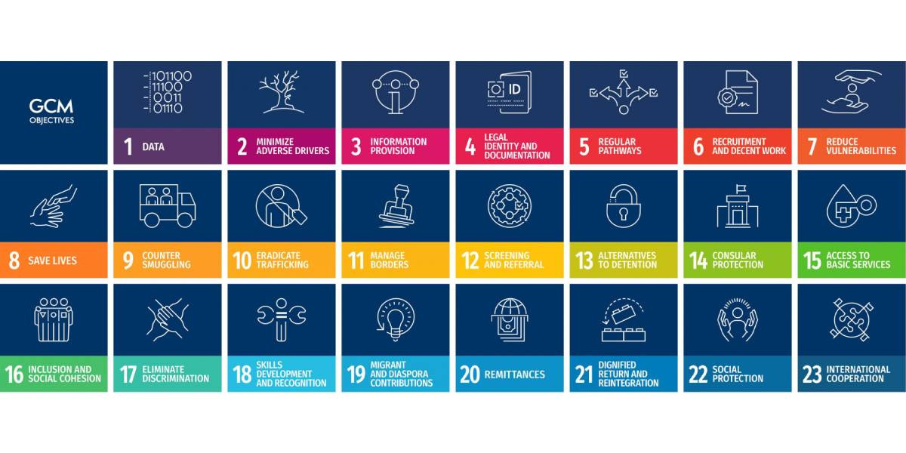
Global Compact
23 obiettivi che affrontano il tema della migrazione a tutto tondo

Slide 55
Il paragrafo 18 del Global Compact
Natural disasters, the adverse effects of climate change, and environmental degradation
(h) Strengthen joint analysis and sharing of information to better map, understand, predict and address migration movements, such as those that may result from sudden-onset and slow-onset natural disasters, the adverse effects of climate change, environmental degradation, as well as other precarious situations, while ensuring effective respect for and protection and fulfilment of the human rights of all migrants;
(i) Develop adaptation and resilience strategies to sudden-onset and slow-onset natural disasters, the adverse effects of climate change, and environmental degradation, such as desertification, land degradation, drought and sea level rise, taking into account the potential implications for migration, while recognizing that adaptation in the country of origin is a priority;

Slide 56
Il paragrafo 18 del Global Compact
(j) Integrate displacement considerations into disaster preparedness strategies and promote cooperation with neighbouring and other relevant countries to prepare for early warning, contingency planning, stockpiling, coordination mechanisms, evacuation planning, reception and assistance arrangements, and public information;
(k) Harmonize and develop approaches and mechanisms at the subregional and regional levels to address the vulnerabilities of persons affected by sudden-onset and slow-onset natural disasters, by ensuring that they have access to humanitarian assistance that meets their essential needs with full respect for their rights wherever they are, and by promoting sustainable outcomes that increase resilience and self‑reliance, taking into account the capacities of all countries involved;

Slide 57
Il paragrafo 18 del Global Compact
(l) Develop coherent approaches to address the challenges of migration movements in the context of sudden-onset and slow-onset natural disasters, including by taking into consideration relevant recommendations from State-led consultative processes, such as the Agenda for the Protection of Cross-Border Displaced Persons in the Context of Disasters and Climate Change, and the Platform on Disaster Displacement.

Slide 58
International Migration Review Forum May 2022
Draft Declaration, paragrafi 12 e 27.
Progressi insufficienti sotto il profilo della lotta al cambiamento climatico
27. The adverse effects of climate change, environmental degradation and natural disasters are among the drivers of migration, which are influenced by economic, social, political and demographic contexts. Efforts to mitigate and adapt to the adverse effects of climate change have been insufficient, including in climate finance, as acknowledged by the twenty-sixth session of the Conference of the Parties to the United Nations Framework Convention on Climate Change and as part of the Glasgow Climate Pact. The responses to the COVID-19 pandemic and the negative impact of climate change and systemic shocks have laid bare the gaps that remain in anticipating, preparing for and responding to events that might trigger large movements of migrants.

