Slide 1
APRAXIA OF SPEECH: THEORETICAL INTERPRETATION AND THREATMENT

Slide 2
DEFINITION of APRAXIA OF SPEECH (AOS)
Darley, Aronson and Brown (1975):
“An articulatory disorder resulting from impairment, due to brain damage, of the capacity to program the positioning of speech musculature for the volitional production of phonemes and the sequences of muscle movements”
Mc Neil et al. (1997):
“Difficulties in translating an accurate and filled phonological frame to the previously acquired kinematic parameters required for correct articulation”
AOS is a phonetic deficit to be distinguished from a phonological encoding deficit and from more peripheral deficits affecting the execution of articulation (dysartria)

Slide 3
Semantic system
Phonological
lexicon
Phonological buffer
APRAXIA OF SPEECH
Articulatory planning
DYSARTHRIA
Articulatory implementation

Slide 4
Apraxia of speech distinct from phonological impairments relies on a distinction between two processing levels:
A phonological level – Where the speech sound are represented as a discreet set of symbols which are used in combination to form the words one’s language (here sounds to not change according to context and pronunciation); >>> deficits leads to phonological impairments
A phonetic level of representation in terms of motoric targets (specifying target oral configurations and/or pathways to reach them); here sounds may differ according to linguistic context and idiosyncratic pronunciations). >>> deficits lead to AoS

Slide 5
CHARACTERISTICS of AoS
Reduced speech rate
Increased transition time between sounds, syllables and words
Words produced syllable by syllable
Distorted prosody?
Sound errors
Distortions (i.e., phonetic errors)
Substitutions (could be phonetic errors perceived as phonological errors or errors where an articulatorily difficult phoneme is replaced with an easier one)
Omissions, additions (intrusive schwa, at least in English patients)
Articulatory groping
Difficulties in initiating speech
More difficulties with onsets than codas in monosyllabic words (e.g., Aichert & Ziegler, 2004; Wambaugh & Nessler, 2004)

Slide 6
Evidence indicate that errors are relatively predictable (e.g., Mc Neil et al., 1995; but also Croot, 2002)
Consistent difficulties with particular sounds (Knock et all., 2000; Galluzzi et al, 2015; Raymer et al., 2002; Wambaugh et al., 1998; 1999; Romani et al., 2017;)
Consistent difficulties with more complex syllabic structures (Romani & Galluzzi, 2005; Romani et al., 2011;)

Slide 7
DIFFERENTIAL DIAGNOSIS
From upper motor neuron dysarthria (see Duffy, 1995)
Dysarthria is also characterized by slow rate and imprecise articulation but, in addition, it presents:
decreased loudness, occasional harshness, drooling, lower facial weakness, tongue weakness;
no effects of word context or syllabic context
From phonological retrieval impairments
These impairments are also characterized by sound errors
but they do not show
associated phonetic errors;
effects of syllabic or phoneme complexity (Romani & Galluzzi, 2005; Romani et al., 2011; Galluzzi et al., 2015)

Slide 8
INTERPRETATIONS
1. An impairment of motor planning
Probably the most common interpretation (e.g., Shriberg et al., 1997; Mc Neil et al, 1995; 1997)
Van der Merwe (1997) distinguishes:
Motor planning - development of a plan in term of motor objectives
Motor programming - control of the muscle movements necessary to carry
out the motor plan
Loss/impaiewd knowledge of motor targets – This results in a disruption in the spatio-temporal coordination of articulation.
Main evidence:
Difficulties in lowering of the velum enough to produce nasal sounds
Difficulties timing the vibration of vocal cords in relation to the release of closure in obstruent sounds
(e.g., Kent & Rosenberg, 1983; Ziegler & Von Cramon, 1986)

Slide 9
2. A limitation in the resources required
for motor planning/articulation
2a - A buffer limitation
A limitation in an (articulatory) output buffer which holds the results of motor planning (or phoneme-articulatory conversion) so that the plan is progressively incremented till it is ready for realization (e.g., Roger & Storkel, 1999).
Main evidence:
Syllable segregation, word produced syllable by syllable,
buffer capacity shrank to a single syllable?
BUT
Not all patients with apraxia of speech produce syllabified speech

Slide 10
2b - Limitation in the use of word-sized articulatory programmes
Damage to a direct word route which allows us to retrieve complete, pre-packaged articulatory plans for words.
Instead, patients may have to use a much less efficient, more labour intensive route which creates de novo the motor plan for a word from smaller units, phoneme or syllable-sized (Varley & Whiteside, 2001).
Main evidence:
Same as for the previous hypothesis
Groping;
Increased duration between phonemes and syllables;
Misarticulations

Slide 11
3. An impairment at the interface
between phonology and articulation.
A reduced efficiency of the articulatory programmer
The process of phonological to articulatory conversion has become slower and/or less precise.
For this reason, the phonological grammar of the patient allows less complexity than generally allowed by his/her language. This produces phonological errors as well as phonetic errors (e.g., Buchwald, 2009; Code, 1998; Degil & Meyer, 1998; Romani et al., 2002; Romani & Galluzzi, 2005)
Main Evidence:
Complexity effects; better production with articulatorily simple than complex words;
Systematic simplifications of complex structure and complex phonemes
CCV> CV; CVC>CV e.g., tra>ta; tan>ta
voiced>unvoiced e.g., b>p; d>t; G>k; v>f
fricative, affricates> stops e.g., f>t; v>d; tc>t; tg>d
velar> coronals/labials e.g., G>d/b; k>t/p

Slide 12
Simplifications through phonological errors, not only through phonetic distortions; e.g., epenthetic vowels produced as lexical vowels (e.g., clone vs . colone see Buchvwald, 2007; 2009)
Following this interpretation, phonological errors are seen as the consequence of a deficit of articulatory planning as are groping and phonetic errors

Slide 13
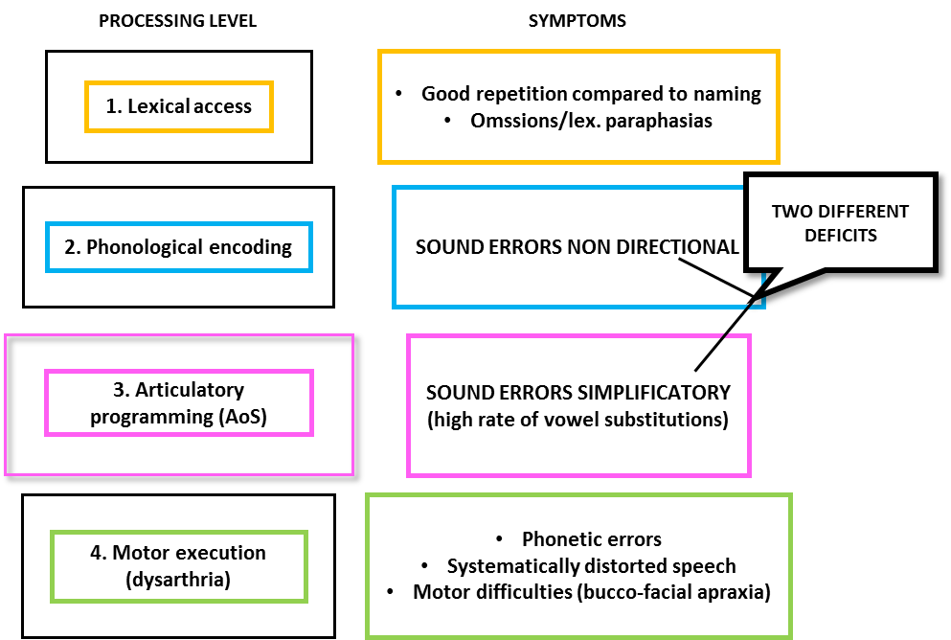
Figure 1 – Schematic word production model indicating possible diagnostic criteria for different impairments. From Galluzzi et al. 2015

Slide 14
TREATMENTS FOR APRAXIA OF SPEECH
Sound production treatment (SPT)
(e.g., Wambaugh, West & Doyle, 1998; Wambaugh et al., 1999)
Training different sound groups (e.g., stops, fricatives, liquids/glides) or individual sounds;
Treatments consists of modelling, integral stimulation, orthographic cueing, response contingent feedback.

Slide 15
Sound production treatment
Example of paradigm from Wambaugh & Nessler, 2004
Word level
The clinician says the word and asks for repetition e.g. /gravel/
If response is correct: five further repetitions are requested;
If response is incorrect:
Step 1. The clinician presents a word with a contrastive feature (e.g., travel) and ask for repetition; if this is again incorrect:
Step 2. The beginning letter of the word is shown (e.g. G), the word is spoken and repetition requested; if still incorrect:
Step 3. Repeat the word with integral stimulation (i.e., “watch me, listen to me, and say it with me’); if still incorrect:
Step 4. Placement cues are provided together with integral stimulation (fingers on the throat)

Slide 16
Sentence level – similar approach, but with carrier sentences
e.g., on the road there was...
Results
Results are generally positive, but vary from one patient to another and for the different sounds trained
Generalizations
Occur from one trained context to another - E.g., from one word to another, but not across phonemes
In fact, in some patients there is a decrease of performance for untreated phonemes (e.g., Wambaugh & Nessler, 2002)

Slide 17
Extending sound production treatment
1. Working on phonological/syllabic complexity
Syllabic complexity can be taken as a good analogue of motoric/articulatory complexity (the best we have)
Treatments based on syllabic complexity have been used successfully with phonologically impaired children (see Gierut , 1998; 2001 for a review), but they are more rarely used with aphasic patients.
E.g., Maas, Barlow, Robin & Shapiro, (2002)
Working on levels of complexity: 1st: singletons, 2nd: two consonant clusters, 3rd: three consonant clusters
Treatment: Modelling, articulatory placement cues (with diagram), reading; consistent feedback provided through out.

Slide 18
Maas, Barlow, Robin & Shapiro, (2002)
Results:
Training complex structures is important
Training complex structures can improve production of simpler
structures even when targeted complex structures do not improve
Simple structures improve more after training with more complex
structures

Slide 19
2. Working on articulatory transitions
Schneider & Frens, 2005
Varying the difference between the sounds to be produced in a sequence
e.g.
Level 1 bobobo
Level 2 bobiba
Level 3 bokomo
Level 4 bokima
Treatment:
1. The clinician models the pattern 3 times;
2. The patient says the pattern along with the clinician.
If the patient fails:
3. The pattern is broken into individual syllables;
then, syllables are progressively integrated into a longer utterance.
If the patient fails:
4. The patient is provided with cues both tactile and verbal regarding the manner and place of each segment in the pattern.

Slide 20
Treatment can operate at each complexity level
Treatment at an higher level is assumed to generalized to lover levels
Results:
Improvement of trained patterns
No generalization to untrained pattern at the same level
Some generalization to untrained pattern at a lower level
Some general improvement to production of words and phrases

Slide 21
General principles of treatment
Working at a post-lexical level: Stay away from using words, but instead use syllables and nonwords (Maas et al., 2002; Schneider & Frens, 2005);
Use of modelling
Focus on awareness of motor patterns and on the articulators involved
Application of principles of motor learning to AOS
(e.g., Knock et al., 2000)
Random practice results in more generalization and maintenance than blocked practice;
Feed-back should NOT be systematic but occur 30-60% of times

Slide 22
After the lecture, the readings and the seminar you should be able to:
Understand the characteristics of apraxia of speech
Be able to evaluate different theoretical interpretations
Describe and evaluate different therapeutical approaches to apraxia of speech

