Slide 1
EPISTEMOLOGY AND PROFESSIONAL ETHICS
October 24, 2023
Fabio Ferlazzo

Slide 2
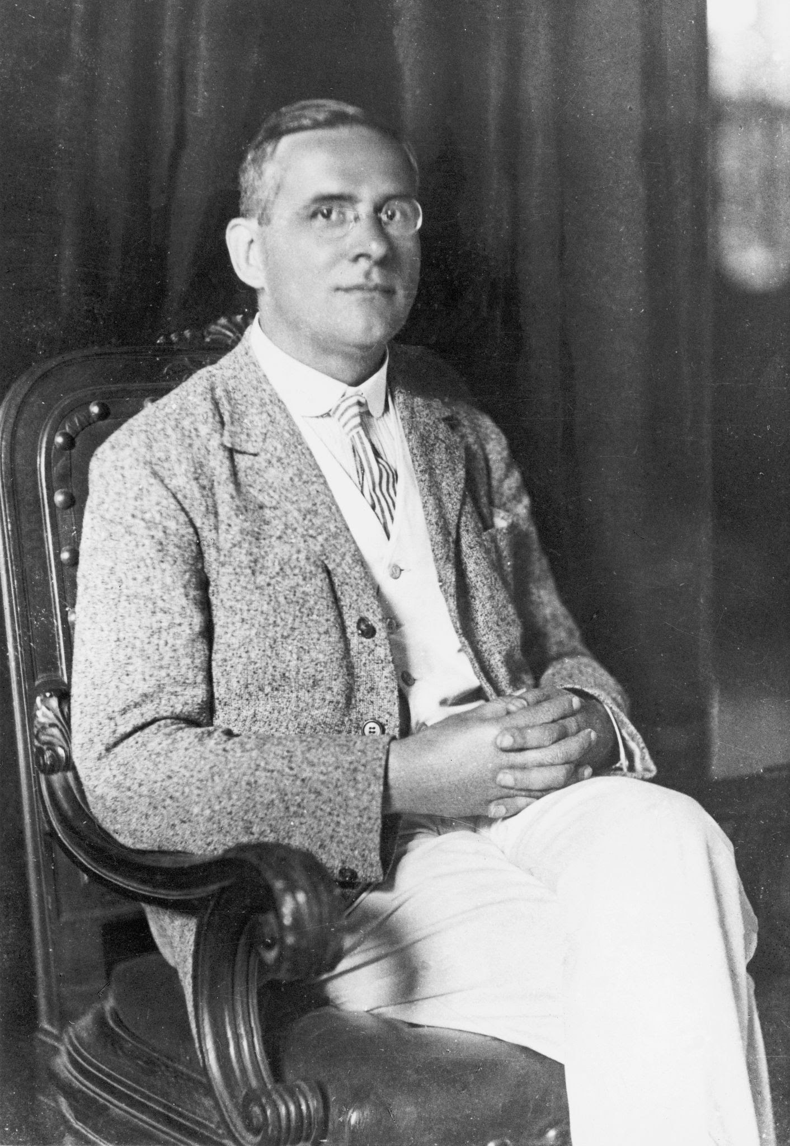
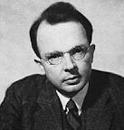
The Vienna Circle
(1922-1936, Schlick, Carnap, Neurath, von Bertalanffy, etc.)
They founded the logical positivism (verificationism, neopositivism)
Moritz Schlick
Otto Neurath
Rudolf Carnap

Slide 3
2) Verifiability theory of meaning
«The light is on» → look at the lamp
meaningful
«The soul is eternal»
meaningless
Only statements that are testable have meaning
Experience is the only source of knowledge and meaning

Slide 4
INDUCTION
(from observations to theory)
Inductive reasoning is a method of drawing conclusions by going from the specific to the general.
It’s usually contrasted with deductive reasoning, where you go from general information to specific conclusions.

Slide 5
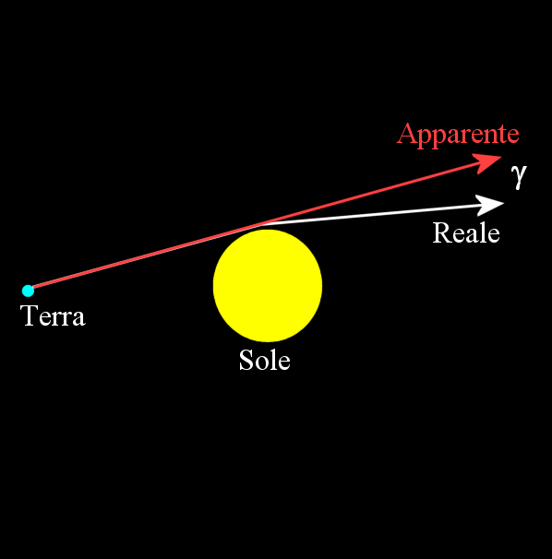
Gravity deflects light
(prediction from the Relativity Theory)
Apparent
Real
Earth
Sun

Slide 7
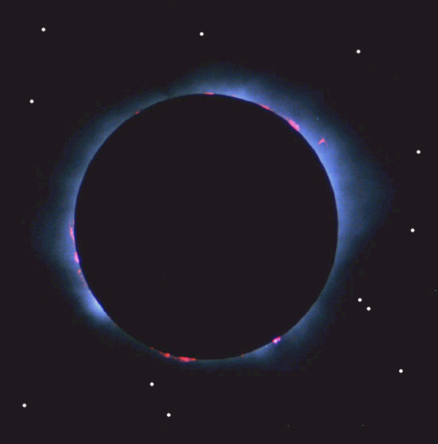

Slide 8
Arthur S. Eddington. Expedition to Principe Islands, 1919
May 29: It stopped raining around noon. We took 16 photographs. The images of the Sun are all good, but the clouds have interfered with the images of the stars. The latest photographs show some pictures which I hope will tell us what we need.
June 3: […] A picture I measured gave a result in agreement with Einstein.
[Petrova, 1982]

Slide 11
INDUCTION
(from observations to theory)
My professor is older than 40
All the professor I met are older than 40
thus
All the professors are older than 40

Slide 12
INDUCTION
Fallacy of inductive logic

Slide 13
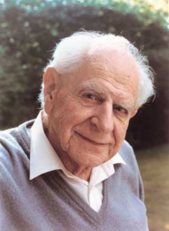
Karl R. Popper
(Vienna, 1902 – London, 1994)
“The scientific status of a theory relies on its falsifiability”
Discovery and justification
Corroboration

Slide 14
INDUCTION
Falsification
You only need one black swan to state for sure that the proposition “all the swans are white” is false!

Slide 15
NULL HYPOTHESIS!

Slide 16
An example: the null-hypothesis (H₀)
DEFINITIONS OF H₀
The residual hypothesis that cannot be rejected unless the test statistic used in the hypothesis testing problem lies in the critical region for a given significance level. In particular, especially in psychology, the hypothesis that certain observed data are a merely random occurrence (Borowski & Borwein, 1991, p. 411)

Slide 17
An example: the null-hypothesis (H₀)
However
According to Popper, we cannot «accept» a theory, namely demonstrate a theory true.
Thus
we can only reject a null-hypothesis, but we cannot accept it or accept the alternative hypothesis

Slide 18
Admissibility of scientific evidence in courtrooms
When can an expert’s opinion be accepted as scientific?
Are psychology or psychiatry sciences?

Slide 19
Admissibility of scientific evidence in courtrooms
Frye v. United States (1923)
The case was about the admissibility of systolic blood pressure deception test as scientific evidence

Slide 20
Admissibility of scientific evidence in courtrooms
Frye v. United States (1923)
“Just when a scientific principle or discovery crosses the line between the experimental and demonstrable stages is difficult to define. Somewhere in this twilight zone the evidential force of the principle must be recognized, and while the courts will go a long way in admitting expert testimony deduced from a well-recognized scientific principle or discovery, the thing from which the deduction is made must be sufficiently established to have gained general acceptance in the particular field in which it belongs.”
Frye Standard

Slide 21
Admissibility of scientific evidence in courtrooms
Daubert v. Merrell Dow Pharmaceuticals, Inc. (1993)
Two children (born with serious birth defects) and their parents (Daubert and Schuller) sued Merrell Dow Pharmaceuticals Inc. claiming that one of their drugs had caused the birth defects.
Merrell Dow’s expert submitted documents showing that no published scientific study demonstrated a link between the drug and birth defects in humans.
Daubert and Schuller submitted expert evidence suggesting that the drug could cause birth defects, based on in vitro and in vivo animal studies, pharmacological studies, and reanalysis of other published studies. But these methodologies had not yet gained acceptance within the general scientific community.

Slide 22
Admissibility of scientific evidence in courtrooms
Daubert v. Merrell Dow Pharmaceuticals, Inc. (1993)
Rule 702. Testimony by Experts
If scientific, technical, or other specialized knowledge will assist the trier of fact to understand the evidence or to determine a fact in issue, a witness qualified as an expert by knowledge, skill, experience, training, or education, may testify thereto in the form of an opinion or otherwise, if (1) the testimony is based upon sufficient facts or data, (2) the testimony is the product of reliable principles and methods, and (3) the witness has applied the principles and methods reliably to the facts of the case.

Slide 23
Admissibility of scientific evidence in courtrooms
Daubert v. Merrell Dow Pharmaceuticals, Inc. (1993)
Justice Blackmun’s comment
[A] key question . . . in determining whether a theory or technique is scientific knowledge . . . [is] whether it can be (and has been) tested. “Scientific methodology today is based on generating hypotheses and testing them to see if they can be falsified; indeed, this methodology is what distinguishes science from other fields of human inquiry.”

Slide 24
Admissibility of scientific evidence in courtrooms
Daubert v. Merrell Dow Pharmaceuticals, Inc. (1993)
American Medical Association: “[a]n opinion is only based upon scientific knowledge if it is developed in accordance with the scientific method”
Citing Popper: “[i]f a hypothesis is repeatedly corroborated by empirical testing, it is . . . generally accepted as valid.” “no scientific theory is ever definitively confirmed”, however “[a]s a practical matter . . . , some theories are so thoroughly tested that they become virtually incontrovertible.”

Slide 25
Admissibility of scientific evidence in courtrooms
Daubert v. Merrell Dow Pharmaceuticals, Inc. (1993)
American Association for the Advancement of Science: “[S]cience . . . proceed[s] through a series of interrelated steps centered on the generation and testing of hypotheses. Hypotheses are educated guesses about a particular phenomenon or event . . . . [S]cientists conduct rigorous experimental testing in order to falsify hypotheses.”
“An hypothesis is accepted as generally valid to the extent that it has survived repeated attempts at falsification.”

Slide 26
Admissibility of scientific evidence in courtrooms
United States v. Bonds (1993)
The defendants proffered evidence that DNA identifications conducted by the FBI laboratory had been found to be unreliable, but the court reasoned that nonetheless the FBI identifications were admissible under Daubert; arguing that “the defendants have conceded that the theory and methods can be tested. The dispute . . . is over how the results have been tested, not over whether the results can be or have been tested.”
Since the FBI lab’s DNA work had been tested and shown to be unreliable showed that the FBI’s testimony could be and had been tested, and hence was grounds for admitting it as reliable.

Slide 27
Problem
Commitee members (academic position in medical science)
A B C
Candidates
2 3 4
A and 1 are father and son
A, B, C have professional ties
1 gets hired
2, 3, 4 sue the commitee for nepotism
Argue in favor of 1 or in favor of 2, 3, 4 using the papers on nepotism

Slide 28
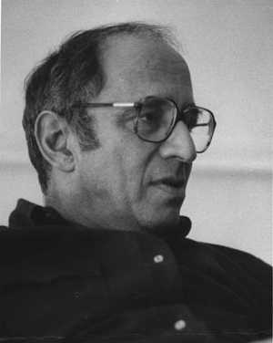
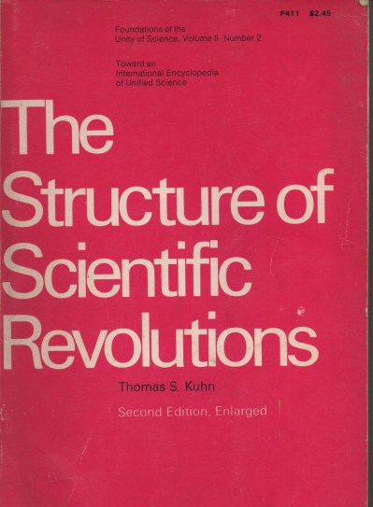
Thomas S. Kuhn
(Cincinnati, 1922 – Cambridge, 1996)

Slide 29
Thomas S. Kuhn
(Cincinnati, 1922 – Cambridge, 1996)
Paradigms, normal science, revolutions
Scientific community
Relativistic conception of reality

