Slide 1
EU Law
History of European Integration

Slide 2
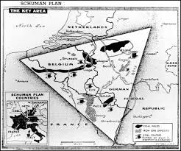
The Schuman Proposal

Slide 3
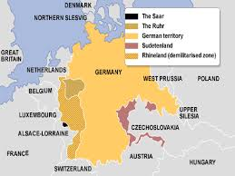

Slide 4
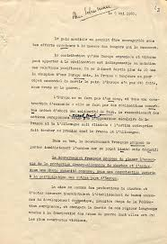
The Schuman Declaration: May 9, 1950

Slide 5
https://www.youtube.com/watch?v=c0dsdgpFjGo.

Slide 6
Important developments
1985 Schengen Treaty
1986 Single European Act and the single/internal market

Slide 7
Schengen area
https://www.europarl.europa.eu/resources/library/images/20230111PHT66212/20230111PHT66212_original.png.

Slide 8
The Maastricht Treaty - 1992

Slide 9
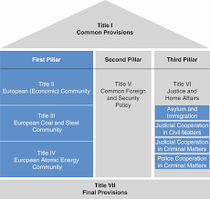
The Pillars

Slide 10
Reform process
1997 Amsterdam Treaty – Enhanced cooperation
2000 Nice Treaty and the Charter of Fundamental Rights
2001 – Laeken Declaration on the Future of Europe

Slide 11
The European Constitution - 2004

Slide 12
Lisbon Treaty - 2007

Slide 13
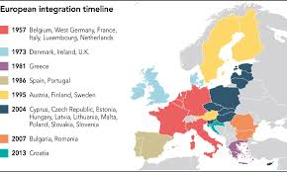
Enlargement

Slide 14
Future enlargement
Candidate countries
These countries are in the process of 'transposing' (or integrating) EU legislation into national law:
Albania
Moldova
Montenegro
North Macedonia
Serbia
Turkey
Ukraine
Potential candidates
Potential candidate countries do not yet fulfil the requirements for EU membership:
Bosnia and Herzegovina
Georgia
Kosovo*

