Slide 1
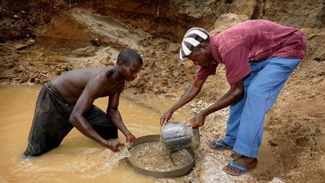
Conflict diamonds and conflict minerals

Slide 5
1998-2000. From Angola to Kimberley
Tackle the illicit trade in diamonds that was fueling conflict in Angola and Sierra Leone
Break the link between diamonds and armed conflict

Slide 6
The international community and «Blood Diamonds»
1998- USSC Resolutions on ban on diamonds from Angola that lacked governmental certification
2000 – Resolution on diamonds from Sierra Leone
2000 – Fowler Report on diamond trafficking in Angola

Slide 7
The Kimberley Process
May 2000
Meeting in Kimberley, South Africa: diamond industry (World Diamond Council), NGOs, States
Sep. 2000 and Oct. 2000
meetings of the participating States in Pretoria and London

Slide 8
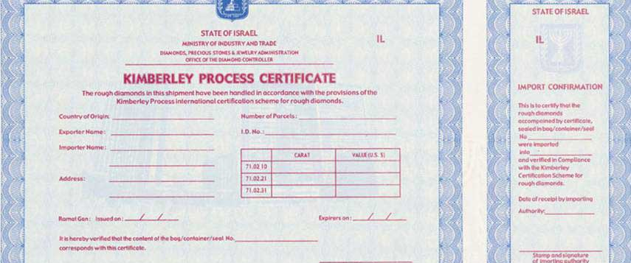
2002, Interlaken: Kimberley Process Certification Scheme for rough diamonds – 37 States

Slide 9
The Core Document of the Interlaken meeting
Recommendation to the States
Specific definition of conflict diamonds
Rough diamonds
Used to finance conflict aimed at undermining legitimate governments
Refers to USSC resolutions

Slide 10
Scheme
A) KP Certificate issued by the exporting country with indication of origin
B) Recommendations for the control by governments of mine sites and licensing procedures for miners, exporters and importers
C) Annual reports and disclosure
D) Peer review mechanism
E) Tripartite consensus

Slide 11
No sanctions but sanctions…
Republic of Congo (Congo Brazzaville) and Lebanon expelled in 2004.
Central African Republic suspended in 2013 (embargo on diamonds for lack of control by the government)
Case of the Marage region in Zimbabwe, 2011: Conflict vs human rights.

Slide 12
The KP as international soft law
Voluntary political agreement
Informal international law-making
But… monitoring system and consequences for non-compliance

Slide 13
The KP and the WTO: the 2003 waiver
Authorization to derogate from WTO obligations in consideration of the extraordinary humanitarian nature of this issue and the devastating impact of conflicts fueled by the trade in conflict diamonds on the peace, safety and security of people in affected countries and the systematic and gross violations of human rights that have been perpetrated in such conflicts

Slide 14
Reactions to the waiver
International trade law vs human rights law
Waiver process as a way to address conflicts of law in a fragmented system

Slide 15
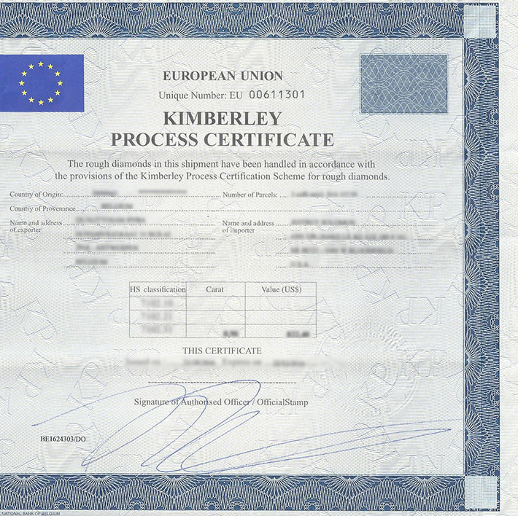
EU Regulation No 2368/2002 implementing the KPCS
EU representative is the Commission
Community authorities (Belgium, Czech Republic, Germany, Portugal, Romania, UK).
Industry self-regulation
In 2014 inclusion of Greenland

Slide 16
The EU Regulation on the supply chain due diligence obligations for Union importers of tin, tantalum and tungsten, their ores, and gold originating from conflict-affected and high-risk areas (No 2017/821)

Slide 17
Background
Conflict in the Democratic Republic of the Congo and neighboring countries
Linkage between illegal exploitation of mineral resources, illicit trade of such resources and proliferation of weapons in the area (UNSC resolutions)
UNSC urges States to implement systems of due diligence in the supply chain of minerals involved in conflict.
Notion of corporate social responsibility

Slide 18
Background
OECD Guidelines for Multinational Enterprises (1970s)
United Nations Human Rights Council 2011: Guiding Principles on Business and Human Rights
OECD: Guidance for Responsible Supply Chains of Minerals from Conflict-Affected and High-Risk Areas (2010)
US Dodd-Frank Act on minerals from the Great Lakes Area (2010), section 1502: disclosure mechanism on the supply and custody chain for minerals from the GLA

Slide 20
The EU Regulation on due diligence in the supply chain of tin, tantalum, tungsten and gold
Objective: Transparency in the supply chain of minerals from the mines to the smelters or refiners
Refers to the OECD Guidance converting it into a binding act.
Obligations for operators are the 5 due diligence steps:
Management system
Risk assessment
Risk management
Third-party audit
disclosure

Slide 21
Obligations for importers and manufacturers
Grievance mechanism (early-warning system based on information from all possible sources)
Response to identified risk (recommedations to comply to suspension of trade with the supplier to disengagement)
Third party audit, always mandatory unless smelters and refiners in the supply chain are in the Commission’s list of compliant smelters and refiners
Obligation to disclose all pertinent information to the authorities and to the public

Slide 22
Problems
Notion of conflict-affected and high-risk areas, Article 2(f): «areas in a state of armed conflict or fragile post-conflict as well as areas witnessing weak or non-existent governance and security, such as failed States, and widespread and systematic violations of international law, including human rights abuses».
Importers have the task to identify CAHR areas
Commission will adopt guidelines and a list of CAHR areas

Slide 23
Problems
2. Compliance with WTO rules. Possible discriminations:
list of responsible smelters and refiners.
Decision of an importer to disengage in case of risk management
3. Possible giustifications:
a. Article XX (c): actions taken by WTO members in compliance with obligations under the UN Charter
b. Article XX (a) and (b): public morals and protection of human life and health
4. Coherence and cooperation with third countries to address CAHR areas

