Slide 1
EPISTEMOLOGY AND PROFESSIONAL ETHICS
October 22, 2024
Fabio Ferlazzo

Slide 2
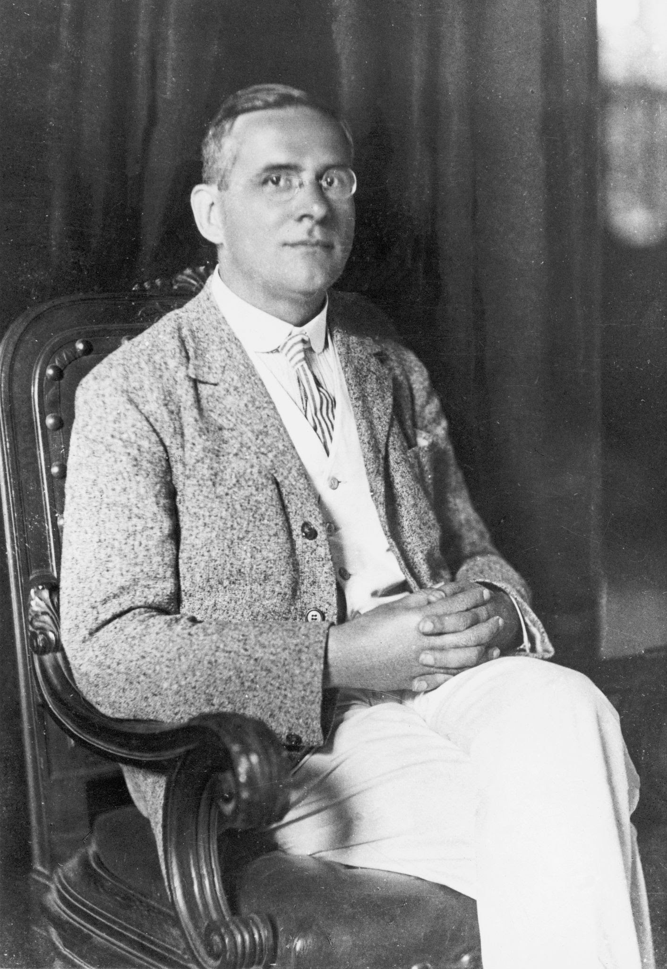
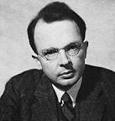
The Vienna Circle
(1922-1936, Schlick, Carnap, Neurath, von Bertalanffy, etc.)
They founded the logical positivism (verificationism, neopositivism)
Moritz Schlick
Otto Neurath
Rudolf Carnap

Slide 3
The Vienna Circle
(1922-1936, Schlick, Carnap, Neurath, von Bertalanffy, etc.)
Interests in science, mathematics, logic, language
Against Hegel, Heidegger, and the dominant ‘800 philosophy
(Their works are incomprehensible and obscure)
Vienna Circle valued clarity, reason, precision
and devalued mysticism, romanticism, nationalism
In essence, they valued science

Slide 4
Logical positivism
1) Analytic statements vs synthetic statements
2) Verifiability theory of meaning

Slide 5
1) Analytic statements vs synthetic statements
Analytic propositions can be true or false because
of their meaning alone
«All the single men are unmarried»
No need of an empirical evidence that the sentence is true
It only depends on the logical relations between
the words meanings (internal coherence)
However, it’s not a truth about the world

Slide 6
1) Analytic statements vs synthetic statements
Mathematical knowledge is analytic
Empirical sciences produce synthetic propositions

Slide 7
2) Verifiability theory of meaning
How have words their meaning?
«The light is on»
«La luce è accesa»
How can we attach a meaning to these sentences?
The meaning of a proposition is how it can be verified
If a proposition cannot be verified, it’s meaningless

Slide 8
2) Verifiability theory of meaning
«The light is on» → look at the lamp
meaningful
«The soul is eternal»
meaningless
Only statements that are testable have meaning
Experience is the only source of knowledge and meaning

Slide 9
2) Verifiability theory of meaning
Observation vs theory
The distinction is far from being clearcut
Theories are abstractions from observations
But what’s an observation? Naked eye? Instruments?
What should be done with things we cannot observe,
not even with an instrument (e.g. black hole)?
Usually, we observe consequences more than things

Slide 10
Discovery vs Justification
It’s rare that scientists discover something in a scientific manner
They have ideas, dreams, popular knowledge and so on:
discovery is outside the realm of science
Science begins when the endeavor of verifying a theory starts

Slide 11
Falling of logical positivism
A number of reasons. Among them:
1) We can make a meaningless proposition testable:
«the light is on and the spirit is eternal»
can be tested by falsifying the first part
(if A is false then A&B must be false)

Slide 12
Falling of logical positivism
A number of reasons. Among them:
2) The verification principle in itself is not analytic,
nor synthetic
Thus it is meaningless

Slide 13
Falling of logical positivism
A number of reasons. Among them:
3) It relies on inductive reasoning:
from observations to theories.
And the inductive reasoning is fallacious

Slide 14
DATA
Data do not exist independently of a theory
(i.e., there are no “objective” data)

Slide 15
INDUCTION
(from observations to theory)
Inductive reasoning is a method of drawing conclusions by going from the specific to the general.
It’s usually contrasted with deductive reasoning, where you go from general information to specific conclusions.

Slide 16
INDUCTION
(from observations to theory)
My professor is older than 40
All the professor I met are older than 40
thus
All the professors are older than 40

Slide 17
INDUCTION
(from observations to theory)
INDUCTIVIST TURKEY (B. Russell)

Slide 18
INDUCTIVIST TURKEY (B. Russell)
A turkey, in an american nurture, decides to shape its vision of the world scientifically, according to the Logical Positivism.
The turkey found that, on his first morning at the turkey farm, he was fed at 9 a.m. Being a good inductivist turkey he did not jump to conclusions. He waited until he collected a large number of observations that he was fed at 9 a.m. and made these observations under a wide range of circumstances, on Wednesdays, on Thursdays, on cold days, on warm days. Each day he added another observation statement to his list. Finally, he was satisfied that he had collected a number of observation statements to inductively infer that “I am always fed at 9 a.m.”.
However, on the morning of Christmas eve he was not fed but instead was killed.

Slide 19
INDUCTION
Induction by enumeration
How many white swans you need to observe in order to state that the proposition “all the swans are white” is true?

Slide 20
INDUCTION
Induction by elimination
Problem: the hypotheses are infinite
"When you have eliminated all which is impossible, then whatever remains, however improbable, must be the truth." —Sherlock Holmes

Slide 22
INDUCTION
(from observations to theory)
My professor is older than 40
All the professor I met are older than 40
thus
All the professors are older than 40

Slide 23
INDUCTION
Fallacy of inductive logic

Slide 24
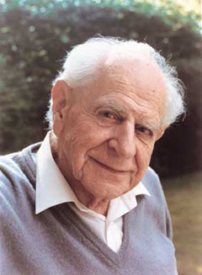
Karl R. Popper
(Vienna, 1902 – London, 1994)
“The scientific status of a theory relies on its falsifiability”
Discovery and justification
Corroboration

Slide 25
INDUCTION
Falsification
You only need one black swan to state for sure that the proposition “all the swans are white” is false!

Slide 26
NULL HYPOTHESIS!

Slide 27
An example: the null-hypothesis (H₀)
DEFINITIONS OF H₀
The residual hypothesis that cannot be rejected unless the test statistic used in the hypothesis testing problem lies in the critical region for a given significance level. In particular, especially in psychology, the hypothesis that certain observed data are a merely random occurrence (Borowski & Borwein, 1991, p. 411)

Slide 28
An example: the null-hypothesis (H₀)
However
According to Popper, we cannot «accept» a theory, namely demonstrate a theory true.
Thus
we can only reject a null-hypothesis, but we cannot accept it or accept the alternative hypothesis

Slide 29
Admissibility of scientific evidence in courtrooms
When can an expert’s opinion be accepted as scientific?
Are psychology or psychiatry sciences?

Slide 30
Admissibility of scientific evidence in courtrooms
Frye v. United States (1923)
The case was about the admissibility of systolic blood pressure deception test as scientific evidence

Slide 31
Admissibility of scientific evidence in courtrooms
Frye v. United States (1923)
“Just when a scientific principle or discovery crosses the line between the experimental and demonstrable stages is difficult to define. Somewhere in this twilight zone the evidential force of the principle must be recognized, and while the courts will go a long way in admitting expert testimony deduced from a well-recognized scientific principle or discovery, the thing from which the deduction is made must be sufficiently established to have gained general acceptance in the particular field in which it belongs.”
Frye Standard

Slide 32
Admissibility of scientific evidence in courtrooms
Daubert v. Merrell Dow Pharmaceuticals, Inc. (1993)
Two children (born with serious birth defects) and their parents (Daubert and Schuller) sued Merrell Dow Pharmaceuticals Inc. claiming that one of their drugs had caused the birth defects.
Merrell Dow’s expert submitted documents showing that no published scientific study demonstrated a link between the drug and birth defects in humans.
Daubert and Schuller submitted expert evidence suggesting that the drug could cause birth defects, based on in vitro and in vivo animal studies, pharmacological studies, and reanalysis of other published studies. But these methodologies had not yet gained acceptance within the general scientific community.

Slide 33
Admissibility of scientific evidence in courtrooms
Daubert v. Merrell Dow Pharmaceuticals, Inc. (1993)
Rule 702. Testimony by Experts
If scientific, technical, or other specialized knowledge will assist the trier of fact to understand the evidence or to determine a fact in issue, a witness qualified as an expert by knowledge, skill, experience, training, or education, may testify thereto in the form of an opinion or otherwise, if (1) the testimony is based upon sufficient facts or data, (2) the testimony is the product of reliable principles and methods, and (3) the witness has applied the principles and methods reliably to the facts of the case.

Slide 34
Admissibility of scientific evidence in courtrooms
Daubert v. Merrell Dow Pharmaceuticals, Inc. (1993)
Justice Blackmun’s comment
[A] key question . . . in determining whether a theory or technique is scientific knowledge . . . [is] whether it can be (and has been) tested. “Scientific methodology today is based on generating hypotheses and testing them to see if they can be falsified; indeed, this methodology is what distinguishes science from other fields of human inquiry.”

Slide 35
Admissibility of scientific evidence in courtrooms
Daubert v. Merrell Dow Pharmaceuticals, Inc. (1993)
American Medical Association: “[a]n opinion is only based upon scientific knowledge if it is developed in accordance with the scientific method”
Citing Popper: “[i]f a hypothesis is repeatedly corroborated by empirical testing, it is . . . generally accepted as valid.” “no scientific theory is ever definitively confirmed”, however “[a]s a practical matter . . . , some theories are so thoroughly tested that they become virtually incontrovertible.”

Slide 36
Admissibility of scientific evidence in courtrooms
Daubert v. Merrell Dow Pharmaceuticals, Inc. (1993)
American Association for the Advancement of Science: “[S]cience . . . proceed[s] through a series of interrelated steps centered on the generation and testing of hypotheses. Hypotheses are educated guesses about a particular phenomenon or event . . . . [S]cientists conduct rigorous experimental testing in order to falsify hypotheses.”
“An hypothesis is accepted as generally valid to the extent that it has survived repeated attempts at falsification.”

Slide 37
Admissibility of scientific evidence in courtrooms
United States v. Bonds (1993)
The defendants proffered evidence that DNA identifications conducted by the FBI laboratory had been found to be unreliable, but the court reasoned that nonetheless the FBI identifications were admissible under Daubert; arguing that “the defendants have conceded that the theory and methods can be tested. The dispute . . . is over how the results have been tested, not over whether the results can be or have been tested.”
Since the FBI lab’s DNA work had been tested and shown to be unreliable showed that the FBI’s testimony could be and had been tested, and hence was grounds for admitting it as reliable.

Slide 38
Problem
Commitee members (academic position in medical science)
A B C
Candidates
2 3 4
A and 1 are father and son
A, B, C have professional ties
1 gets hired
2, 3, 4 sue the commitee for nepotism
Argue in favor of 1 or in favor of 2, 3, 4 using the papers on nepotism

Slide 39
INDUCTION
Fallacy of inductive logic

Slide 40
Karl R. Popper
(Vienna, 1902 – London, 1994)
“The scientific status of a theory relies on its falsifiability”
Discovery and justification
Corroboration

Slide 41
INDUCTION
Falsification
You only need one black swan to state for sure that the proposition “all the swans are white” is false!

Slide 42
NULL HYPOTHESIS!

Slide 43
Population
Rome
Florence
160 cm
195 cm
height

Slide 44
Population
Rome
Florence
160 cm
195 cm
height
Sample
Average = 175 cm

Slide 45
Population
Rome
Florence
160 cm
195 cm
height
Sample
Average = 175 cm
Sample
Average = 180 cm
Difference = -5 cm

Slide 46
Population
Rome
Florence
160 cm
195 cm
height

Slide 47
Population
Rome
Florence
160 cm
195 cm
height
Sample
Average = 182 cm

Slide 48
Population
Rome
Florence
160 cm
195 cm
height
Sample
Average = 182 cm
Sample
Average = 170 cm
Difference = 12 cm

Slide 49
Population
Rome
Florence
160 cm
195 cm
height

Slide 50
Population
Rome
Florence
160 cm
195 cm
height
Sample
Average = 169 cm

Slide 51
Population
Rome
Florence
160 cm
195 cm
height
Sample
Average = 169 cm
Sample
Average = 180 cm
Difference = -11 cm

Slide 52
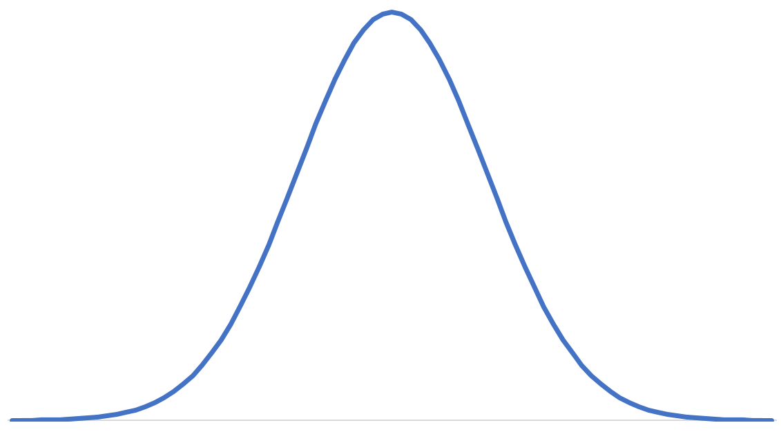
Population
Rome
Florence
160 cm
195 cm
height
Sampling distribution under the null hypothesis (h0) that
people from Rome and Florence belong to
the same population (same average height)
The variability is only due to chance.
frequency
-30 cm
-20 cm
-10 cm
0 cm
10 cm
20 cm
30 cm
height difference

Slide 53
Population
Rome
Florence
160 cm
195 cm
height

Slide 54
Population
Rome
Florence
160 cm
195 cm
height
Sample

Slide 55
Population
Rome
Florence
160 cm
195 cm
height
Sample
Average = 165 cm
Sample
Average = 188 cm
Difference = -23 cm

Slide 56
Population
Rome
Florence
160 cm
195 cm
height
Sampling distribution under the null hypothesis.
frequency
Difference = -23 cm
-30 cm
-20 cm
-10 cm
0 cm
10 cm
20 cm
30 cm
height difference
If the probability of measuring a difference of 23 cm is
below (usually) .05 then the null hypothesis is rejected

Slide 57
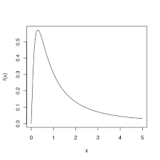
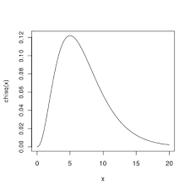
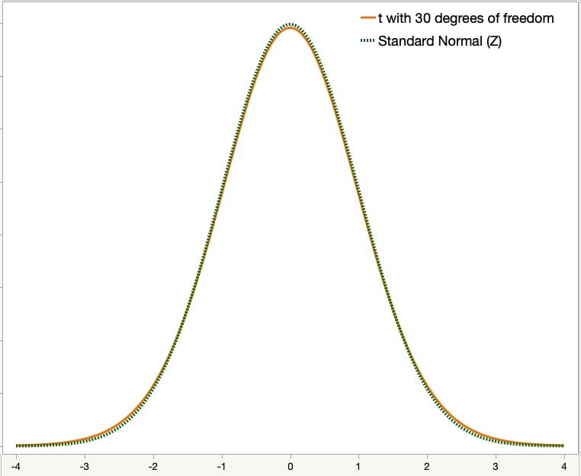
Many sampling distributions, depending on the statistics being used
Fisher’s F
Chi- squared
Student’s t

Slide 58
An example: the null-hypothesis (H₀)
DEFINITIONS OF H₀
The logical contradictory of the hypothesis that one seeks to test. If the null hypothesis can be proved false, its contradictory is thereby proved true (English & English, 1958, p. 350)
Symbolically, we shall use H₀ (standing for null hypothesis) for whatever hypothesis we shall want to test and H_{A} for the alternative hypothesis (Freund, 1962, p. 238). […] the acceptance of H₀ is equivalent to the rejection of H_{A}, and vice versa (p. 250).

Slide 59
An example: the null-hypothesis (H₀)
However
According to Popper, we cannot «accept» a theory, namely demonstrate a theory true.
Thus
we can only reject a null-hypothesis, but we cannot accept it or accept the alternative hypothesis

Slide 60
A ≠ B
**
Vd
A
B
C

Slide 61
A ≠ B
**
Vd
B = C
A
B
C

Slide 62
A ≠ B
**
Vd
B = C
A = C
A
B
C

Slide 63
A ≠ B
**
Vd
B = C
A = C
A = B
A
B
C

Slide 64
An example: the null-hypothesis (H₀)
DEFINITIONS OF H₀
The residual hypothesis that cannot be rejected unless the test statistic used in the hypothesis testing problem lies in the critical region for a given significance level. In particular, especially in psychology, the hypothesis that certain observed data are a merely random occurrence (Borowski & Borwein, 1991, p. 411)

Slide 65
Admissibility of scientific evidence in courtrooms
When can an expert’s opinion be accepted as scientific?
Are psychology or psychiatry sciences?

Slide 66
Admissibility of scientific evidence in courtrooms
Frye v. United States (1923)
The case was about the admissibility of systolic blood pressure deception test as scientific evidence

Slide 67
Admissibility of scientific evidence in courtrooms
Frye v. United States (1923)
“Just when a scientific principle or discovery crosses the line between the experimental and demonstrable stages is difficult to define. Somewhere in this twilight zone the evidential force of the principle must be recognized, and while the courts will go a long way in admitting expert testimony deduced from a well-recognized scientific principle or discovery, the thing from which the deduction is made must be sufficiently established to have gained general acceptance in the particular field in which it belongs.”
Frye Standard

Slide 68
Admissibility of scientific evidence in courtrooms
Daubert v. Merrell Dow Pharmaceuticals, Inc. (1993)
Two children (born with serious birth defects) and their parents (Daubert and Schuller) sued Merrell Dow Pharmaceuticals Inc. claiming that one of their drugs had caused the birth defects.
Merrell Dow’s expert submitted documents showing that no published scientific study demonstrated a link between the drug and birth defects in humans.
Daubert and Schuller submitted expert evidence suggesting that the drug could cause birth defects, based on in vitro and in vivo animal studies, pharmacological studies, and reanalysis of other published studies. But these methodologies had not yet gained acceptance within the general scientific community.

Slide 69
Admissibility of scientific evidence in courtrooms
Daubert v. Merrell Dow Pharmaceuticals, Inc. (1993)
Rule 702. Testimony by Experts
If scientific, technical, or other specialized knowledge will assist the trier of fact to understand the evidence or to determine a fact in issue, a witness qualified as an expert by knowledge, skill, experience, training, or education, may testify thereto in the form of an opinion or otherwise, if (1) the testimony is based upon sufficient facts or data, (2) the testimony is the product of reliable principles and methods, and (3) the witness has applied the principles and methods reliably to the facts of the case.

Slide 70
Admissibility of scientific evidence in courtrooms
Daubert v. Merrell Dow Pharmaceuticals, Inc. (1993)
Justice Blackmun’s comment
[A] key question . . . in determining whether a theory or technique is scientific knowledge . . . [is] whether it can be (and has been) tested. “Scientific methodology today is based on generating hypotheses and testing them to see if they can be falsified; indeed, this methodology is what distinguishes science from other fields of human inquiry.”

Slide 71
Admissibility of scientific evidence in courtrooms
Daubert v. Merrell Dow Pharmaceuticals, Inc. (1993)
American Medical Association: “[a]n opinion is only based upon scientific knowledge if it is developed in accordance with the scientific method”
Citing Popper: “[i]f a hypothesis is repeatedly corroborated by empirical testing, it is . . . generally accepted as valid.” “no scientific theory is ever definitively confirmed”, however “[a]s a practical matter . . . , some theories are so thoroughly tested that they become virtually incontrovertible.”

Slide 72
Admissibility of scientific evidence in courtrooms
Daubert v. Merrell Dow Pharmaceuticals, Inc. (1993)
American Association for the Advancement of Science: “[S]cience . . . proceed[s] through a series of interrelated steps centered on the generation and testing of hypotheses. Hypotheses are educated guesses about a particular phenomenon or event . . . . [S]cientists conduct rigorous experimental testing in order to falsify hypotheses.”
“An hypothesis is accepted as generally valid to the extent that it has survived repeated attempts at falsification.”

Slide 73
Admissibility of scientific evidence in courtrooms
United States v. Bonds (1993)
The defendants proffered evidence that DNA identifications conducted by the FBI laboratory had been found to be unreliable, but the court reasoned that nonetheless the FBI identifications were admissible under Daubert; arguing that “the defendants have conceded that the theory and methods can be tested. The dispute . . . is over how the results have been tested, not over whether the results can be or have been tested.”
Since the FBI lab’s DNA work had been tested and shown to be unreliable showed that the FBI’s testimony could be and had been tested, and hence was grounds for admitting it as reliable.

Slide 74
Problem
Commitee members (academic position in medical science)
A B C
Candidates
2 3 4
A and 1 are father and son
A, B, C have professional ties
1 gets hired
2, 3, 4 sue the commitee for nepotism
Argue in favor of 1 or in favor of 2, 3, 4 using the papers on nepotism

